Slide 1
Surgical Techniques for Non–Temporal Lobe Epilepsy: Corpus Callosotomy,
Multiple Subpial Transection, and
Topectomy Youmans chap. 73

Slide 2
CORPUS CALLOSOTOMY
Patient Selection
After unsuccessful medical therapy for 2 years or continued disabling seizures despite maximal medical therapy, the patient’s epilepsy is deemed to be refractory.
Mental retardation is not a contraindication to surgery.
Indications of Corpus callosotomy
Generalized seizures.
Atonic seizures.
Unapproachable or multiple seizure foci.
Multiple pediatric conditions, such as LennoxGastaut syndrome, Rasmussen’s encephalitis, and infantile hemiplegia.
Patients with lateralizing pathologic conditions, such as Rasmussen’s encephalitis or infantile hemiplegia, when hemispherotomy threatens intact visual fields or motor function.
Epilepsy does not respond to VNS.

Slide 3
Procedure
Performed on the nondominant side in order to limit the risk of injury to the dominant hemisphere.
During the approach, care is taken to identify the callosal marginal arteries and then the pericallosal arteries.
If adhesions between the frontal lobes must be divided, it is important that the division stay medial to the arteries to avoid disrupting small perforators.
The corpus callosum is usually easily identified from its characteristic glossy white appearance.
The callosotomy begins 3 cm posterior to the genu, where the midline is easier to identify, and proceeds ventrally to the midline leaves of the septum pellucidum and anteriorly to the anterior commissure.
During posterior callosotomy,
Care must be taken to avoid injuring internal cerebral veins and the vein of Galen just below the splenium;
It is important that the dissection remains midline and is advanced cautiously to avoid injuring the fornices, which are located just below the corpus callosum.

Slide 4
Complications
Associated with the operative approach include epidural hematoma, subdural hematoma, meningitis, and deep venous thrombosis.
Associated with disconnection of the hemispheres include mutism, acute disconnection syndrome (ADS), posterior disconnection syndrome, and split brain syndrome.
Prefrontal lobe disconnection
symptoms identical to those of the supplementary motor area (SMA) syndrome characterized by paresis of the nondominant leg, incontinence, and decreased spontaneous speech.
The duration and severity of the syndrome is shown to be worse for patients undergoing single-stage, complete callosotomy.
The patient may also have
apraxia of the nondominant hand,
nondominant hypotonia,
repetitive grasping with the nondominant hand,
bilateral Babinski response.

Slide 5
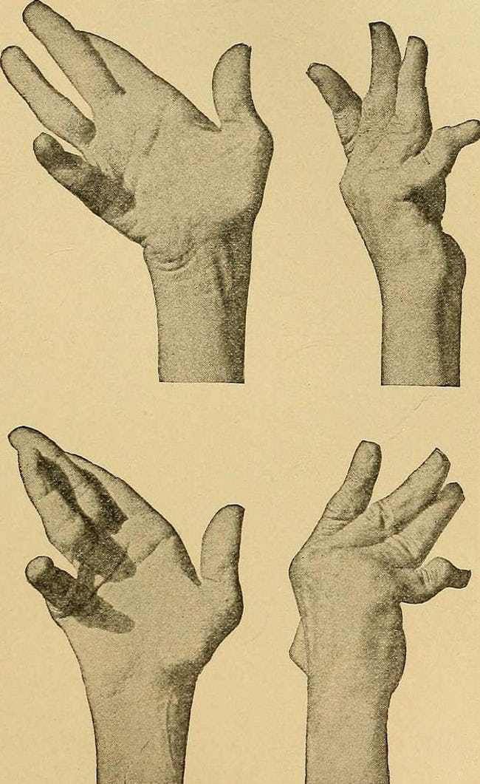
Chronic syndromes include
Alien hand syndrome due to frontal lobe disconnection.
Poor sound localization from temporal lobe disconnection.
Tactile dysnomia and “pure” word blindness from parietal dysfunction.
Visual suppression from occipital lobe isolation.

Slide 6
MULTIPLE SUBPIAL TRANSECTION
Subpial transection is reserved for patients in whom the seizure activity originates in eloquent cortex.
MST has been used to treat patients with epileptogenic lesions of the speech, motor, or primary sensory cortex.
MST can be used for the treatment of carefully selected cases of the following disorders:
Epilepsia partialis continua (with motor signs)
Focal sensory, somatosensory, or visual cortex seizures (with sensory signs)
Persistent epileptogenic activity in eloquent areas adjacent to a previous or concomitant resection
Rasmussen’s encephalitis
Status epilepticus

Slide 7
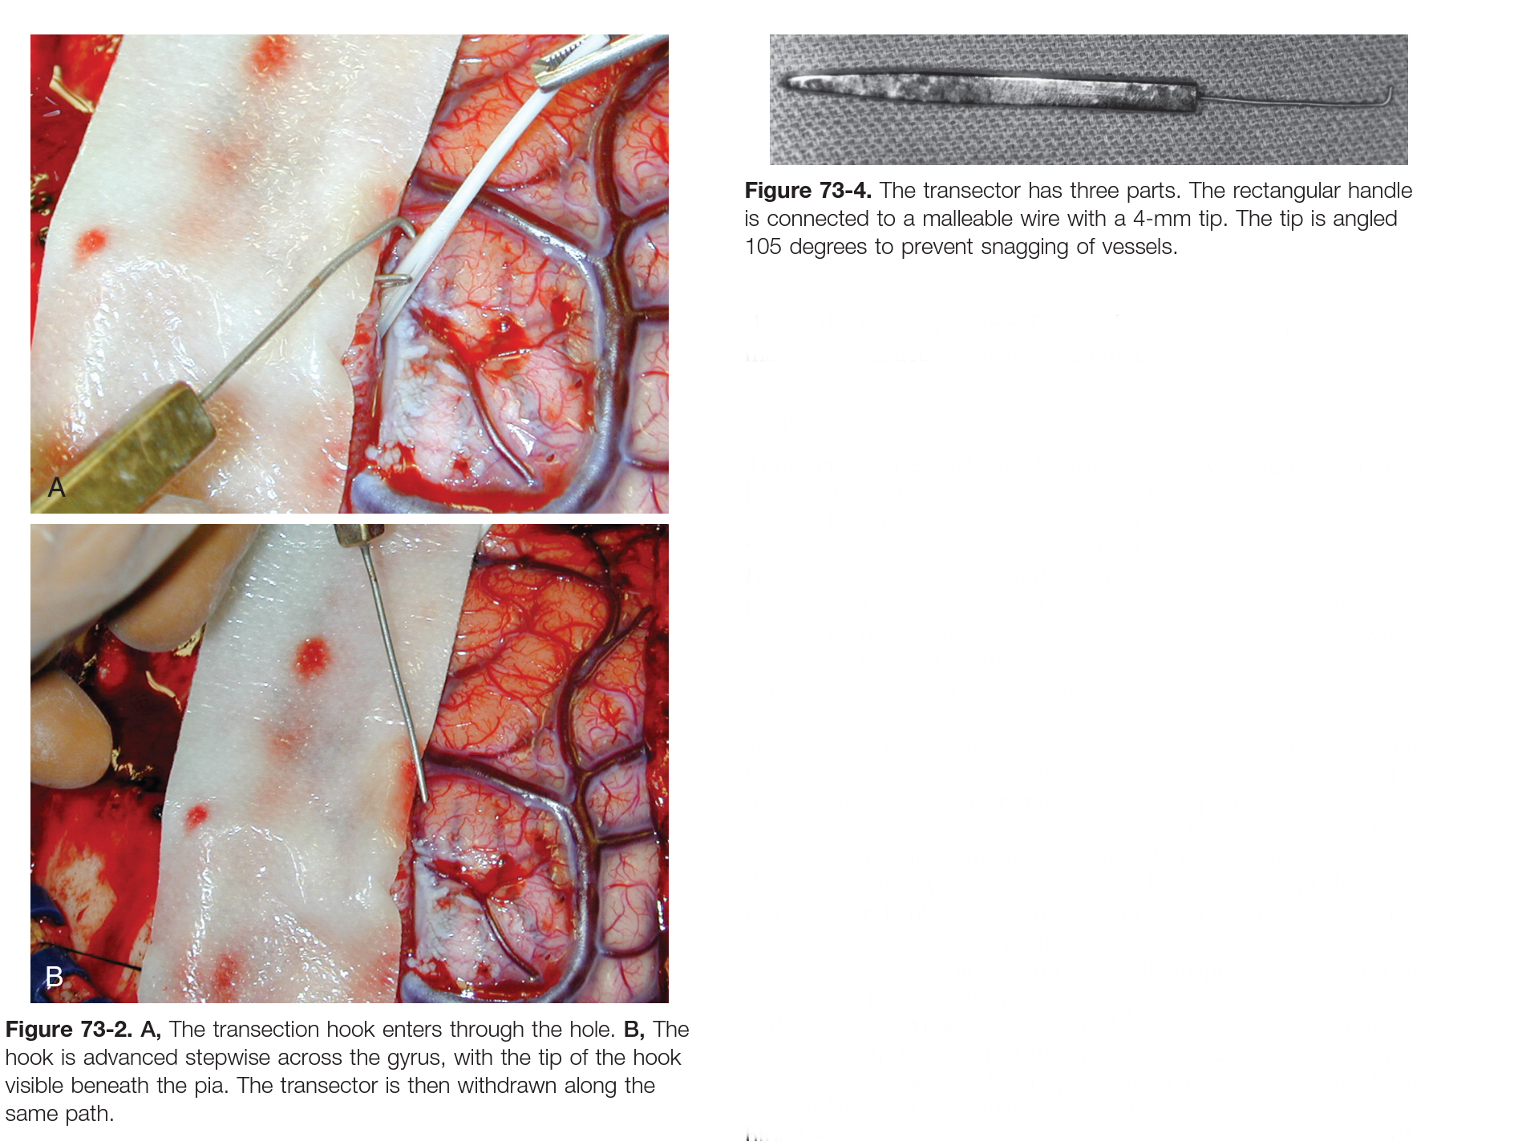

Slide 8
TOPECTOMY
Topectomy generally indicates resection of focal cerebral cortex from the frontal, parietal, or occipital lobe.
Resection of only epileptogenic gray matter (cerebral cortex) rather than white matter should in theory be sufficient to eliminate seizures.
The most characteristic pathologic changes are the presence of gliosis, loss of neurons, and dendritic abnormalities.
Chronic psychosis is a contraindication to surgical treatment, but epilepsy-related acute psychosis is not.
Mental retardation is not a contraindication.
Topectomy can be considered when the seizure arises from a focal and functionally silent area of the brain, a finding that usually means that the focus is not in the speech, primary visual, sensory, or motor cortex.
Multiple widespread or bilateral foci are generally contraindications to resection.
In eloquent brain regions, MST or RNS

Slide 10
Surgical Outcome
Extratemporal nonlesional resection is associated with worse seizure control rates and a higher incidence of major postoperative morbidity than is lesional or temporal lobe resection surgery.

Slide 11
Surgery for Extratemporal Lobe Epilepsy

Slide 12
FRONTAL LOBE EPILEPSY
The frontal lobe represents nearly 35% to 40% of total cortical volume.
Frontal seizures are typically short lasting and often associated with complex motor behavior, sometimes with emotional symptoms.
Frontal lobe epilepsy (FLE) is the second most common focal epilepsy syndrome after TLE.
Frontal lobe seizures divided into three main subtypes
Partial motor: characterized by focal clonic activity with preserved consciousness.
Supplementary motor: characterized by speech arrest, blinking, and asymmetrical tonic posturing.
Complex-partial seizures: involve staring spells, vocalization, diminished responsiveness, and sometimes bizarre bimanual and bipedal movements.

