Slide 1
Standard Temporal Lobectomy Youmans chap. 75

Slide 3
Standard Temporal Lobectomy
Standard resection means an anteromedial temporal resection.
Indications
Commonly used for medically intractable temporal lobe epilepsy (TLE) due to mesial temporal sclerosis.
For other epileptic substrates (malformations of cortical development, cavernomas, neoplasms, and other focal epileptogenic lesions) involving the temporal lobe.
Presence of focal epilepsy resistant to treatment with an adequate trial of anticonvulsant therapy.

Slide 4
PREOPERATIVE EVALUATION
History and Neurological Examination
Video EEG Monitoring
Imaging
MRI
PET demonstrate hypometabolism in the mesial temporal region.
Single-photon emission computed tomography [SPECT]
Magnetoencephalography (MEG)
Typical findings of mesial temporal sclerosis include atrophy of the affected hippocampus and increased signal intensity on the FLAIR and T2 sequences .
Neuropsychological and Psychosocial Preoperative Evaluations
Each surgical candidate must meet for a temporal lobectomy must have:
Partial seizures.
Refractory seizures.
Not having progressive or diffuse brain disease.

Slide 5
General Anatomy
The temporal lobe consists of
The superior (T1), middle (T2), and inferior (T3) temporal gyri laterally.
The fusiform and parahippocampal gyri inferiorly.
The mesial surface includes the amygdala and the parahippocampal gyrus, which includes the uncus.
The collateral sulcus separates the fusiform and parahippocampal gyrus and serves as a reference to locate the temporal horn.
Within the temporal horn the inferior choroidal point is a critical landmark. The anterior choroidal artery enters the choroid plexus at this point.
The amygdala is located below an imaginary line between this point and the MCA bifurcation.

Slide 7
SURGICAL TECHNIQUE
The targets of this operation are the mesial temporal lobe structures that are “sclerotic”: the parahippocampus, hippocampus, and amygdala.
The procedure does vary slightly for the language nondominant and language-dominant sides.
The traditional approach to lateral cortical resection during a standard temporal lobectomy has been to limit
The dominant lobe excision to 3 to 4 cm.
The nondominant side to 5 to 6 cm.

Slide 9
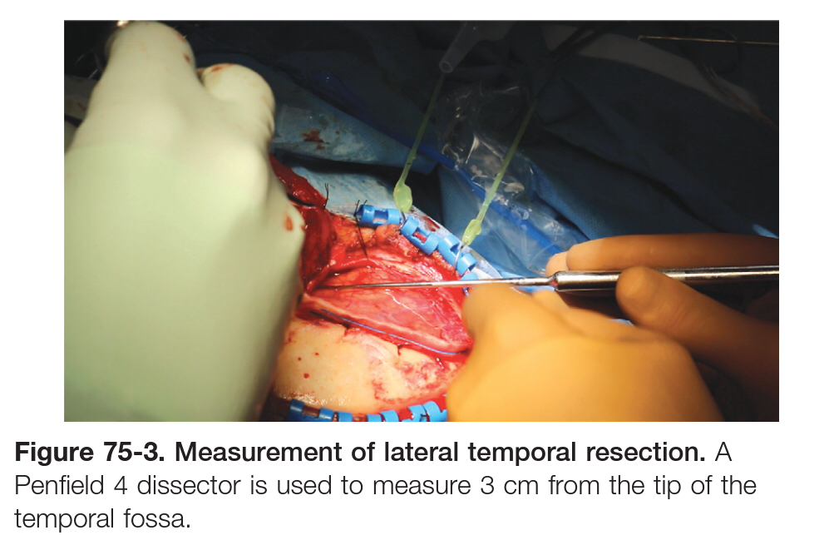

Slide 10
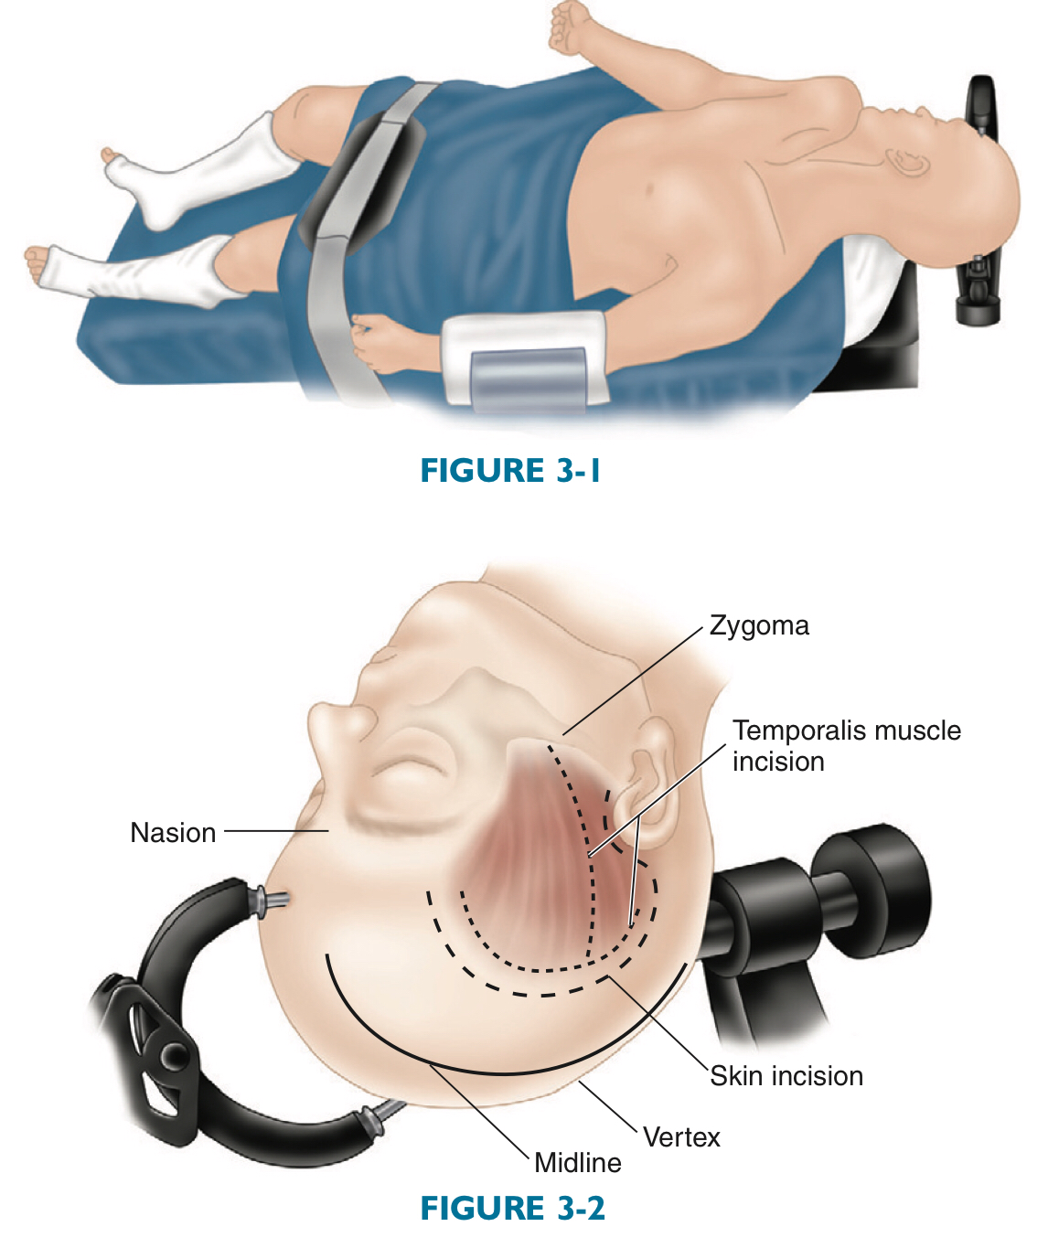
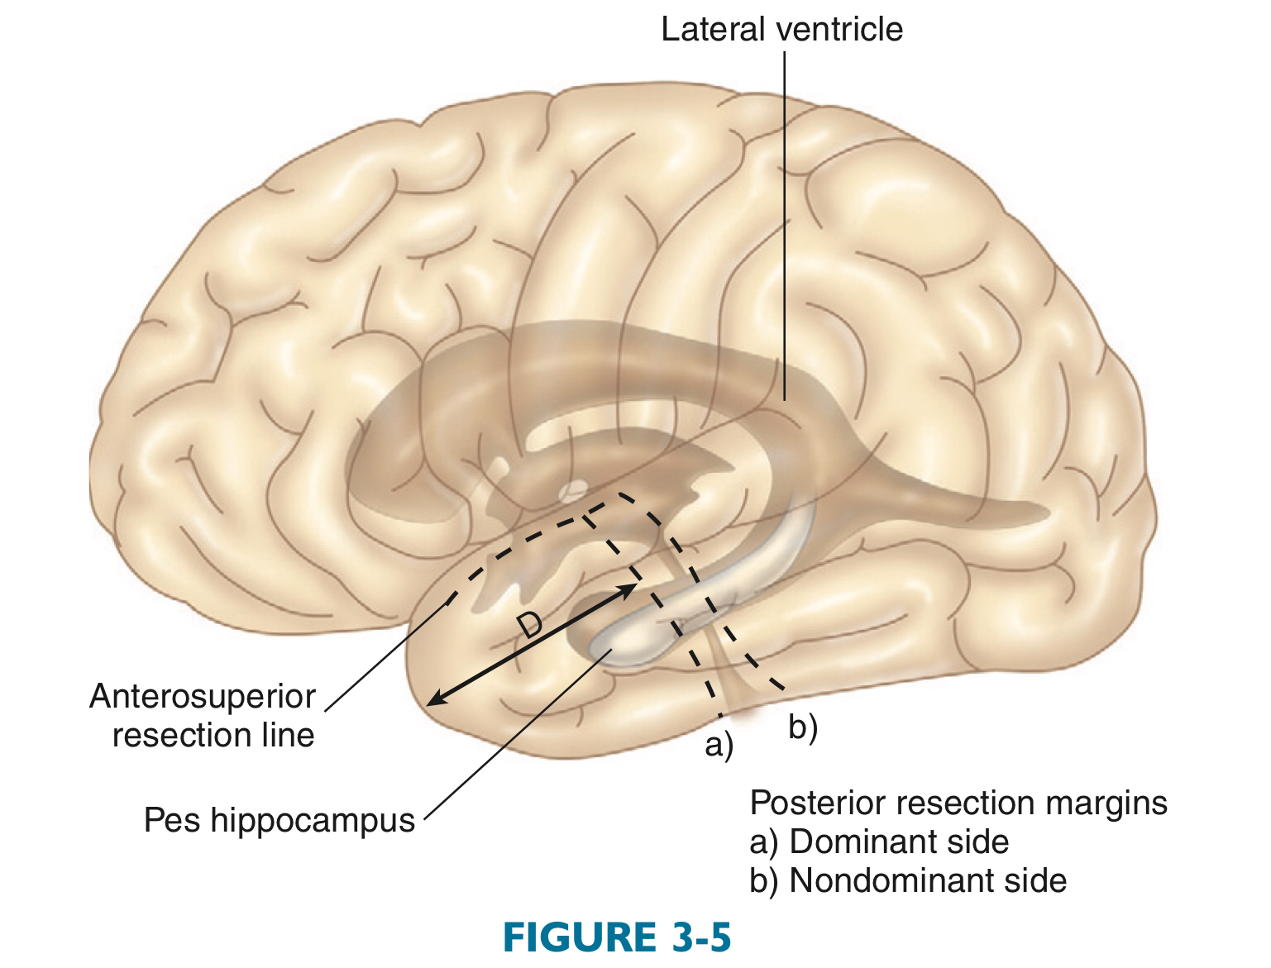

Slide 11
SURGICAL COMPLICATIONS
The rate of significant complications after temporal lobectomy is fortunately quite low.
General complications include
Infection, hemorrhage ( epidural,subdural, intracerebral), acute blood loss anemia.
DVT, anesthetic complications, and death.
The incidence of mortality after temporal lobectomy is approaching zero as experience and technology improves.
Complications specific to the temporal lobe include
Visual field loss: contralateral superior quadrantanopia (“pie in the sky”)
Naming and language deficits (dominant temporal lobe).
Memory deficits.
Cranial nerve palsies.
Hemiparesis or plegia.
Psychiatric morbidity (depression, anxiety).

Slide 12
Visual field loss after temporal lobectomy:
Contralateral superior quadrantanopsia (“pie in the sky”)
From damage to Meyer’s loop as it courses forward in the roof of the temporal horn of the lateral ventricle.
Contralateral homonymous hemianopsia
Is much less common and usually results when larger temporal lobe resections are performed and damage to the geniculocalcarine tract occurs at the posterior aspect of the inferior temporal horn (trigone region).
Optic tract damage
Horizontal and vertical diplopias
Resulting from irritation to the third and fourth cranial nerves, respectively.

Slide 13
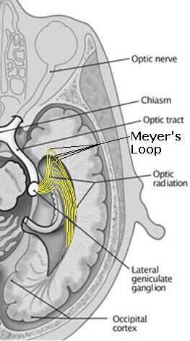

Slide 14
Postoperative aphasias
Can occur after dominant temporal lobe resections.
It is transient and peak within 24 to 48 hours
Management include
Postoperative MRI with stroke protocol.
Corticosteroid therapy.
Speech therapy services.
Common postoperative conditions (not complications) include
Headache
Wound swelling
Jaw discomfort
Retro-orbital pain, and cosmetic deformity
These conditions largely resolve over 2 to 3 months, although preoperative headaches and temporomandibular joint dysfunction can predispose the patient to a longer recovery period after surgery.

Slide 15
OUTCOMES
After the surgery is completed, time must pass before determining outcome.
Long-term seizure-free outcomes after temporal lobectomy, especially when performed for mesial temporal sclerosis, are often stated to be the best of all surgical procedures for medically resistant epilepsy.
The initial seizure-free rate reaching 80% after 5-10 years.
Factors predicting an unfavorable outcome may include
The presence of epileptic activity on the 6-month postoperative EEG.
Frequent preoperative seizures.
Generalized motor seizures.
Bilateral MRI abnormalities.
Increased epilepsy duration.

Slide 16
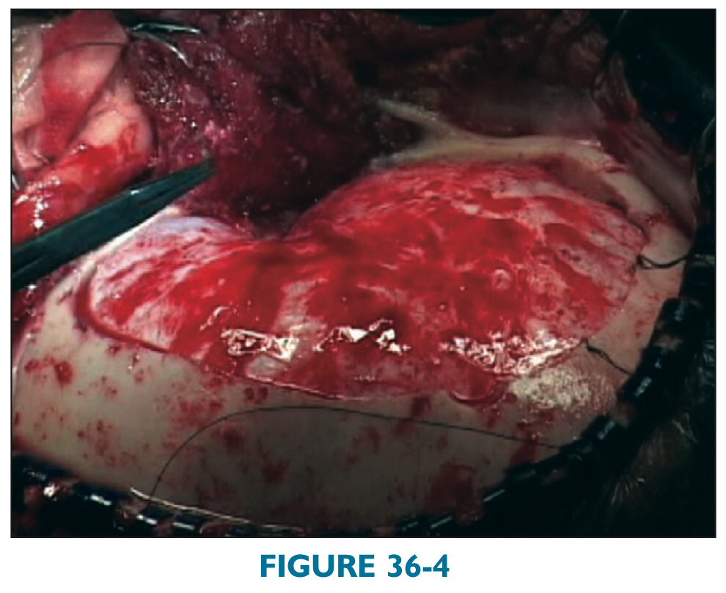
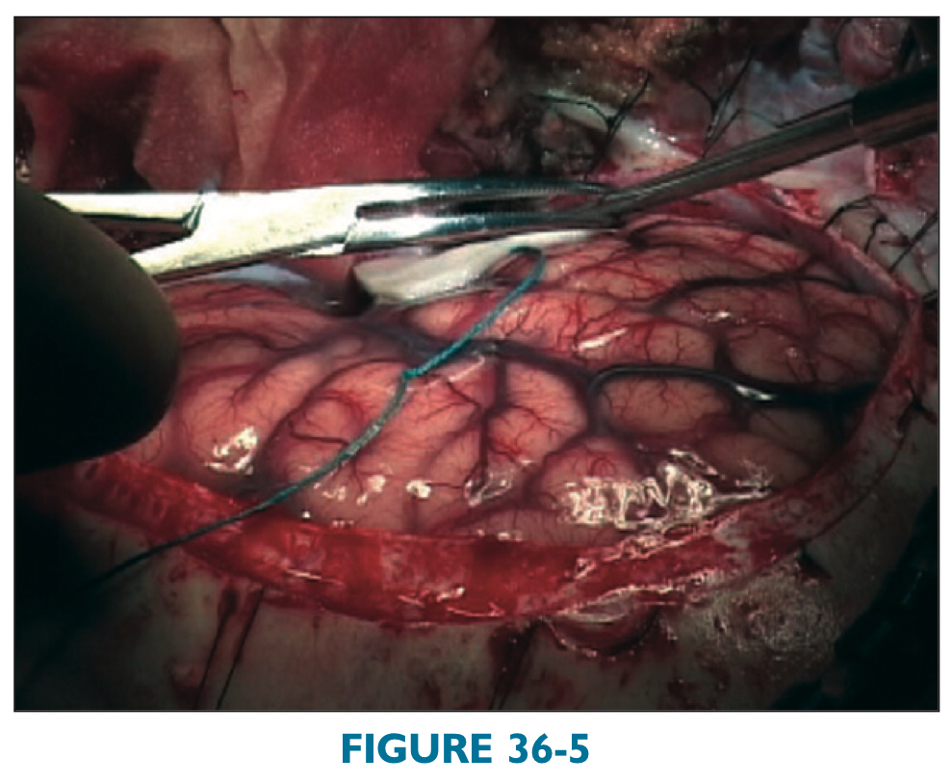
Surgical procedure
The dura is opened in the shape of a C and reflected anteriorly. To plan the posterior margin of the lateral cortical resection of the middle and inferior temporal gyri, and measure from the temporal tip to a prominent cortical vein approximately 3 to 3.5 cm from the temporal tip.

Slide 17
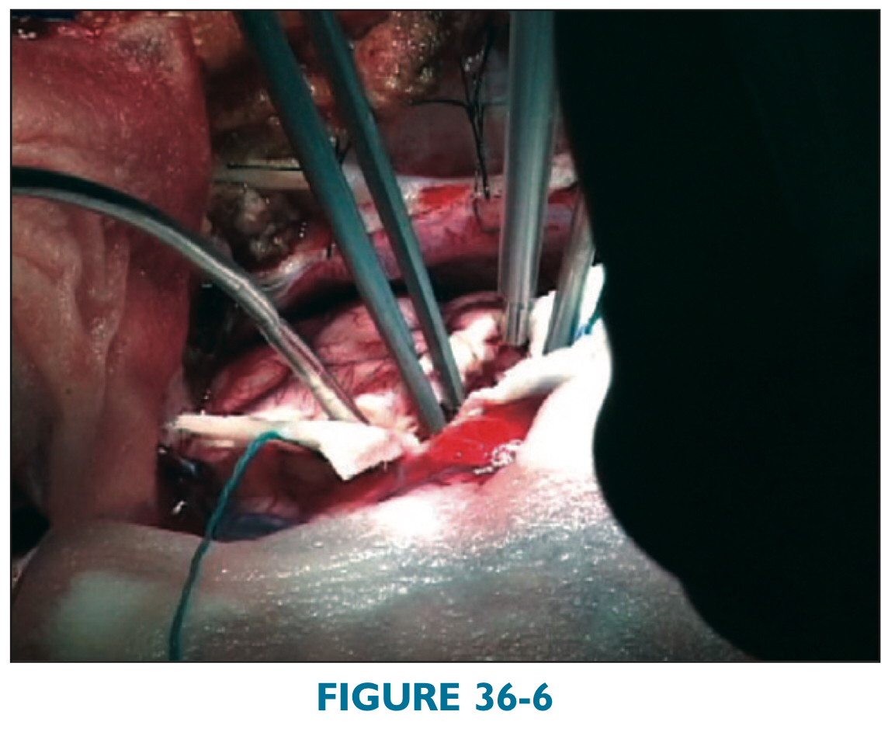
The pia is coagulated and then incised sharply in front of the vein to preserve it, extending from the inferior temporal gyrus along the middle temporal gyrus superiorly to the superior temporal sulcus (STS). The superior temporal gyrus is preserved on the dominant side to protect language and on the nondominant side for uniformity.
The cortical incision is extended anteriorly along the STS, dissecting inferior to the STS in the subpial plane. The cortical incision is deepened with ultrasonic aspiration.

Slide 18
As the cortical incision is deepened, the temporal horn (TH) is identified by following the arachnoid of the fusiform gyrus from inferior to superior.
The TH is perpendicular to the cortical surface at the inferior temporal sulcus.
Care is taken not to dissect superiorly into the temporal stem.
Superior to the TH, there is no intervening arachnoid plane if one were to dissect medially from the anterior temporal lobe white matter through the temporal stem and basal ganglia/amygdala complex into the crus cerebri.

Slide 19
TH. Approximate location of the fusiform arachnoid (FA) is also indicated.
TH is shown after resection of lateral neocortex and is opened more widely.
TH in anatomic specimen. CoS ¼ collateral sulcus; ITG ¼ inferior temporal gyrus; MTG ¼ middle temporal gyrus; STG ¼ superior temporal gyrus; THLV ¼ temporal horn of lateral ventricle.

Slide 20
Selective Amygdalohippocampectomy
Patient selection
Medically resistant.
Complex partial seizures which involve an aura experienced as a rising epigastric sensation, smell, fear, or déjà vu, and head and hand automatisms such as contralateral forced head version prior to secondary generalization, lip smacking, and dystonia.
The surgical rationale for performing Selective Amygdalohippocampectomy is to limit surgical resection to brain structures that must be removed to eliminate seizures while minimizing the risk for injury to important collateral structures.

Slide 21
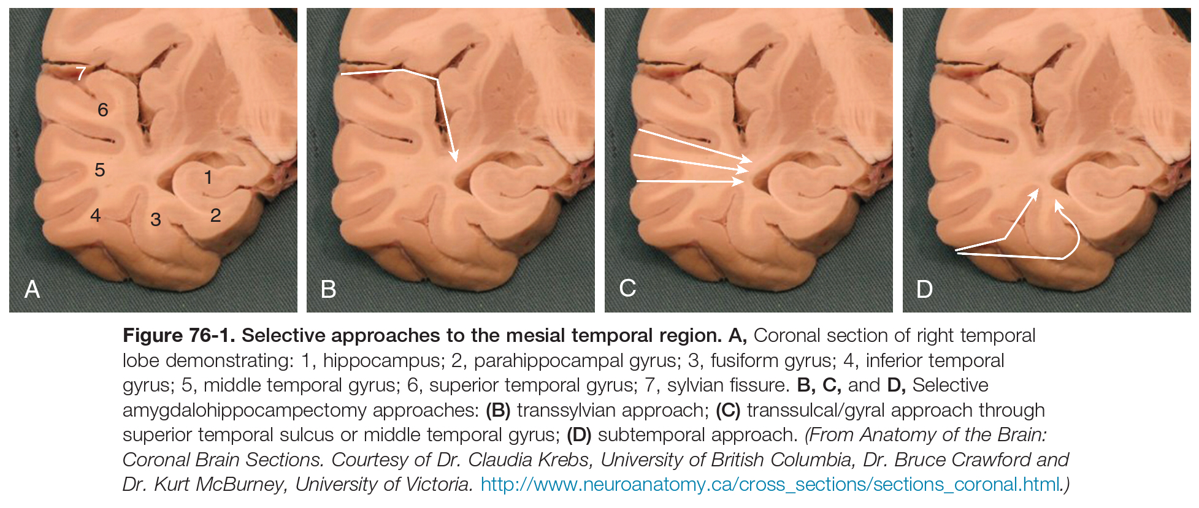
Surgical procedure
A reverse question mark–shaped incision.
Alternatively, a linear incision can be used, extending from the root of the zygoma to just below the superior temporal line.
Surgical approach through
Temporal stem from the Sylvian fissure.
Laterally through the middle temporal gyrus or middle temporal sulcus.
Basally coming through the inferior temporal or collateral sulcus.

Slide 22
The temporal horn is preferably entered anterolaterally to minimize risk to Meyer’s loop of the optic radiations.
At this point, those structure can be identified within the temporal horn.
Amygdala (anteromedially),
Choroid plexus (medially),
Collateral eminence (laterally),
Hippocampus (anteroinferiorly)
The parahippocampal gyrus is resected in a subpial fashion moving anteriorly into the uncus, which is completely emptied subpially.
The oculomotor nerve, tentorial edge, and posterior cerebral artery (P1) can be seen through the pia here.
The amygdala is then identified by its speckled brown color and location anterosuperior to the hippocampus within the medial temporal horn, along a line connecting choroid plexus and limen insula.
The basolateral amygdala is then removed entirely, again taking care to respect pial boundaries and keeping in mind that the posteromedial boundary of resection remains the choroid plexus/ inferior choroidal point.

Slide 23
OUTCOMES
Both SAH and ATL lead to high rates of freedom from seizures in carefully selected patients.
No differences in seizure outcomes or most neuropsychological measures between the two surgical groups
Potential complications of SAH include:
Inadvertent vascular injury.
Hematoma.
Infection.
Quadrant visual field defect.
Psychiatric disorders (delirium, depression, and anxiety).
Brain stem injury.
Neuropsychological sequelae.

Slide 26
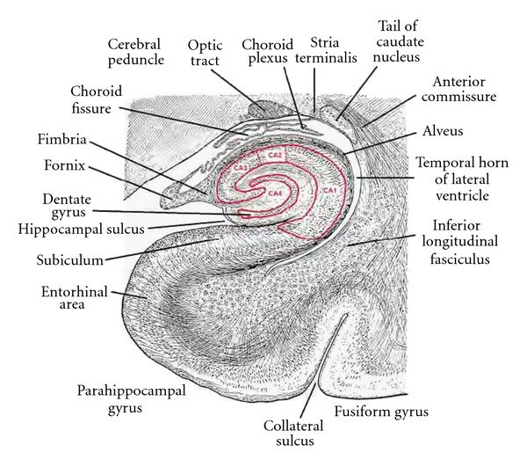

Slide 27
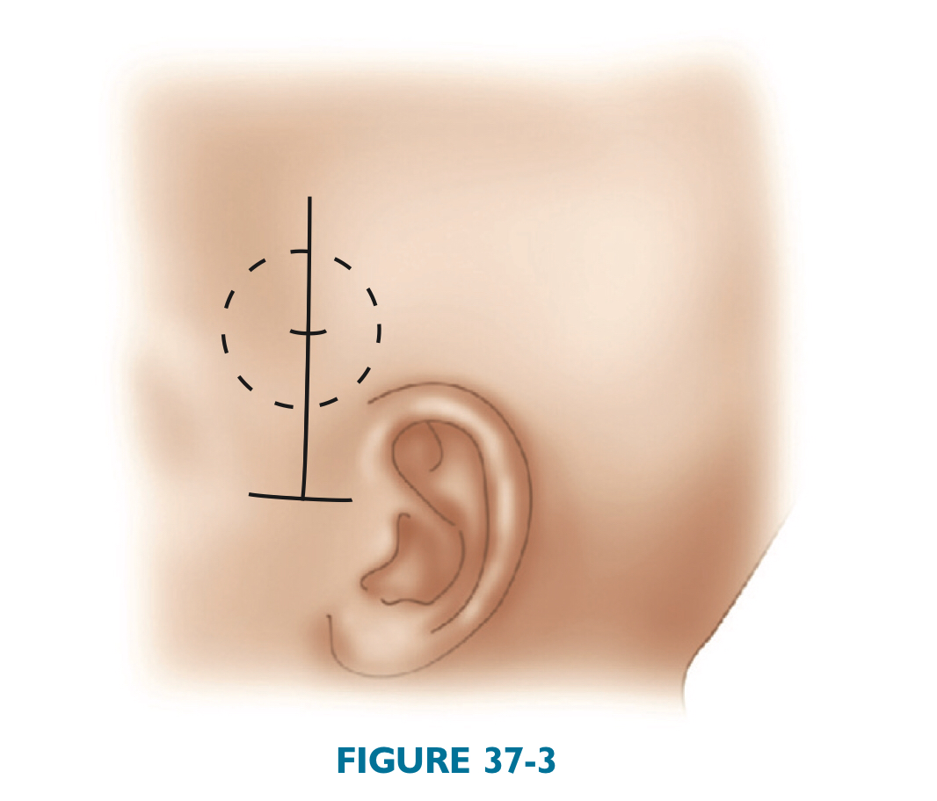

Slide 28
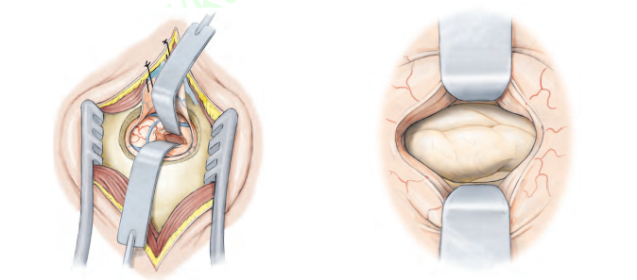
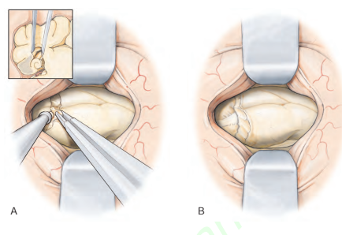

Slide 30
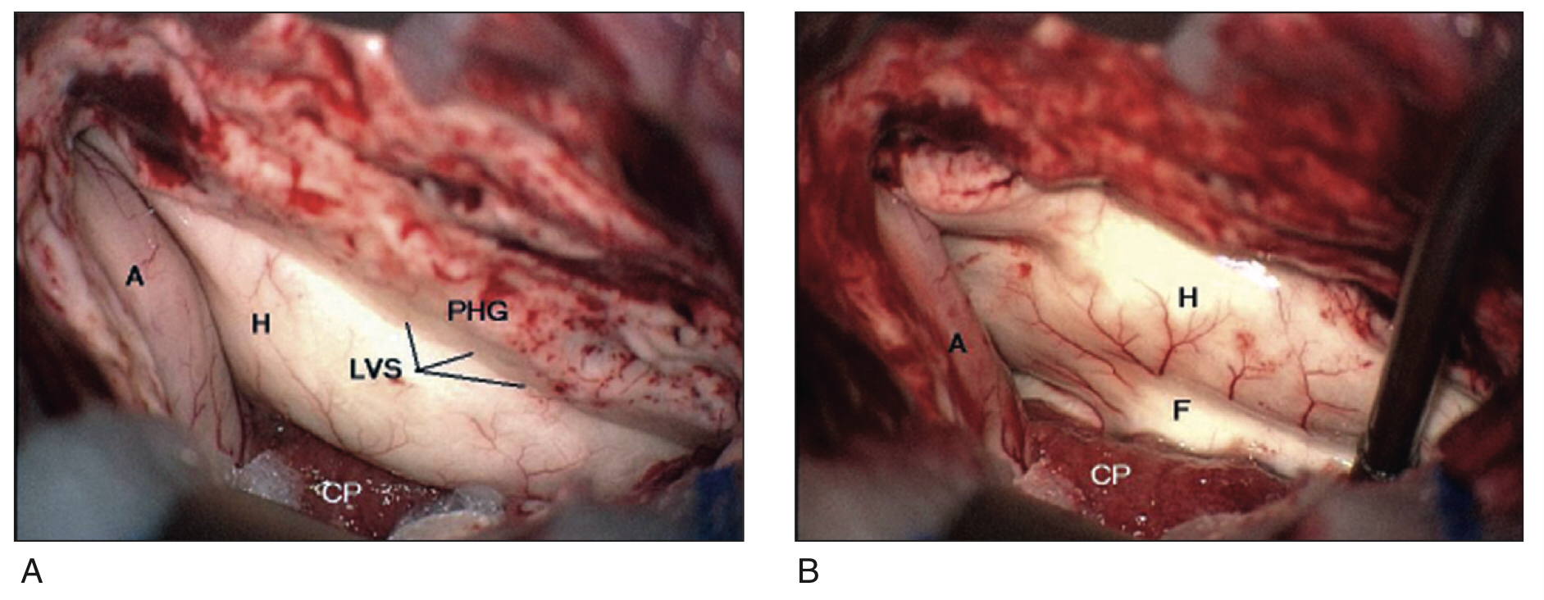
Access into the ventricle. Identification of critical landmarks at the onset of surgical approach is crucial. A=amygdala; CP = choroid plexus; H = hippocampus; LVS = lateral ventricular sulcus or collateral sulcus; PHG = parahippocampal gyrus.

Slide 31
Hemispheric Disconnection Procedures
DEFINITION
Hemispheric disconnection procedures are a group of surgical interventions for chronic epilepsy that are used as alternatives to anatomic hemispherectomy.
The common denominator of these procedures is disconnection of the cortical layer of one hemisphere from the contralateral hemisphere and from the deeper structures of the basal ganglia.
The term hemispherotomy is frequently used as an alternative expression for the same group of operations.
Although the terms hemispheric deafferentation and hemispherotomy imply that the hemispheric tissue is not removed,
Other techniques such as hemicorticectomy or hemidecortication also disconnect the cortex from the deeper structures but do so by removing the cortex.

Slide 32
Indications
Treat drug-resistant epilepsy resulting from diffuse damage to one hemisphere.
The diagnoses typical in these patients may be grouped into inborn, perinatal, or acquired conditions and include
Sturge-Weber syndrome (SWS).
Cortical malformation (multilobar cortical dysplasia, polymicrogyria, lissencephaly, hemimegalencephaly [HME]).
Cystic defects from intrauterine or perinatal infarction or hemorrhage.
Hemiplegia-hemiconvulsion-epilepsy syndrome (HHE).
Rasmussen’s encephalitis

Slide 33
Transsylvian Keyhole Technique
This approach is characterized by four main features:
Transsylvian exposure of the circular sulcus (or sulcus limitans) of the insular cortex via a small craniotomy through a linear or curvilinear incision.
Temporomesial disconnection via a transventricular approach through the temporal stem,
Complete opening of the entire lateral ventricle through a transcortical insular incision from the insular cistern along the inferior, posterior, and superior parts of the circular sulcus into the ventricle from the temporal horn.
Mesial disconnection in the frontal and parieto-occipital area and callosotomy.

Slide 36
Vertical Parasagittal Hemispherotomy
Also called a dorsal transcortical subinsular hemispherotomy:
This technique differs from the perisylvian and transsylvian approaches by:
Much less brain resection and more disconnection
Use of a vertical approach through a parasagittal craniotomy
The approach is characterized by five features:
A parasagittal frontal craniotomy approximately 3 × 5 cm, one third anterior and two thirds posterior to the coronal suture.
Transcortical access to the lateral ventricle via limited cortical resection to enable access to the foramen of Monro and the posterior thalamic region.
Paramedian callosotomy, including transection of the posterior column of the fornix.
Lateral transection between the thalamus and the striatum starting in the lateral ventricle and reaching down to the temporal horn.
After completion of the anterior callosotomy, resection of the posterior part of the gyrus rectus and extension of the transection line laterally so that the head of the caput caudatum meets the substriatal transection line lateral to the thalamus.

Slide 37
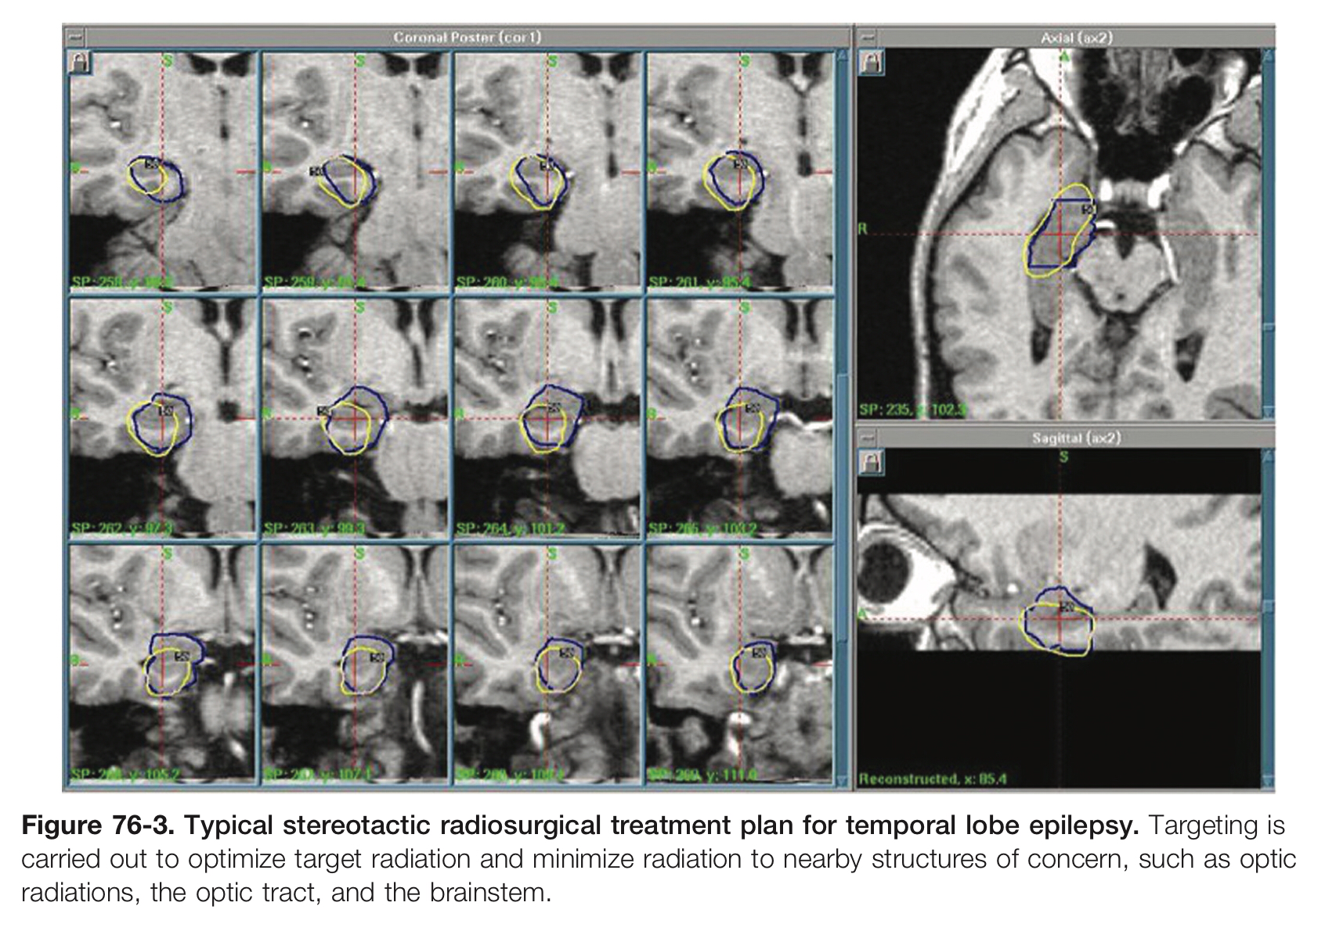
Radiosurgical Treatment for Epilepsy
MEDIAL TEMPORAL LOBE EPILEPSY
MTS is an idiopathic process associated with extensive loss of neurons and an increase in astrocytes in the mesial temporal structures, which include the amygdala and hippocampus in the temporal lobe.
When temporal lobe epilepsy is due to underlying MTS, improvements in seizures with open microsurgical structural resections can be expected in 65% to 90% of patients.
GKRS for MTS showed comparable efficacy rates (65%) for reduction of seizures.
Marginal dose of 24 Gy.
Neurostimulators for epilepsy
Deep brain stimulation DBS
Responsive neurostimulation RNS
Vagus nerve stimulation VNS

Slide 38
Thank You

