Slide 1
EPILEPSY Youmans Chap.61

Slide 2
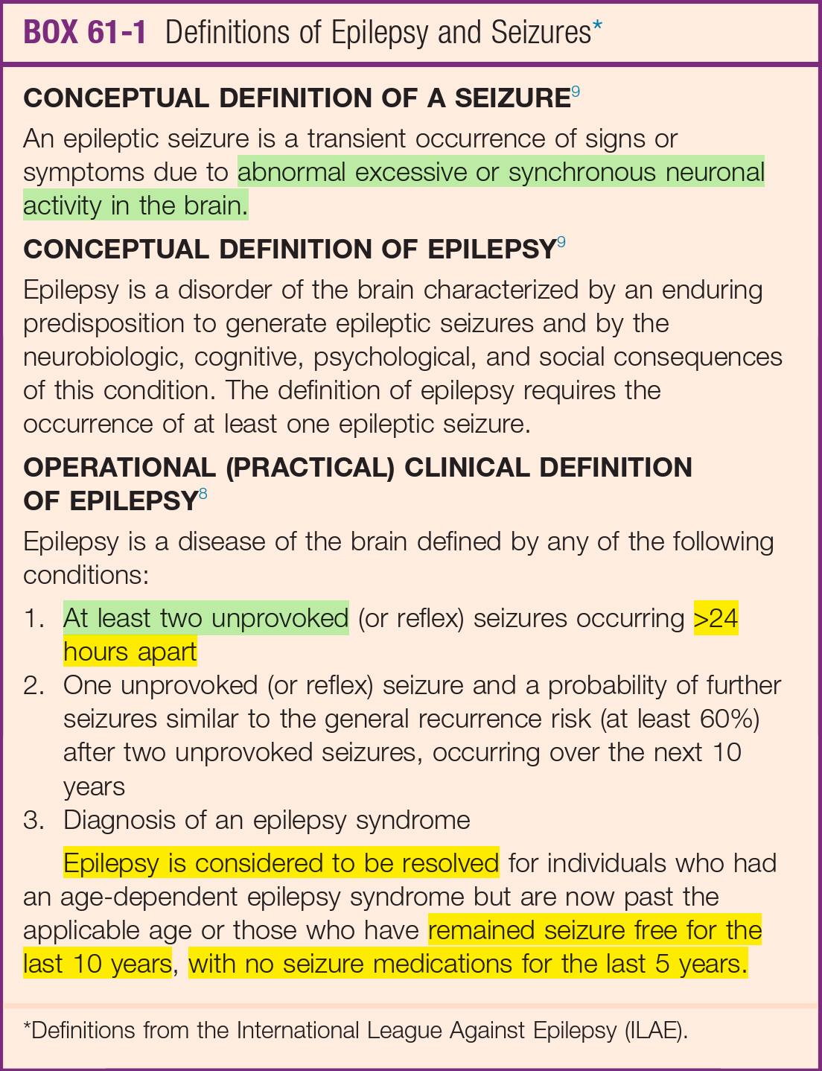

Slide 3
Classification of Seizures
Three main types of seizures: partial (focal) seizures, generalized seizures, and unclassified epileptic seizures.
Focal seizures can be divided into
Seizures without impairment of awareness (simple partial seizures).
Those with impairment of awareness (complex partial seizures).
Seizure disorders were described as symptomatic, cryptogenic, or idiopathic.
Symptomatic is used to describe an epilepsy syndrome with a known underlying disorder of the central nervous system (CNS).
Cryptogenic is used when a presumed underlying symptomatic cause has not yet been identified.
Idiopathic was used to identify syndromes in which there was no underlying cause with the exception of a possible genetic predisposition.

Slide 4
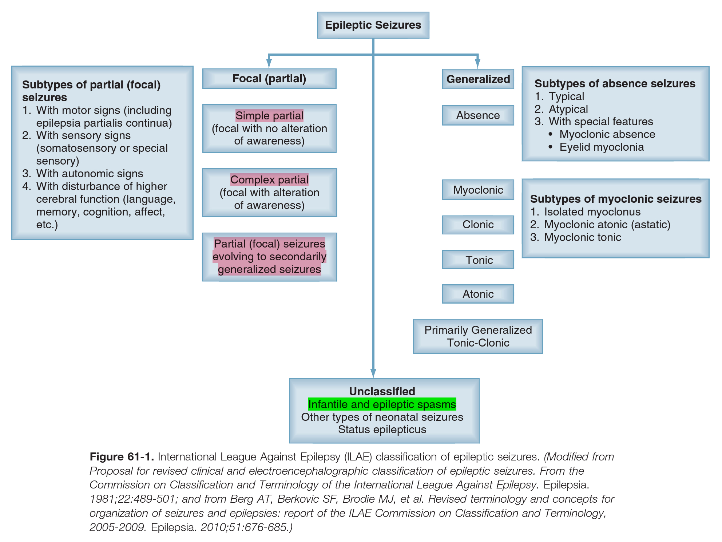

Slide 5
DIAGNOSIS OF SEIZURES AND EPILEPSY
Differential Diagnosis
The most common causes of episodes misdiagnosed as seizures are syncope and psychogenic nonepileptic spells (PNES).
Other less common differential diagnosis are Migrane , cerebral ischemia , sleep disorder , movement disorder.
The “gold standard” for the diagnosis of psychogenic nonepileptic spells is identification of a characteristic episode on video-EEG monitoring.
One of the features most useful for distinguishing a generalized tonic-clonic seizure from syncope or other non epileptic phenomena is a sustained tonic phase, which is generally absent during syncope and almost always present in generalized tonic-clonic seizures.
Loss of postural tone and a brief period of complete immobility precedes abnormal movements in syncope, but not in most seizures.
Urinary incontinence is equally likely to be reported in syncope, PNES, and seizures.
Tongue bite is more likely in seizures than in PNES, but this feature is not associated with high sensitivity or specificity.

Slide 6
Other injuries: such as lacerations, fractures, dental injury, and burns, can occur with PNES.
Posterior dislocation or fracture of the shoulder or shoulder instability may occur after recurrent seizures.
Epilepsy would not be diagnosed if the only manifestations were acute symptomatic seizures,
Acute symptomatic seizures are defined as “seizures occurring in close temporal relationship with an acute CNS insult, which may be metabolic, toxic, structural, infectious or due to inflammation,
Seizures should be considered acute symptomatic if they occur within 7 days of the onset of an acute cerebrovascular syndrome.

Slide 8
Non convulsive ( NCSzs) Seizures and Non convulsive Status Epilepticus NCSE
Status epilepticus (SE) is a prolonged seizure, defined as at least 5 minutes of ongoing clinical or electrographic seizure activity or recurrent seizures without recovery to baseline between seizures.
The causes of NCSzs and NCSE include structural lesions, infections, metabolic derangements, toxins, drug withdrawal, and epilepsy,
NCSzs may occur in 1/3rd of neurological critical care patient after acute brain injury.
Coma is the most common clinical presentation of NCSE.
Clinical signs include face and limb myoclonus, nystagmus, eye deviation, pupillary abnormalities, and autonomic instability.
Convulsive Status Epilepticus CSE
Prolonged seizure activity on EEG accompanied by the tonic-clonic movements of the extremities, mental status impairment, and potential transient neurologic deficits in the postictal phase.
Clinical diagnosis does not always require EEG confirmation, However, its necessary to differentiate between CSE and psychogenic seizures or cerebral herniation, which may both be accompanied by rhythmic movements of the extremities as well.

Slide 10
Investigations
Initial Investigations
Serum electrolyte, calcium, and magnesium measurements; toxicology screen, to identify acute provoking factors.
Serum prolactin levels within 20 to 30 minutes at least twice a baseline level after a seizure particularly generalized tonic-clonic seizures, and do not rise after PNES.
Can increase after syncope, and so an elevated prolactin level would not be helpful in distinguishing seizures from syncope.
Anion-gap metabolic acidosis (almost always seen right after a convulsive seizure and resolving rapidly).
Elevated white blood cell count (demargination).
Elevated creatine kinase (CK) level (most helpful >24 hours after the event).
Elevated ammonia level, and increased amount of neuron-specific enolase.

Slide 11
Electroencephalography (EEG)
EEG is of particular use in the evaluation of patients with seizures for three main reasons:
Providing additional evidence that the spell was epileptic, if epileptiform discharges are present on EEG.
Providing additional information about epilepsy subtype (focal or generalized).
Determining the likelihood of recurrent events after a first seizure.
A normal EEG does not rule out the diagnosis of epilepsy or seizures occur in 10%.
Focal lesion can generate discharges that appear generalized on scalp EEG, a phenomenon known as secondary bilateral synchrony and most common with frontal lobe foci.
Video-EEG monitoring is the “gold standard” in the diagnosis of seizures and nonepileptic spells.
Neuroimaging
Either CT or MRI should be considered in all who present with first seizure.
CT may be appropriate in the emergency setting, in which MRI is not easily available, and the purpose is to identify an acute provoking factor, such as hemorrhage or acute infarction.

Slide 13
Management of Epilepsy 62
Phenytoin, phenobarbital, and carbamazepine enzyme inducers.
Valproic acid enzyme inhibitors.

Slide 14
Antiepileptic Drugs
Phenytoin
Uses
Partial seizure
Generalized convulsion
Neonatal seizure
Status epilepticus
Typical side effects
With high serum concentrations, include nystagmus, ataxia, diplopia, drowsiness, and hepatotoxicity.
With chronic use include gingival hyperplasia, hirsutism, peripheral neuropathy, and bone demineralization.
Intravenous infusion has been associated with bradycardia and hypotension, as well as local skin necrosis, known as purple glove syndrome.
Can be avoided through the use of fosphenytoin.
Dose: loading 15mg/kg Maintenance: 5 mg/kg/day.

Slide 15
Carbamazepine and Oxcarbazepine
Uses
Focal onset seizures.
Both partial and secondarily generalized.
Side effect
nausea, dizziness, drowsiness, diplopia, weight gain, rash, and hyponatremia.
Stevens-Johnson syndrome and toxic epidermal necrolysis.
Transient leucopenia may also be seen in the first few month.
Hyponatremia is more common with oxcarbazepine than carbamazepine.

Slide 16
Valproic Acid
Uses
First-line agent for primary generalized epilepsy.
Generalized seizure types, including absence, myoclonic, and tonic-clonic seizures.
Partial seizures, seizures associated with Lennox-Gastaut syndrome, infantile spasms, neonatal seizures, and febrile seizures.
Side effect
Transient hair loss, weight gain.
Acute mental status.
Thrombocytopenia which may cause excessive bleeding.
Increased risk of neural tube defects.
The initial target dose of valproic acid is 15 mg/kg/day.
L-carnitine supplementation has been beneficial in acute valproic acid overdoses.

Slide 17
Medical management (ANTIEPILEPTIC DRUGS)
Drug | Oral Dose | IV dose | Uses | Side effect
Phenytoin (Epanotin) | 5 - 6 mg./ day | 1 mg./kg/ min. | Partial seizure generalized convulsion,neon-atal convulsion | Bradyarythmia, hypotension, skin necrosis ,nystagmus , ataxia, bone density decrease due to vit. D deficiency
Carbamazepine (Tegretol) | 10-30 mg/kg/day 100 to 200 mg/day to a target dose of 600 to 800 mg/ day | No | Focal onset seizures, both partial and secondarily generalized | CNS toxicity, hypo natremia, neutropenia ,hyper sensitivity , allergic rash , diplopia, weight gain
Valproic Acid | 15 mg/kg/day (500 to 1000 mg/day) |  | first-line agent for primary generalized epilepsy. also effective in treating partial seizures, seizures associated with LennoxGastaut syndrome, and unclassified seizure. | Transient hair loss, weight gain, and dose-related tremor, vomiting, GI distress, and anorexia, altered platelet function and disturbances of hemostasis, increased risk of neural tube defects
Phenobarbital (Luminal) And Primidone | 2 to 5 mg/kg/day (60 to 180 mg/day) 500 to 1000 mg/day |  | Neonatal seizures, status epilepticus, and alcohol withdrawal seizures | dysarthria, ataxia, incoordination, and nystagmus
Levetiracetam (Kepra) | 250 to 500 mg twice daily in adults and 20 mg/kg/day in children. |  | Partial seizures, primary generalized tonic-clonic seizures. | somnolence, dizziness, and behavioral problems, including emotional lability, depression, agitation, hostility, anxiety, and aggression

Slide 18
Use of Anesthetics
Midazolam and Propofol
Indication
If status epilepticus persists longer than 1 hour despite the use of conventional AEDs.
First-line agents in patients with either refractory generalized convulsive or focal status epilepticus.

Slide 19
Special Neurosurgical Considerations
Craniotomy and Perioperative Antiepileptic Drugs
20% and 50% of all patients who undergo neurosurgery have a seizure in the first week after surgery.
Phenytoin reduce the risk of seizures in the first postoperative week by 44%. But can cause hematologic suppression and increase plasma clearance, as well as decrease bioavailability of dexamethasone.
Levetiracetam has replaced phenytoin postoperatively in many neurological ICUs.
Trauma and Antiepileptic Drugs
Because of the high incidence of early posttraumatic seizures with severe traumatic brain injury, affected patients should receive prophylactic AEDs in the first week after injury.
Levetiracetam may be preferable because of its better side effect profile and better adverse event profile.

Slide 20
Brain Tumors and Antiepileptic Drugs
Patients with brain tumors who present with seizures should begin AED therapy immediately.
The decision to initiate AEDs for perioperative prophylaxis should be influenced by tumor size and location.
Seizures occur more frequently when tumors are located in the frontoparietal, frontotemporal, parasagittal, and temporal regions.
In patients who may require chemotherapy, a non–CYP enzyme–inducing AED (Depakin), which will not diminish serum chemotherapy agent levels, is preferred.

Slide 21
Decision to Discontinue Drug Treatment
Seizures are more likely to recur after cessation of treatment if the patient have :
history of known remote symptomatic epilepsy associated with a prior neurological insult.
seizure onset after the age of 12 years.
family history of epilepsy.
focal or generalized slowing on EEG.
history of complex febrile seizures.
The rate of drug tapering does not alter the seizure recurrence risk at 2 yrs.
In patients who have achieved seizure freedom after epilepsy surgery, the decision to alter medication regimens is not usually considered until 1 year after surgery, unless the medications produce intolerable side effects.

Slide 22
Evaluation of Patients for Epilepsy Surgery 64

Slide 23
Preoperative Evaluation for Epilepsy
The main aim is complete resection (or disconnection) of the cortical areas or networks responsible for the generation of seizures (epileptogenic zone [EZ]), leading to complete seizure control in patients in whom multiple antiepileptic medications have failed.
Epilepsy surgery evaluation should be considered after the diagnosis of pharmacoresistant epilepsy (recently defined as a failure to respond to two or more adequately chosen and used antiepileptic medications) >2 yrs.
CLINICAL APPROACH AND TECHNIQUES USED IN THE PRESURGICAL EVALUATION
A detailed history taken from the patient first (in particular the details of the aura, if present) is the most important (and most cost-effective) part in the process of epilepsy surgery evaluation
Questions regarding birth history, febrile convulsions, head injuries, central nervous system (CNS) infections, and other possible causes of seizures should be asked. Medication trials, doses used, and their side effects should be reviewed
A neurological examination should uncover focal neurological abnormalities (which may constitute the anatomopathologic substrate of the epilepsy).

Slide 24
Techniques for the Localization of the Epileptogenic Zone
Two most important and necessary studies to be performed in all patients considered for epilepsy surgery are
High-resolution MRI.
Scalp-video electroencephalographic monitoring.
High-resolution MRI scan to document the presence of
hippocampal sclerosis
cortical dysplasia
other potentially epileptogenic brain lesions.
Gadolinium is not necessary unless a tumor or mass lesion is found.

Slide 25
Two extra operative invasive methods have been used to accomplish these goals:
SDG (subdural grid) electrodes.
Stereotactically placed EEG depth electrodes (SEEG).
Indications for Invasive Evaluation
MRI negative cases.
Deep seated lesions.
Multiple anatomic lesions with the location of at least one of them being discordant with the electroclinical hypothesis, or both lesions are located within the same functional network and it is unclear if one or both of them are epileptic.
Lesion involves potentially eloquent cortex to determine the relationship of epileptic zone with potentially eloquent cortex.

Slide 26
Special Indications for SEEG:
Deep-seated or difficult to cover location of the EZ in areas such as the mesial structures of the temporal lobe, perisylvian areas, cingulate gyrus and mesial interhemispheric regions, ventromedial prefrontal areas, insula, and depths of sulci.
The failure of a previous subdural invasive procedure.
The need for extensive bihemispheric explorations (in particular in focal epilepsies arising from the interhemispheric or deep insular regions, or temporoparietooccipital junction)
Presurgical evaluation suggestive of an extended network involvement (e.g., temporofrontal or frontoparietal) in the setting of normal MRI

Slide 27
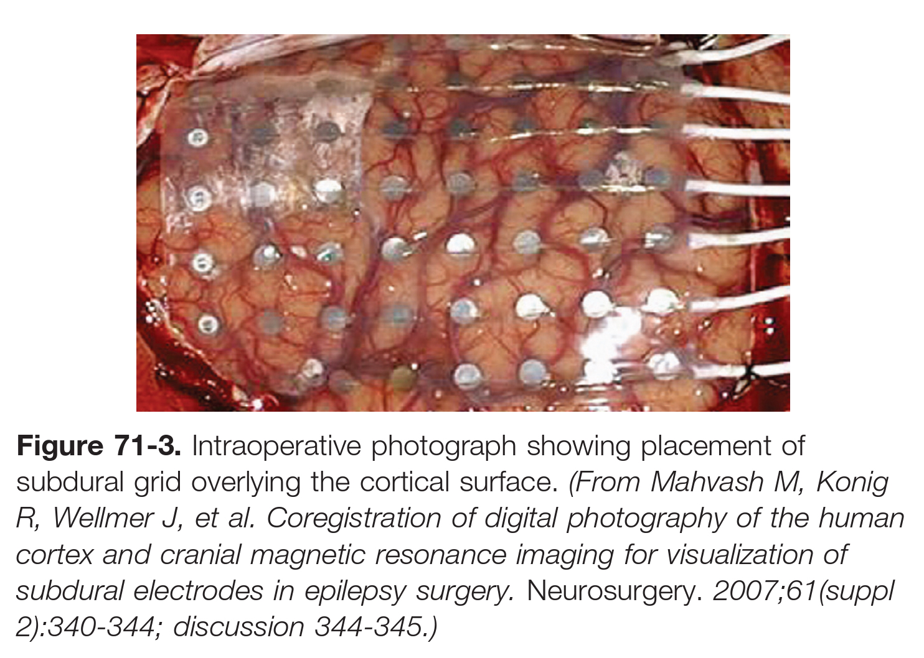
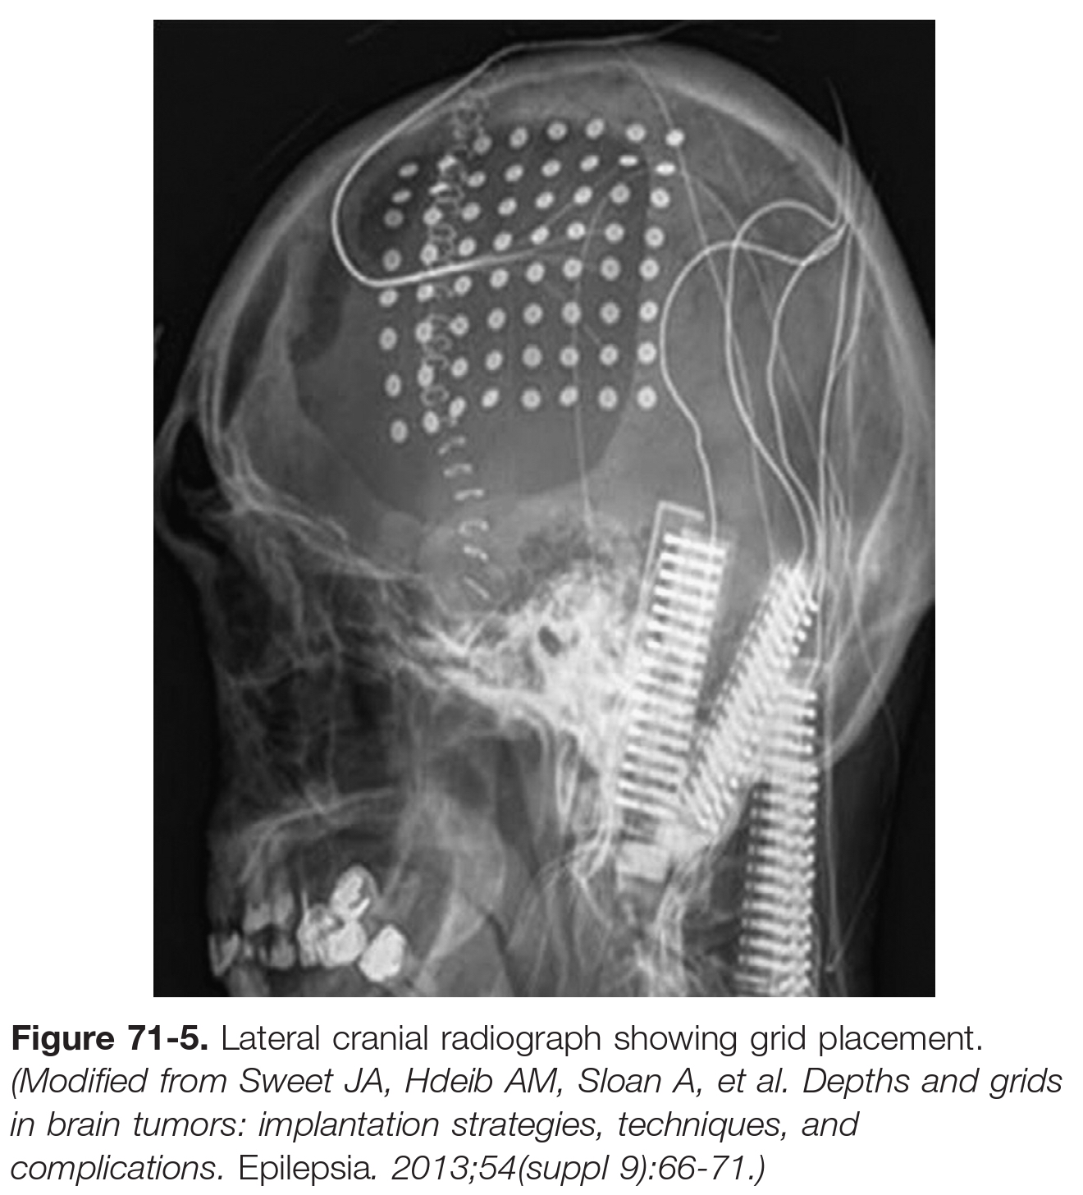

Slide 30
Neuroradiologic Evaluation for Epilepsy Surgery: 65

Slide 31
Magnetic Resonance Imaging
STRUCTURAL CEREBRAL ABNORMALITIES IDENTIFIED WITH MAGNETIC RESONANCE IMAGING
Hippocampal Sclerosis
Malformations of Cortical Development
Focal Cortical Dysplasia
Tumors
Vascular Malformations

Slide 32
Hippocampal Sclerosis
Mesial temporal lobe epilepsy is the most common form of epilepsy in adults, and hippocampal sclerosis or mesial temporal sclerosis is the main pathologic process associated with it.
Hippocampal sclerosis is demonstrated as hippocampal atrophy on coronal T1 and as increased signal intensity on T2.
Features associated with hippocampal sclerosis are as follows:
Temporal horn dilatation, caused by volume loss of the hippocampus
Atrophy of the structures that form the outflow tracts from the hippocampus (inferiorly, the parahippocampal gyrus; posteriorly, the ipsilateral fornix connected to the ipsilateral mammillary body)
Atrophy of the structures indirectly connected with the hippocampus (the remainder of the temporal lobe, the thalamus, and the caudate nucleus).
The limitation with sole visual inspection is that hippocampal sclerosis can be missed if it is mild or bilateral.

Slide 33
Structural Magnetic Resonance Imaging and Cognition in Epilepsy
Patients with temporal lobe epilepsy exhibit global reduction in the volume of white matter tissue in frontal, temporal, and parietal lobe regions, but not occipital lobe regions.
This reduction in volume of white matter is strongly associated with cognitive impairment.
In temporal lobe epilepsy, there appears to be a relationship between hippocampal volume and memory dysfunction:
Reduced left-sided volumes → impairments in verbal learning and memory.
Normal left sided volumes → greatest postoperative memory decline.
Reduced right side in amygdala volumes → visual memory loss and interictal aggression.
Increased amygdala volume → depression, dysthymia, and psychosis.

Slide 34
FUNCTIONAL IMAGING
Functional Magnetic Resonance Imaging (fMRI)
Electroencephalography–Functional Magnetic Resonance Imaging (EEG-fMRI)
Diffusion-Weighted Imaging ( DWI )
MAGNETIC RESONANCE SPECTROSCOPY ( MRS)

Slide 35
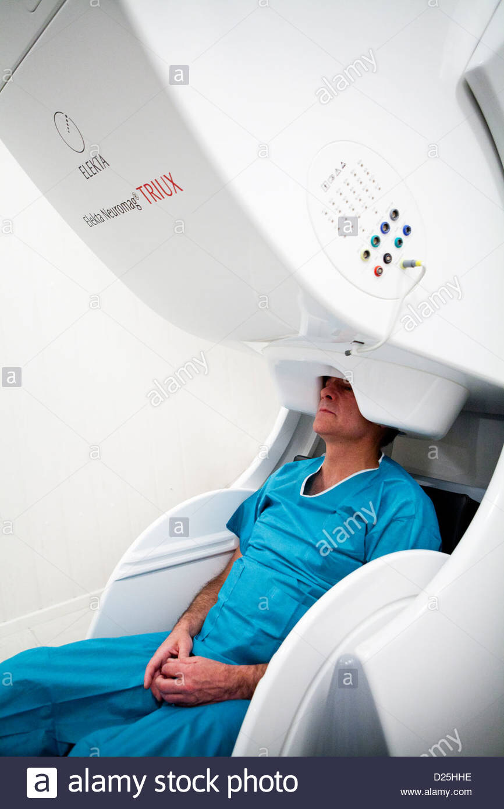
Magneto encephalo graphy(MEG)/Magnetic Source Imaging(MSI)
Noninvasive and painless procedure that involves no external magnetic field, electricity, x-rays, or radioactivity, in which source estimates (dipoles) are coregistered with the patient’s MRI.
Common Indications
Negative MRI with a mesial temporal onset suspected.
Negative EEG (spikeless).
Multiple lesions on MRI.
Large lesion on MRI.
Intrasylvian onset suspected.
Interhemispheric onset suspected.
Insular onset suspected.
Ambiguous EEG findings suggestive of “bilateral” or “generalized” pattern.
Lacking or imprecise hypothesis regarding a seizure onset.

Slide 36
Wada Testing
Refers to a class of procedures involving brief anesthetization of one cerebral hemisphere to enable assessment of cognitive function of the contralateral, nonanesthetized hemisphere.
It involves, primarily, assessment of language and memory during the period of hemianesthesia.
Pre-Wada Procedures
Patients referred for Wada testing typically have pharmacologically refractory epilepsy, with seizures that arise from the temporal lobe, and thus these patients are at risk for language (if seizures arise from the dominant hemisphere) and memory decline.
EEG leads may be applied to assist in monitoring
the effect of hemianesthesia
the presence of seizure activity.
whether the patient is in an awake or sleep state.

Slide 37
Before the anesthetizing agent is administered, carotid angiography is performed to
determine the presence or degree of blood flow to the contralateral hemisphere.
the extent of perfusion of the posterior cerebral artery (PCA).
potentially dangerous neurovascular patterns that would result in perfusion to the brainstem.
Wada procedures
The patient lying supine.
Before the injection of the anesthetic , the patient is instructed to raise both arms, typically gripping the physicians fingers for a baseline measure of grip strength.
When it is determined that the hemianesthetic effect has taken hold several seconds after the initial injection (i.e., contralateral hemiplegia, unilateral EEG slowing).
Amobarbital dosages is 100 – 125 mg (short-acting drug, with peak effect lasting 4 to 8 minutes).

Slide 38
From hand book
Technique:
Catheterize ICA: usually start on side of lesion
Have patient hold contralateral arm in air, and instruct them to hold it there
Inject 100–125 mg sodium amobarbital (Amytal®) rapidly into internal carotid artery (effect starts almost instantaneously, begins to subside after ≈ 8 minutes (may subside in ≈ 2 minutes with AVM where flow rates are high)
Determine adequacy of injection by assessing motor function in elevated arm (should be ≈ flaccid)
Assess language skills by showing patient pictures of objects and asking them to name each one out loud and remember each one
Assess memory function by asking patient to name as many of the pictures as they can ≈15 minutes after test: if they have difficulty, ask them to pick out pictures from a group that contains additional ones not shown to patient
Repeat procedure on other side (use lower Amytal doses with each subsequent injection)

Slide 39
The Wada test (intracarotid amobarbital [Amytal] test) is performed to identify the dominant hemisphere for language functions and to determine the degree to which memory functions are subserved by each hemisphere.
In right-handed patients
96% had speech lateralized to the left cerebral hemisphere
4% to the right hemisphere.
In left-handed patients
70% had speech lateralized to the left,
15% to the right,
15% had some representation of speech in each hemisphere.

Slide 40
Complications
Encephalopathy
Seizure
Stroke
Transient ischemic attack
Localized hemorrhage at the catheter insertion site
Carotid artery dissection
Allergic reaction to contrast
Infection
Risk Factors
Older age for stroke and dissection
Younger age for seizures.

Slide 41
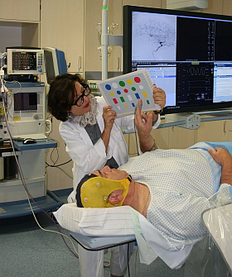

Slide 42
Thank You

