Slide 1
Ependymomas
Youmans Chap. 212, 143

Slide 2
Ependymoma is the 3rd most common pediatric brain tumor, behind astrocytoma and medulloblastoma.
Account for 10% of pediatric brain tumors.
Mean age at diagnosis of intracranial ependymoma is 5 to 8 years.
More than 90% of ependymomas are located intracranially in children:
1/3 are supratentorial.
60% arise in ventricular system (lateral or third ventricle).
40% arise in areas remote to the ventricles.
2/3 are infratentorial.
60% arise from the floor
30% arise from lateral aspect
10% arise from roof of the fourth ventricle
In contrast, most adult cases occur in the spinal cord.

Slide 3
CLINICAL OVERVIEW
Infratentorial (posterior fossa) ependymomas
Group A tumors
occur in younger children with a median age of 2.5 years.
more common in males (70% males).
laterally located which Extend laterally into CPA.
more aggressive.
increased risk for recurrence, and have worse outcomes.
Group B tumors
more frequent in adolescents and young adults with a median age of 20 years.
Midline (Midline cerebellum or spinal cord ).
genetically similar to spinal ependymomas.
less aggressive, and have a better prognosis.

Slide 4
PROGNOSTIC FACTORS
PROGNOSTIC FACTORS Depend on:
The extent of disease at diagnosis.
Age of the patient at diagnosis.
Tumor location.
Tumor grading.
Approximately 5% to 10% of children with ependymoma have disseminated (leptomeningeal) disease at the time of diagnosis.
Risk factors for dissemination include
Younger age.
Less than gross total resection.
High proliferative index.
High grade histology.

Slide 5
Extent of Resection
The single most important determinant of outcome in pediatric ependymoma is the extent of surgical resection.
Because minimal residual disease can be cured with radiotherapy, it is not necessary to perform extensive, aggressive resections that put the patient at risk.
Ependymoma resections are classified as gross total, near total, subtotal, and biopsy.
Gross total resection is defined as the absence of tumor on postoperative MRI, even if microscopic disease (visualized with the operating microscope during surgery) is still present.
Near-total resection is arbitrarily defined as
less than 1.5 cm3 residual tumor on postoperative imaging or
0.5-cm residual thickness of tumor bed enhancement.
Subtotal resection is defined as remaining gross residual tumor that is visible to the surgeon during surgery or on postoperative neuroimaging.

Slide 6
Age
Patients younger than 3 years at the time of diagnosis may have a poorer prognosis than older children
Location
there was no difference in overall survival between supratentorial and infratentorial ependymomas.
spinal location was associated with improved survival (5-year overall survival of 86.7%).
Tumor grade
worse survival in anaplastic ependymomas compared to WHO grade II ependymomas.

Slide 7
World HealthOrganization Classification of ependymoma
Grade 1 (adult age)
Subependymoma
Myxopapillary ependymoma
Grade 2 (pediatric age)
Cellular
Clear cell
Papillary (aggressive)
Tanycytic
Grade 3 (pediatric age)
Anaplastic ependymoma

Slide 8
PATHOLOGY
Slowly growing tumors originating from the ventricular wall or spinal canal.
Gross Pathology
Are reddish-tan or gray in color and form relatively well-demarcated, lobulated masses.
Microscopic Pathology
Well-delineated, moderately cellular, glial tumors with round monomorphic nuclei and “salt and pepper” speckling of the chromatin.
Mitoses are absent or rare.
The tumors are characterized by perivascular pseudorosettes (groups of cells arranged radially around a blood vessel) and, less commonly, by true ependymal rosettes.
They usually stain positive for glial fibrillary acidic protein GFAP, vimentin, and CD56.
Anaplastic ependymomas are malignant gliomas with ependymal differentiation, hyper cellularity, nuclear pleomorphism, high mitotic activity, microvascular proliferation, and pseudopalisading necrosis.
In grade II ependymomas, perivascular pseudorosettes are common.

Slide 9
HEREDITARY TUMOR SYNDROMES
There are few known familial ependymoma syndromes, and most ependymomas occur sporadically.
Neurofibromatosis type 2 (NF2).
Li-Fraumeni syndrome : mutation in the p53 tumor suppressor gene (TP53)
Multiple endocrine neoplasia type 1 syndrome MEN 1.
Turcot’s syndrome: is the association of colonic neoplasia with a central nervous system (CNS) tumor and is caused by mutations in the adenomatous polyposis coli (APC) gene on chromosome 5.

Slide 10
NEUROIMAGING
MRI is the diagnostic imaging modality of choice .
Ependymoma has a propensity to grow
Out of the foramen of Luschka into the cerebellopontine angle (CPA).
Out of the foramen of Magendie into the cervical spine.
Preoperative imaging of the entire neuraxis because approximately 5% of children have leptomeningeal dissemination.
The risk for CNS seeding more in posterior fossa than supratentorial.
Postoperative imaging should be done within 2 days of surgery to assess the extent of resection.

Slide 11
CT findings
Isodense or hyperdense to brain parenchyma
Half show calcifications.
Usually demonstrate varying degrees of enhancement that may be heterogeneous; they sometimes enhance homogeneously
MRI findings
T1-heterogeneous and hypointense or isointense .
T2-may be isointense or hyperintense.
Enhance uniformly , more often, demonstrate varying intensities of heterogeneous enhancement because of the presence of cystic, hemorrhagic, or calcified areas within the tumor.
Calcifications appear as
Hyperintense on T1
Hypointense regions on T2
MRS usually demonstrate elevated choline and decreased N-acetyl aspartate.

Slide 12
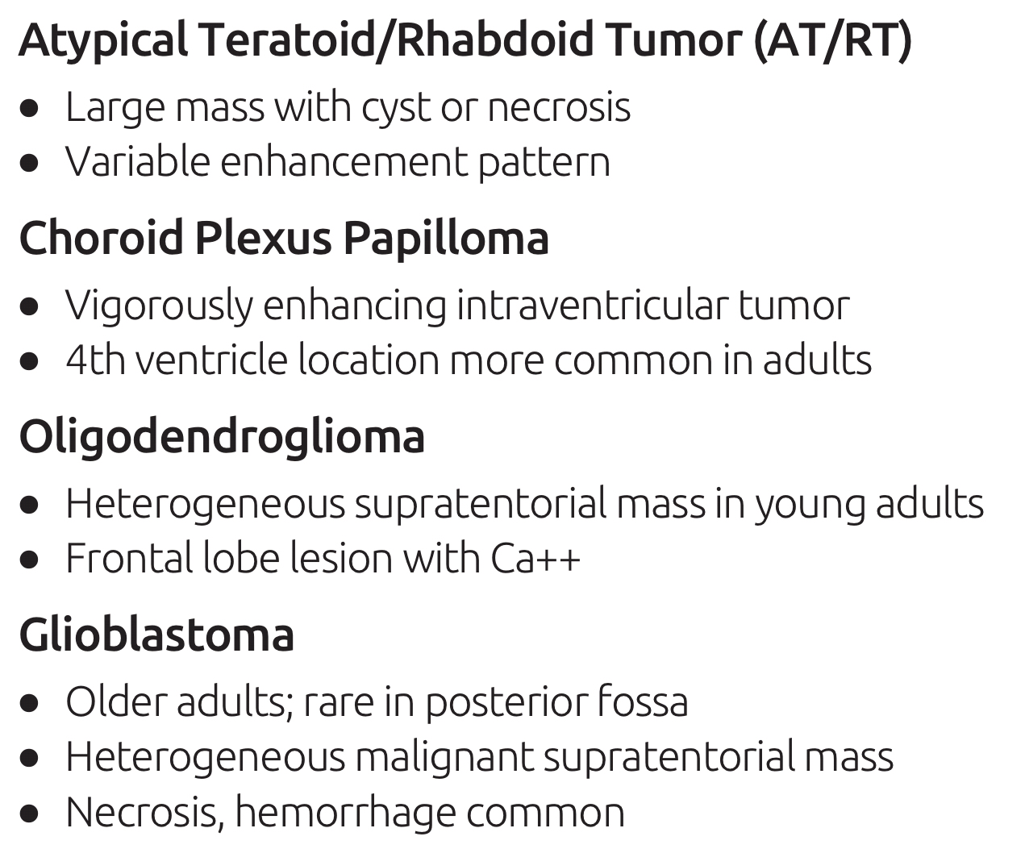
Deferential Diagnosis osborne

Slide 17
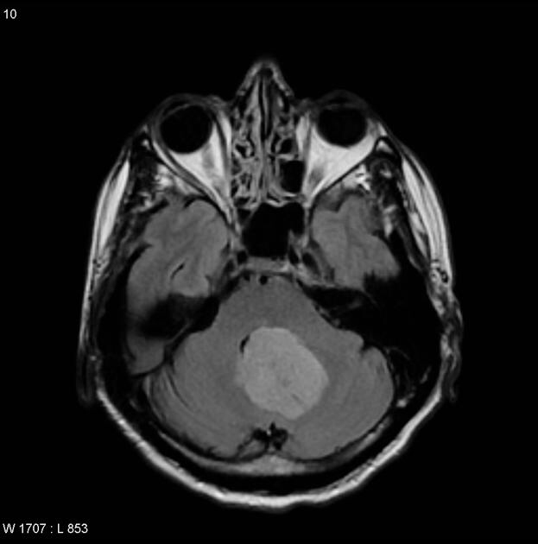
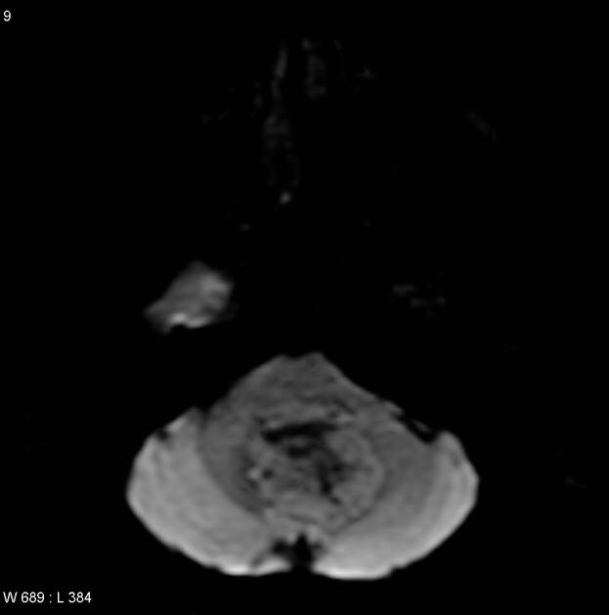
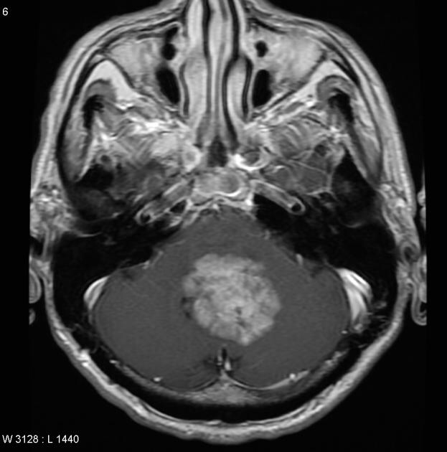
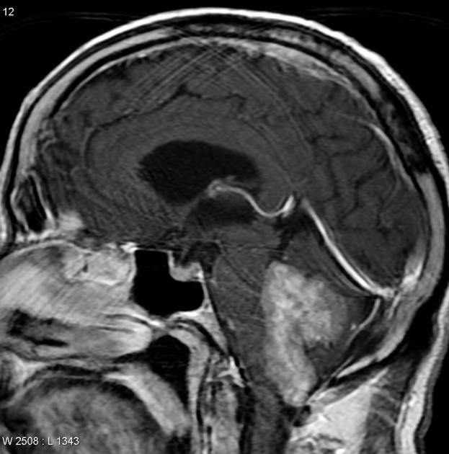
T2
Flair
DWI
Contrast

Slide 18
INITIAL SURGERY
Children with ependymoma most often present with localized, invasive disease. Most recurrences are local, but subarachnoid dissemination occurs rarely and is usually fatal.
Complete resection is more readily achieved in supratentorial tumors and in those that arise from the roof of the 4th ventricle.
Gross total resection of tumors that invade the floor of the 4th ventricle or extend through the foramen of Luschka (often acting as an extra-axial posterior fossa mass) to involve the lower cranial nerves is much more difficult, and surgical complication rates are higher.

Slide 19
SURGERY FOR RESIDUAL OR RECURRENT TUMOR
Indications for 2nd surgery
Less than a near-total resection in the 1st surgery to reduce the tumor burden to minimal residual disease.
Localized recurrent disease that is amenable to surgical resection.
Except in those rare cases in which resection of the residual tumor may injure a critical CNS structure (brainstem, motor cortex or tracts)
Chemotherapy before resection of residual ependymoma may decrease the vascularity of the tumor and allow surgery to be delayed, providing very young children an opportunity to grow.

Slide 20
Plan of Management
Primary (NOT RESIDUAL OR RECURRENT TUMOR):
Surgery without (radiotherapy or chemotherapy) in: GTR
supratentorial ependymoma or roof of 4 th Ventricle , with absence of pathologic features of anaplastic ependymoma.
areas of noneloquent brain, a thin rim of normal white matter should be resected around the ependymoma to ensure complete resection and to devascularize the tumor.
Surgery with (radiotherapy or chemotherapy)in:
Grade 3 anaplastic ependymoma .
Infratentorial ependymoma (those arising from the floor and lateral aspect)

Slide 21
Secondary (RESIDUAL OR RECURRENT TUMOR):
Radiotherapy or chemotherapy without Surgery----Eloquent area
Surgery with (radiotherapy or chemotherapy)----non Eloquent area
Children who had a second operation within 30 days lower complication rate than those who had second-look surgery more than 30.
Children with localized recurrent disease that is amenable to surgical resection should also undergo reoperation In most cases, this should be followed with some form of radiotherapy, either radiosurgery or repeat conformal radiotherapy (CRT) .

Slide 22
SURGICAL TECHNIQUE
For Supratentorial Ependymoma
The tumor is very distinct from the surrounding normal brain, providing for clear surgical margins.
In areas of noneloquent brain, a thin rim of normal white matter should be resected around the ependymoma to ensure complete resection and to devascularize the tumor.
Ependymomas do not contain functioning neural tissue and can usually be safely resected from areas of eloquent cortex.
Supratentorial ependymomas that are truly located within the ventricles are rare.
Some supratentorial ependymomas abut or compress the ventricle without actually entering it.

Slide 23
For 4th ventricular Ependymoma
Supplied by branches from the PICA.
If there is considerable hydrocephalus, a ventriculostomy may be placed before opening the posterior fossa.
Care should be taken to release cerebrospinal fluid (CSF) slowly so as
not to precipitate upward herniation or shifts in the tumor, with consequent intratumoral hemorrhage.
Precipitous release of CSF and consequent lowering of intracranial pressure can also lead to retinal hypoperfusion with retinal infarct.
Craniotomy is preferred to craniectomy because it decreases
the incidence of CSF leak and pseudomeningocele formation.
the incidence of chronic postoperative pain.
If the tumor extends rostrally, the bone should be removed up to the level of the torcula without actually exposing the venous sinuses to diminish the chance of hemorrhage from sinus injury or sinus thrombosis.

Slide 24
foramen magnum should be removed to increase the exposure and open up pathways for CSF flow.
If the dura over the cerebellum is tight, the dura over the upper cervical cord can be incised (to allow the slow egress of CSF until the dura begins to pulsate) to bring down intracranial pressure.
Alternatively, CSF can be withdrawn through a previously placed ventriculostomy.
After the dura is opened, the cerebellar tonsils are identified and separated to find and follow the posterior inferior cerebellar arteries.
If the tumor arises from the roof, complete excision is possible.
If the tumor arises from the floor, a portion of the tumor is left on the floor of the ventricle as a thin carpet.
The lateral margins of the tumor are dissected out to diminish the tumor’s blood supply, followed by debulking of the tumor using either the bipolar suction technique or CUSA.

Slide 25
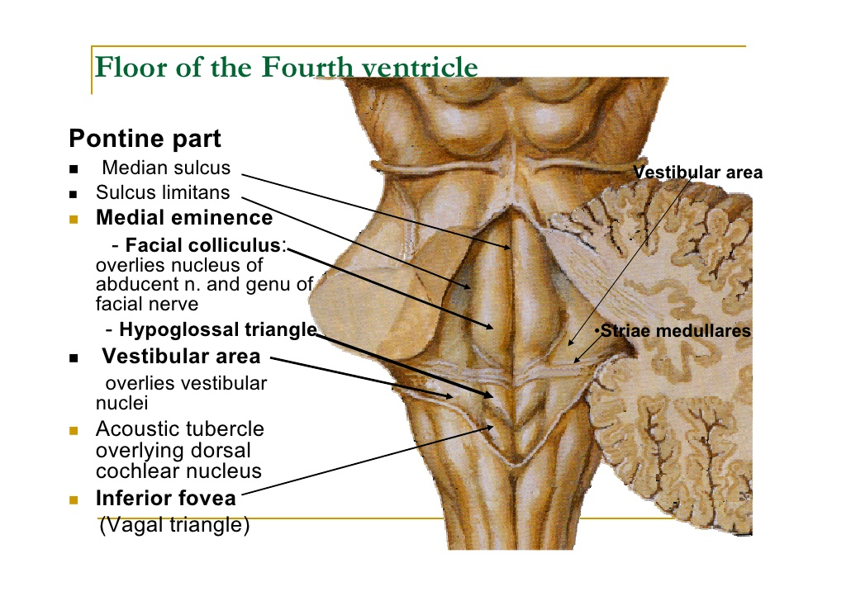
Injury to the floor through an overzealous bipolar approach can lead to 6th and 7th C.N palsies as well as damage to the medial longitudinal fasciculus.
Look for the foramen of Luschka bilaterally to avoid missing a small piece of tumor.
Care should also be taken to dissect out the cerebellar tonsils and open up the CSF flow pathways to diminish the need for a future CSF diversionary procedure.

Slide 26
For CPA ependymomas
originate from the lateral wall of the brainstem at the junction of the pons and the medulla.
Their slow growth results in the encasement of multiple cranial nerves by the time of diagnosis (cranial nerves V to X are all at risk).
Unilateral growth rotates the brainstem, distorting the normal anatomy and disorienting the surgeon.
CPA ependymomas can grow back up the foramen of Luschka into the fourth ventricle, filling the ventricle with tumor.
Blood supply from PICA & AICA
The tumor is then debulked laterally until cranial nerves IX and X are identified entering the jugular foramen.
In an attempt to obtain gross total removal, hearing is invariably lost even if cranial nerve VIII remains in continuity.
Postoperative cranial nerve VII palsy is a common occurrence in resecting the remaining brainstem component in the CPA.
The intraspinal portion of the tumor is removed first.

Slide 27
Post OP care and complications
Children are kept intubated overnight, and the postoperative MRI is performed early the following morning .
Within 48 hours of extubation, we perform a swallowing test.
Complications
C.N palsies : although many children have cranial nerve VI, VII, IX, or X palsies after surgery, more than 90% experience significant recovery within 3 to 6 months.
Presence of residual tumor which can be avoided by intraoperative MRI , should diminish the chance of leaving tumor in the resection bed.
Vocal cord paralysis, when present, should be unilateral. Complete unilateral vocal cord paralysis in children who cannot handle their secretions mandates a tracheostomy and often a gastrostomy tube for nutrition .

Slide 28
TREATMENT OF HYDROCEPHALUS
Hydrocephalus is much less common in patients with supratentorial ependymomas.
Rarely, hydrocephalus is seen in the setting of a spinal ependymoma caused by high levels of CSF protein secreted by the tumor.
Preoperative
Corticosteroid to reduce symptoms of hydrocephaly
Shunting is avoided when possible to avoid making children shunt dependent after surgery.
VP shunt in urgent conditions
The use of intraoperative ETV may decrease the need for CSF diversion.
Postoperative
incidence of 25% to 50%.
The typical presentation is a pseudomeningocele at the site of the posterior fossa incision, but hydrocephalus may also present in a more traditional manner with headache, nausea, vomiting, and lethargy.

Slide 29
RADIOTHERAPY and CHEMOTHERAPY
The standard of care for children with non disseminated ependymoma is postoperative radiotherapy.
Do not send for radiotherapy in :
supratentorial ependymomas if gross total resection with adequate margins has been achieved and the pathology is classical ependymoma (not anaplastic ependymoma).
some children after resection of an intramedullary spinal cord ependymoma.
patients younger than 3 years.
The standard radiation dose to treat local ependymoma ranges from 54 to 59 Gy.
Three-dimensional CRT, intensity-modulated radiotherapy, fractionated radiotherapy, proton-beam therapy, and stereotactic radiosurgery are all used to treat ependymomas.
CHEMOTHERAPY
The role of chemotherapy in the treatment of childhood ependymoma is unclear; it is not part of standard care.
Chemotherapy may have a role in avoiding or delaying radiotherapy in children younger than 3 years with intracranial ependymoma

Slide 30
Intracranial Ependymomas in Adults

Slide 31
Ependymomas constitute 3% to 5% of CNS tumors in adults.
10% of CNS tumors in children.
Supratentorial ependymomas are much less frequently seen than their infratentorial counterparts and occur more commonly in adults.
Origin
Arise from ependymal cells lining the ventricles of the brain or central canal of the spinal cord.
When ependymomas arise within the brain parenchyma, they originate from nests of ependymal cells that have migrated from periventricular areas.
Anatomical predilection
Subependymoma —> Fourth ventricle
Myxopapillary ependymoma —> Conus medullaris, cauda equina, filum terminale
Clear cell ependymoma —> Supratentorial
Tanycytic ependymoma —> Spinal Cord

Slide 32
PATHOLOGY
Grossly, ependymomas are soft gray or tan lesions with well-demarcated borders that may contain cystic, hemorrhagic, necrotic, or calcified regions.
One of the most frequent chromosomal defects seen in ependymomas involves chromosome 22. Neurofibromin 2 (NF2) is a tumor suppressor gene located at the 22q12.2 region; mutation of this gene is known to occur in patients with neurofibromatosis type 2, and these patients have a predilection for spinal ependymomas.
Imaging
Supratentorial ependymomas tend to demonstrate greater cystic areas when compared to infratentorial.
Intracranial leptomeningeal seeding is often seen as leptomeningeal enhancement, nodules or masses, or communicating hydrocephalus.
Spinal leptomeningeal seeding may be seen as
Thecal sac irregularity,
Enhancing intradural extramedullary or,
Rarely, intramedullary foci, or nerve root irregularity or clumping.

Slide 33
CLINICAL PRESENTATION
The clinical presentation of ependymomas is variable and depends on the location, size, and histologic grade.
Tumor Location | Common Presentation
Infratentorial | Hydrocephalus; cranial nerve deficits.
Supratentorial-extraventricular | Seizures, focal neurological deficits (e.g., hemiparesis, visual field defects, speech difficulty, behavioral changes, memory deficits).
Supratentorial-lateral ventricle | Hydrocephalus, focal neurological deficits.
Supratentorial-third ventricle | Hydrocephalus, focal neurological deficits, Parinaud’s syndrome .

Slide 35
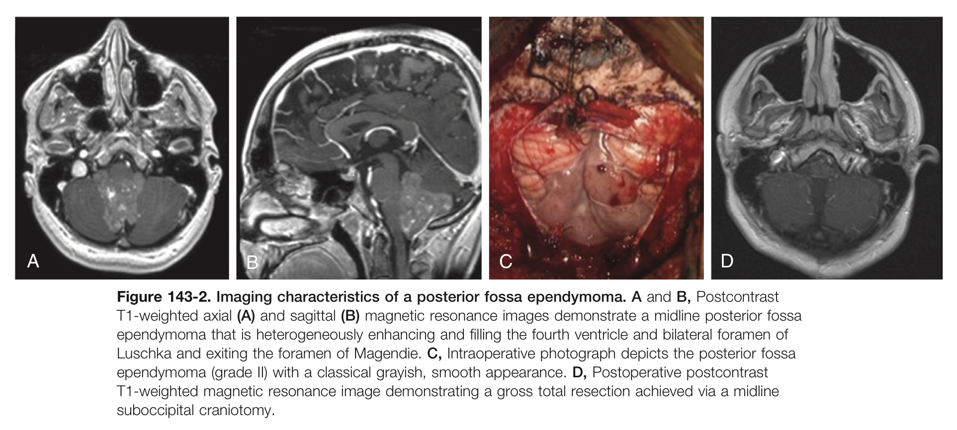
TREATMENT
Surgical Treatment.
Surgical resection of the tumor is the mainstay of treatment for patients with ependymomas.
The goals of surgery include
tissue diagnosis
gross total resection (or maximal safe debulking if gross total resection is not feasible).
reestablishment of CSF flow pathways and alleviate obstructive hydrocephalus, especially in intra- or periventricular tumors.

Slide 36
Surgical facilities
The surgical approach depends on tumor size and location, as well as surgeon preference and experience.
Use of frameless stereotaxy significantly enhances surgical planning and resection
Intraoperative ultrasound to localize, assess the extent of, and facilitate dissection of the tumor,
neuromonitoring (somatosensory and motor evoked potentials) can also guide resection and help reduce morbidity
Postoperatively, MRI is usually obtained within 48 hours after surgery, and a second attempt at resection should be favored if there is significant residual tumor
near the eloquent cortex, preoperative functional imaging and intraoperative cortical stimulation mapping may be necessary.

Slide 37
Approches
For intraventricular supratentorial ependymomas, an open microsurgical or endoscopic approach can be used.
the route commonly includes a
transsulcal or
transcortical or
interhemispheric transcallosal corridor for third ventricular lesions.
The disadvantages include :
risk of cortical injury and seizures after transcortical approach, with postoperative seizures varies from 29% to 70%.
disconnection syndrome if an overexuberant callosotomy is made, particularly involving the splenium after transcallosal approaches, with postoperative seizures varies from 0%-10%.

Slide 38
Neuroendoscopic techniques
The established role of endoscopy with ependymomas has been in the treatment of hydrocephalus and biopsy of intraventricular lesions.
For obstructive hydrocephalus caused by posterior fossa, aqueductal, or posterior third ventricular ependymomas, endoscopic third ventriculostomy is a good therapeutic option, provided the interpeduncular cistern is not obliterated by tumor or brainstem displacement.
For lateral ventricular ependymomas that cause hydrocephalus as a result of unilateral obstruction of the foramen of Monro, endoscopic fenestration of the septum pellucidum is a viable treatment strategy.
Limitations
intraventricular tumors with large cystic components.
problems with visibility secondary to bleeding and ability to achieve adequate hemostasis, especially in larger tumors

Slide 39
For posterior fossa ependymoma
The transvermian approach is often associated with postoperative mutism and is therefore often replaced by the telovelar approach
initiated by opening of the cerebellomedullary fissure and superolateral retraction of the cerebellar tonsils.
This provides access to the tela choroidea, which is then opened to free the tonsils from the medulla and open the lateral recess, thereby exposing the fourth ventricle and/or tumor.
Vascular supply of fourth ventricular ependymomas is usually from branches of the posterior inferior cerebellar artery, and early coagulation of vascular feeders to the tumor helps to reduce intraoperative bleeding during tumor resection.

Slide 40
Radiotherapy
For some patients with supratentorial ependymomas who have undergone gross total resection, observation may be reasonable, and RT can be deferred for recurrent tumors.
For patients with high-grade ependymomas, surgical resection should be followed by adjuvant RT.
For patients with infratentorial ependymomas, surgical resection is usually followed by adjuvant RT irrespective of tumor grade and extent of surgical resection.
When patients are administered RT, the treatment field usually covers the resection cavity and a 1- to 2-cm margin around it.
Craniospinal radiation is reserved for patients with evidence of metastatic seeding.
SRS is a useful adjunct for patients with recurrent ependymomas after surgical resection and RT.

