Slide 1
Dermoid Epidermoid Neurenteric cyst Chapter 152

Slide 2
Dermoid and epidermoid cysts, as well as dermal sinus tracts, reflect an abnormality of surface ectoderm.
Neurenteric cysts are a type of endodermal malformation.
All three disorders are frequently associated with one or more of the mesodermal malformations, particularly those involving the vertebrae :
Hemivertebrae
absence of vertebrae
fused vertebrae
butterfly vertebrae
midline bony spurs
They result from primary failure of neurulation.
Epidermoid and dermoid cysts are common in females, while neurenteric cyst are equal in both sex.

Slide 3
Epidermoid Cyst
Are benign lesions that may arise in the spine or intracranially.
The cranial lesions may be
Intradural (usually extraaxial) occur in the CPA or Parasellar cisterns.
Extradural (usually arising in the diploic space of the calvaria) occur in the Vault of skull.
Intracranial epidermoid cysts account for 0.2% to 1.8% of all intracranial tumors.
Most intraspinal epidermoid cysts are subdural extramedullary, and they rarely develop in the intramedullary compartment.
They can be seen at any age, but the average age of presentation is 40 years.

Slide 4
Clinical presentations
Clinical features are variable and depend on tumor location.
Extradural lesions often manifest as local masses with or without headache.
Intra-dural tumors are more likely to be associated with headache (because of the common parasellar location), visual disturbance, and, to a lesser extent, hypothalamic alterations.
middle fossa grow quite insidiously and are often asymptomatic.
CPA may cause ataxia, dizziness, or local cranial nerve deficits.
Spinal epidermoid tumors are frequently associated with vertebral anomalies.
A picture of acute meningitis may indicate rupture of an epidermoid cyst. (Chemical meningitis occur due to pre-op rupture or intra-op spillage).

Slide 5
Pathology
Location :
ECs are more often off- or paramidline and have a predilection for the basal cisterns , where they insinuate themselves around cranial nerves and vessels.
Gross Pathology :
The outer surface of an EC is often shiny , resembling mother of pearl.
Multiple "cauliflower“ excrescences are typical .
The cyst is filled with soft, waxy, creamy, or flaky material.
Microscopic pathology :
The epidermoid cyst is benign and consists of a thin capsule of stratified, keratinized squamous epithelium.
It contains an accumulation of desquamated epithelial cells, keratin, and cholesterol.
Malignant transformation is rare (squamous cell carcinoma).
Staining are positive ( Carbohydrate Antigen CA19-9), used to evaluate patients for tumor recurrence or progression.
Incomplete tumor resection → postoperative CA19-9 serum values were still elevated, but lower than preoperative values.

Slide 6
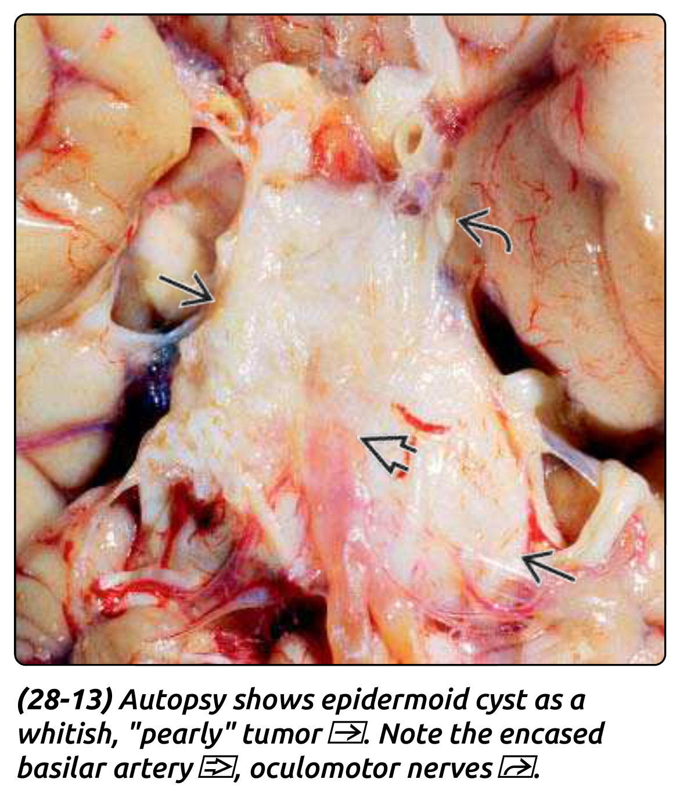

Slide 7
Imaging
X-Ray: limited to extradural lesions, with their characteristic changes of lytic erosion of the skull with scalloped margins. The inner table of the skull is usually destroyed, and the outer table thinned.
CT scan:
homogeneous nonenhancing hypodense lesion in the subarachnoid space without surrounding edema.
epidermoids present as high-density masses (“white epidermoids”) on CT scans, making diagnosis difficult.
MRI: Typically, the tumor signal is heterogeneous and most often shows
hypointensity on T1
hyperintensity on T2
FLAIR Does not suppress
DWI Restricts ("bright")
some tumors show rim enhancement with gadolinium administration.
There is usually no edema of the surrounding parenchyma, and hydrocephalus is rare, even in the setting of large tumors and brain displacement.
Rapture of epidermoid will cause chemical meningitis, this associated with radiographic findings of small fat globules in the subarachnoid and intraventricular spaces.

Slide 10
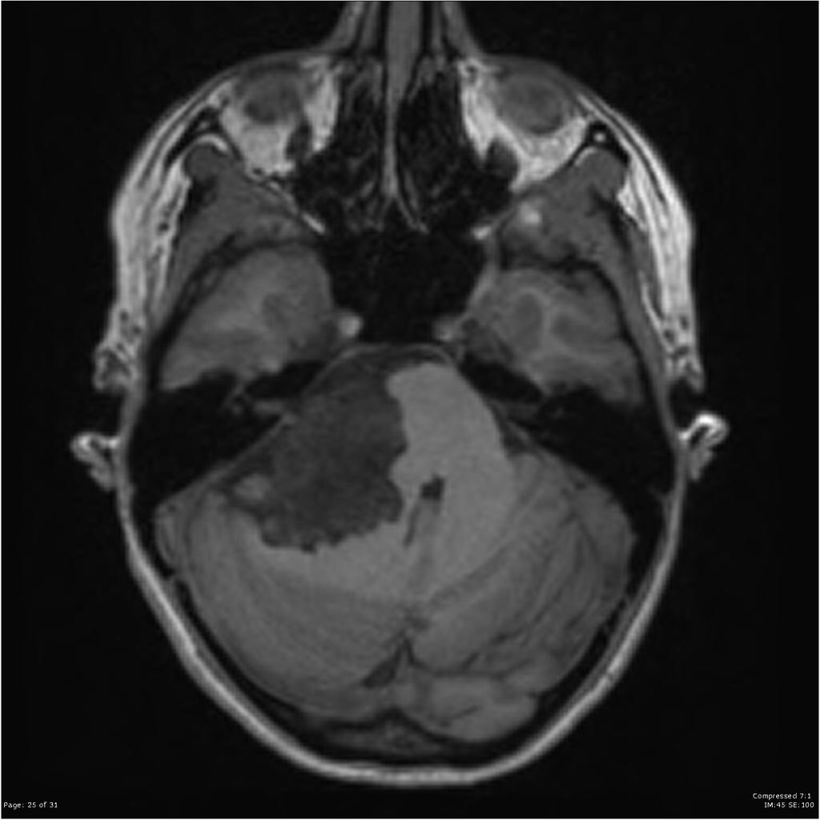
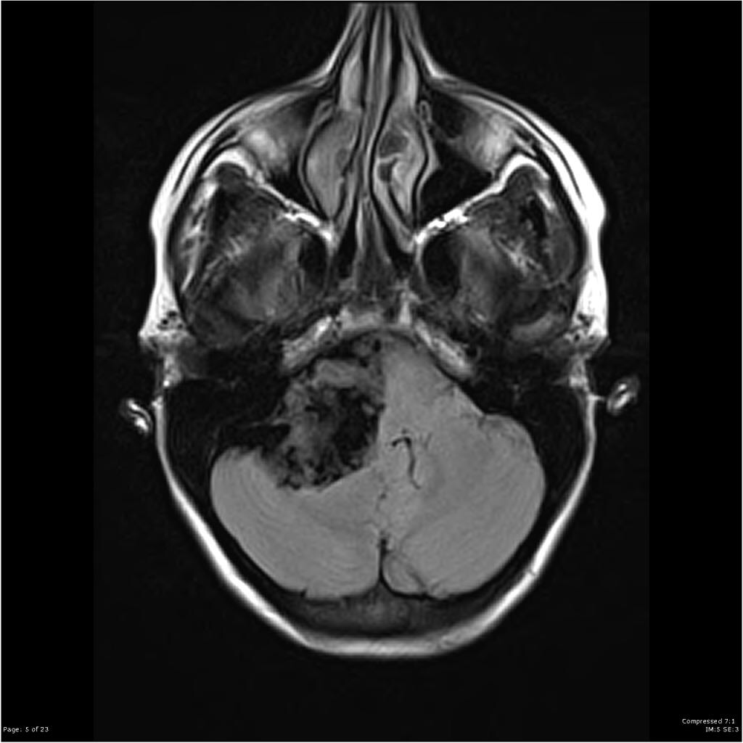
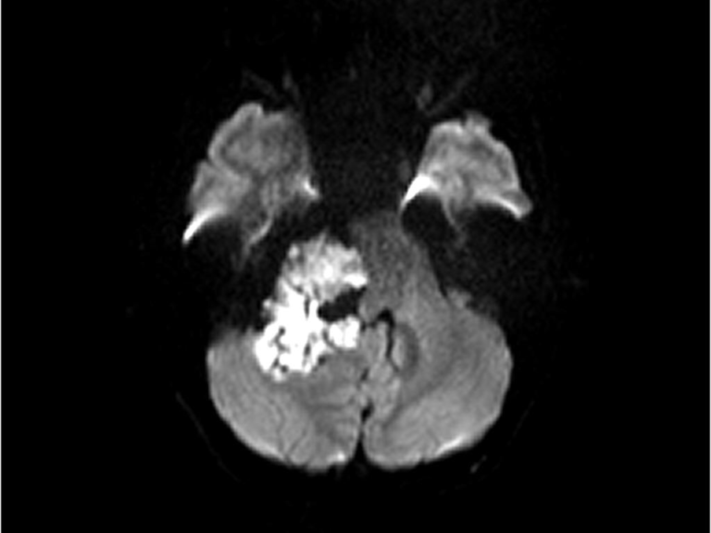
T1-weighted
T2-weighted
FLAIR
DWI

Slide 11
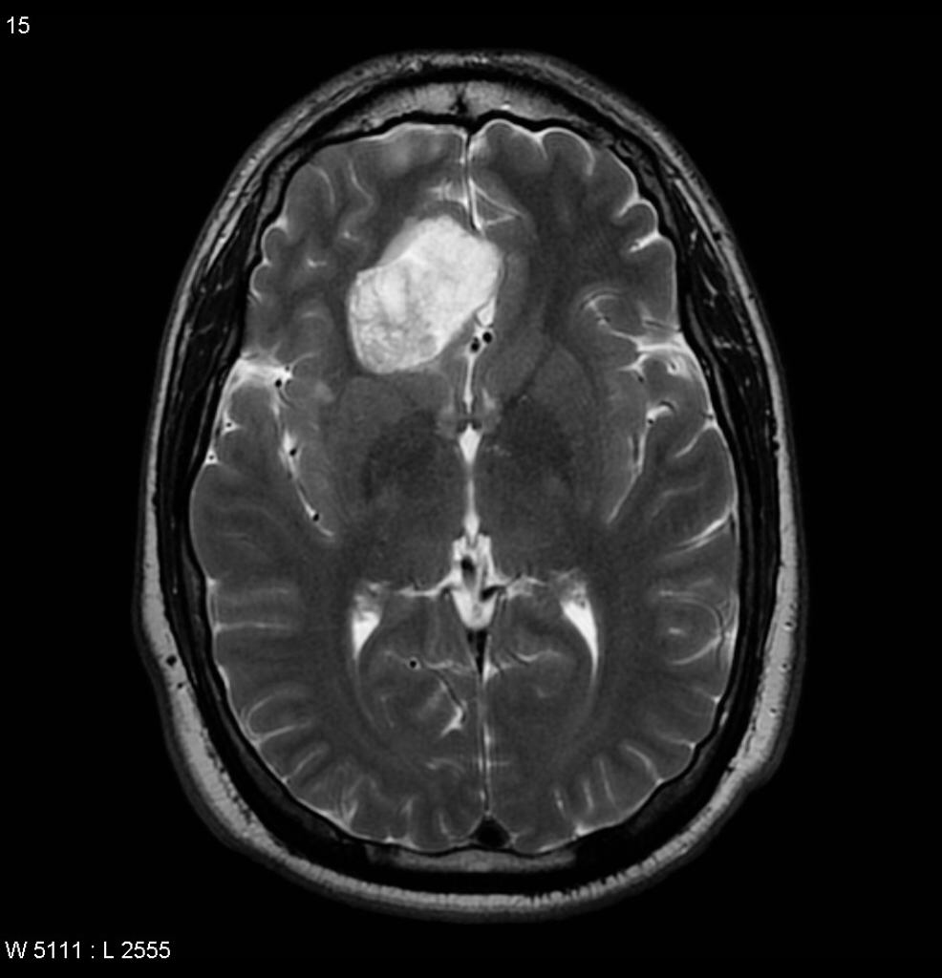
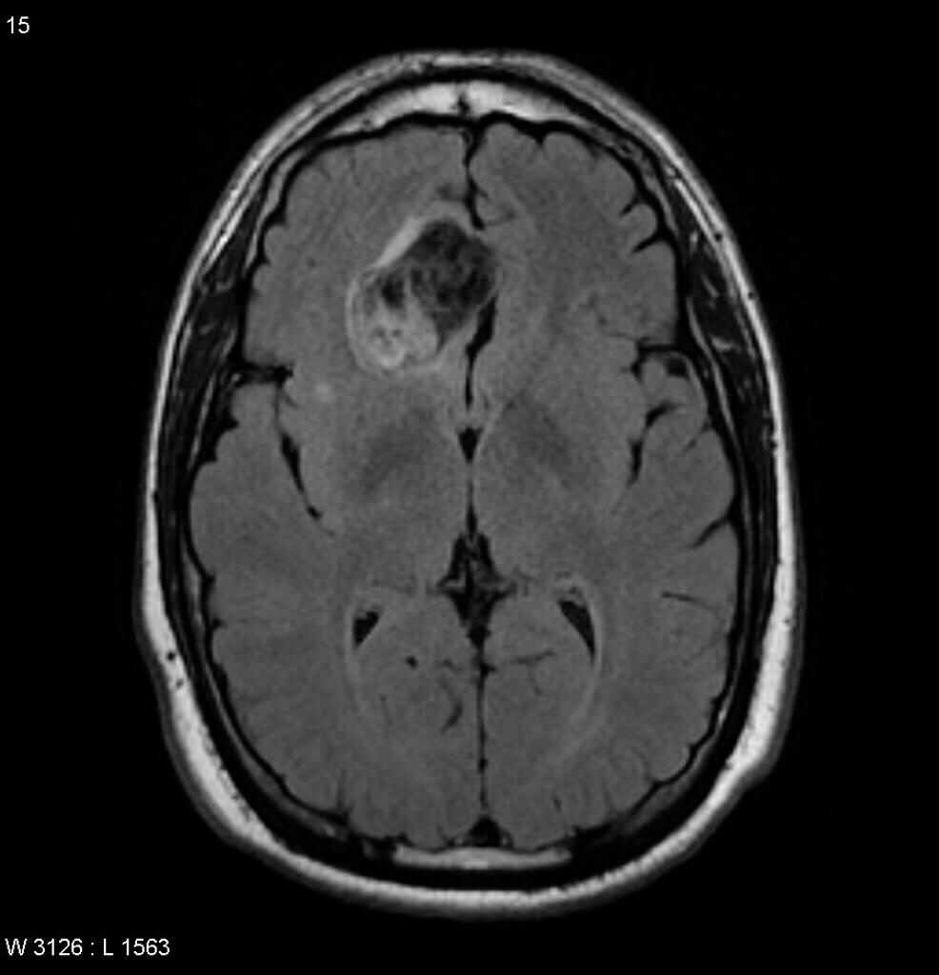
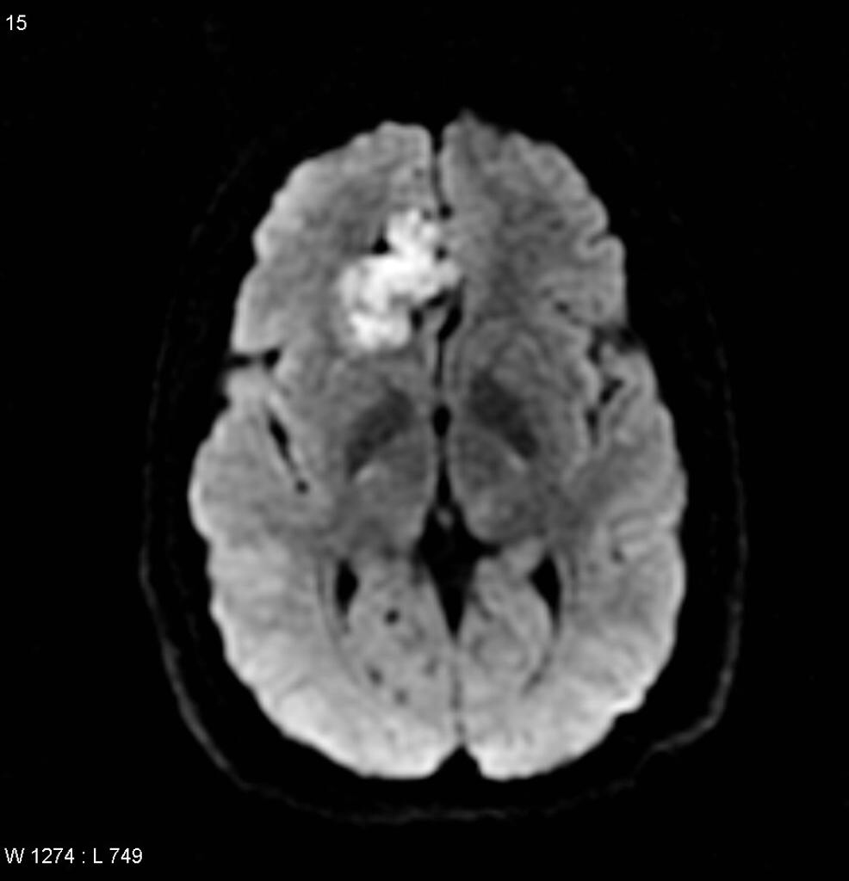
T1-weighted
T2-weighted
FLAIR
DWI

Slide 12
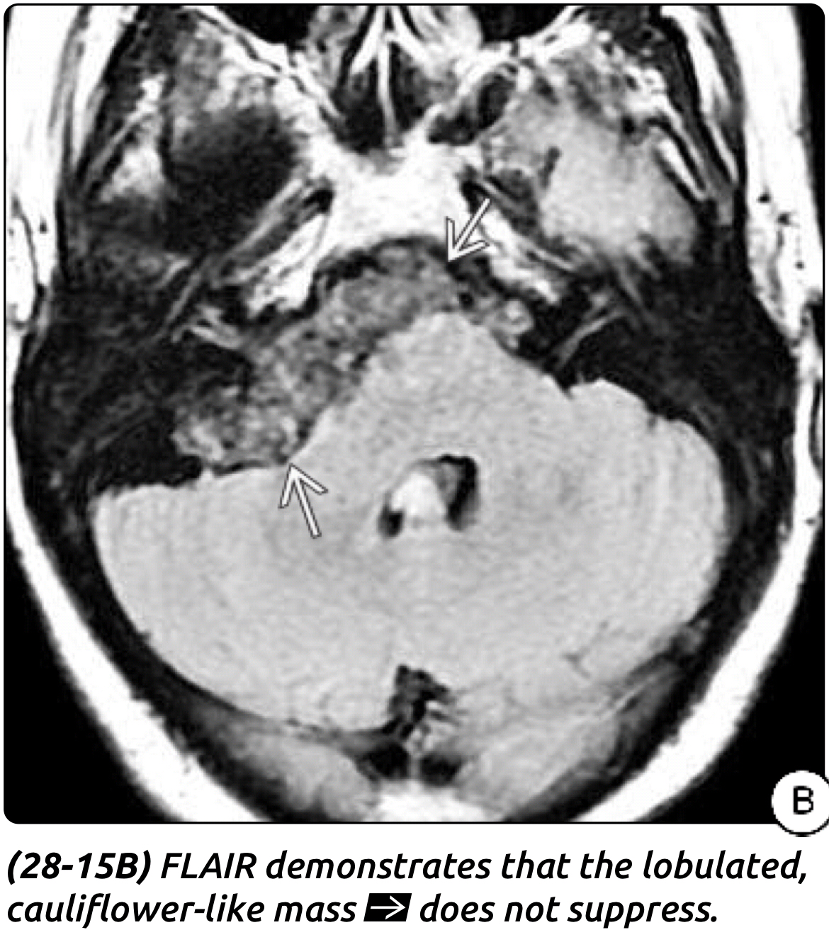
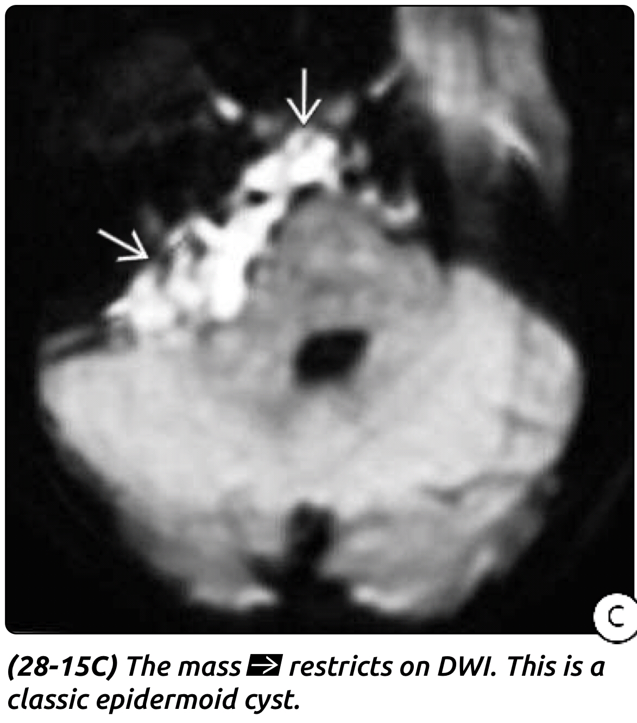

Slide 13
The differential diagnosis includes
Arachnoid cyst:
the most difficult, For the best differentiation we need DWI and FLAIR
AC
suppress in FLAIR and
not restrict in DWI
Rathke’s cleft cyst.
Craniopharyngioma.
Other cystic tumors.

Slide 14
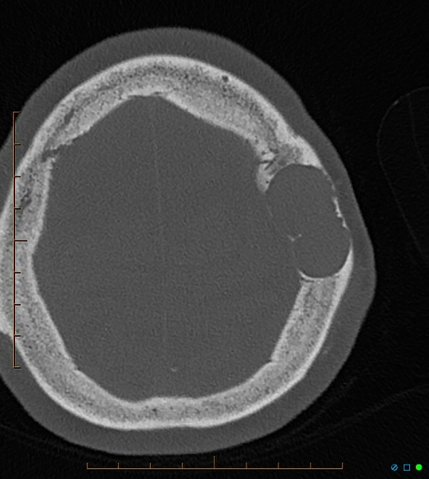
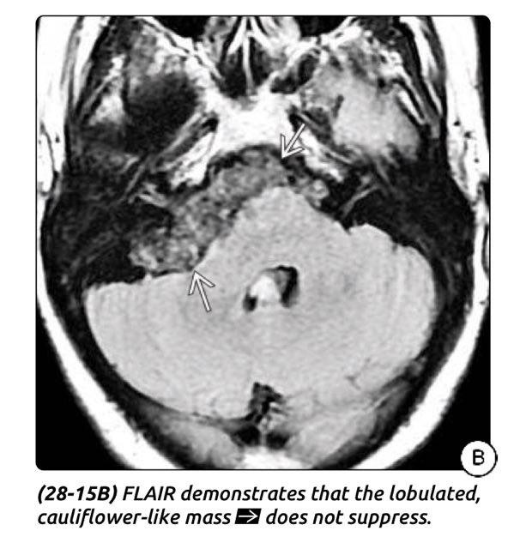
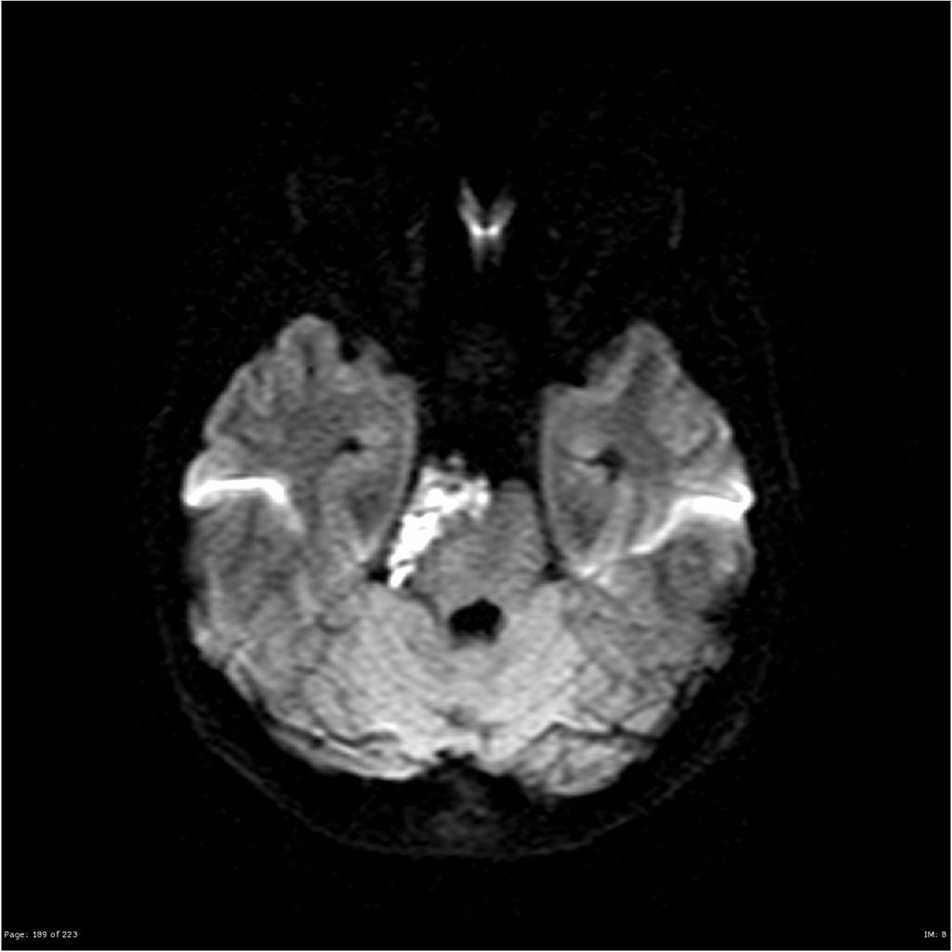
Epidermoid Cyst
DWI
FLAIR
Extradural epidermoid
Arachnoid cyst

Slide 15
Treatment
Symptomatic patients benefit from surgery, which is often technically difficult owing to tumor insinuating itself among adjacent structures.
The tumor is well demarcated, with a smooth hypovascular capsule, The cyst contains characteristic pearly ﬂakes.
Primary intracapsular debulking and subsequent removal of the capsule using the ultrasonic aspirator which is extremely useful.
Fragments of capsule adherent to important structures are left to avoid neural and vascular injury. Although subtotal resection increases the risk of recurrence, the slow growth of epidermoid cysts makes this situation less problematic.
The capsule should not be removed from intramedullary cysts because of the risk of causing neurological deficits.
No role for radiotherapy or chemotherapy in the treatment of epidermoid cyst.

Slide 16
Spinal epidermoid cyst From Radiopedia
Congenital epidermoids usually occur in the thoracic spine, particularly the congenital intramedullary form, and cauda equina.
Acquired cysts are found in the lower lumbar region
Acquired spinal epidermoids are a late complication of lumbar puncture, resulting from implanted epidermal elements into the spinal canal.
Treatment and prognosis
Spinal epidermoid cysts are slow growing. Surgery is the treatment of choice. Complete excision is usually possible and is curative .
If the cyst wall is tightly adherent to the cord parenchyma, the wall should be left in place, however, this leads to a risk of recurrence

Slide 17
Differential diagnosis
General imaging differential considerations include:
Spinal arachnoid cyst
no restriction on DWI
signal suppression on FLAIR
vertebral anomalies uncommon
Spinal dermoid cyst
usually contains fatty elements
less likely to demonstrate diffusion restriction on DWI
patients are usually younger than 20 years of age
Spinal neurenteric cyst
thoracic and cervical regions most common
usually ventral to spinal cord
associated vertebral anomalies common

Slide 18
Dermoid Cyst
Dermoid cysts are also benign tumors, they share many characteristics with epidermoid cysts.
Whereas epidermoid cysts contain epithelial cell debris and keratin, dermoids contain elements of the dermis, such as hair and hair follicles, and apocrine, sebaceous, or sweat glands.
account for 0.04% to 0.6% of all intracranial tumors.
there is a female predominance.
Presentation:
Patients with dermoid cysts present at a younger age than those with epidermoids with average age of 15 years.
As with epidermoid cysts, the patients may present with local neural deficit, headache, or meningitis.
Dermoid tumors have been reported in association with Klippel-Feil syndrome.

Slide 19
Pathology
Location
DCs are usually extraaxial lesions that are most often found in the midline.
The suprasellar cistern is the most common site, followed by the posterior fossa and frontonasal region.
Gross Pathology:
A dermoid cyst is a thick-walled unilocular cyst lined by stratified squamous epithelium. Sectioned DCs typically contain thick, greasy sebaceous material, keratin debris, and skin adnexa such as hair follicles .
Lipid and cholesterol elements floating on proteinaceous material may be present.

Slide 20
Imaging
CT the lesions are usually hypodense and avascular, and they do not show contrast enhancement.
MRI
characteristics are also similar to those of epidermoids, with perhaps even more signal heterogeneity.
The tumors usually show high signal levels on both T1- and T2-weighted images
Because dermoid tumors are generally more solid than epidermoid tumors, they are less likely to grow in between neurovascular structures, and they tend to demonstrate more of a local mass effect.
Dermoid cysts are usually found at the midline.
Spinal dermoid cysts have manifested as hydrocephalus secondary to fat droplets causing CSF obstruction.
Dermoid cyst rupture can result in three patterns of distribution of the spilled contents, as visualized on MRI.
Most commonly, fat droplets may be seen throughout
subarachnoid
intraventricular
localized dissemination in the sulci, causing widening, perhaps contained by pia or inﬂammatory tissue.
An extradural cranial lesion shows the typical bony erosive changes seen with epidermoids.

Slide 21
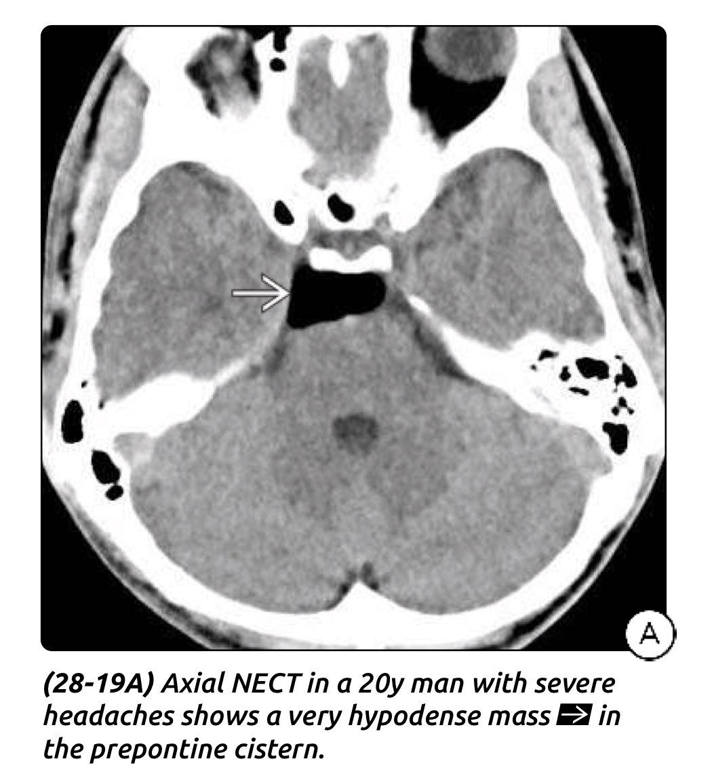
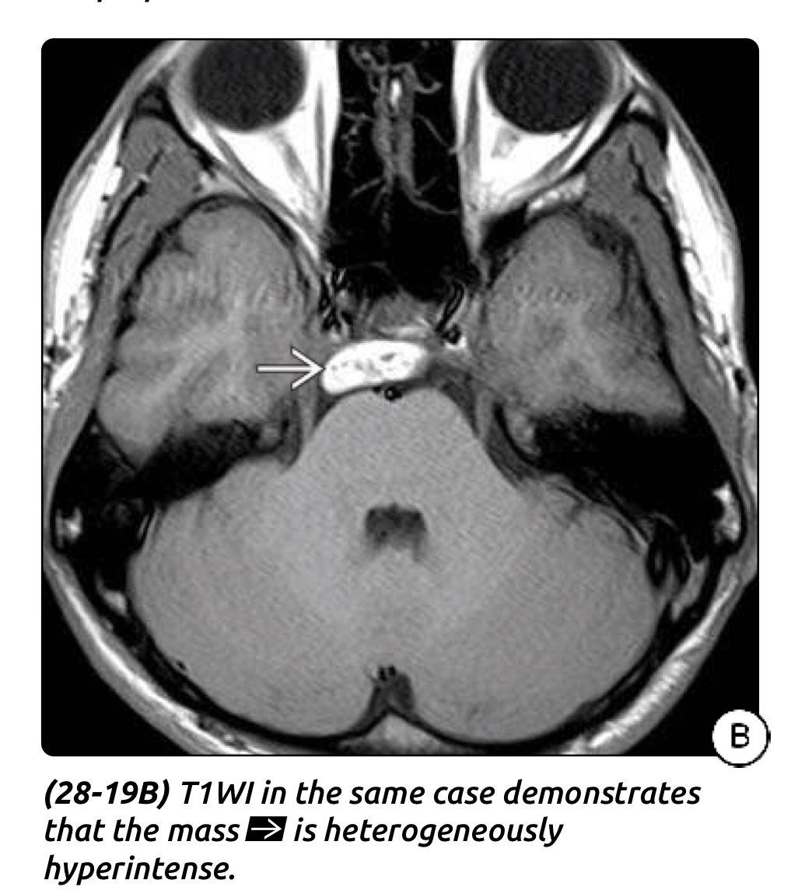
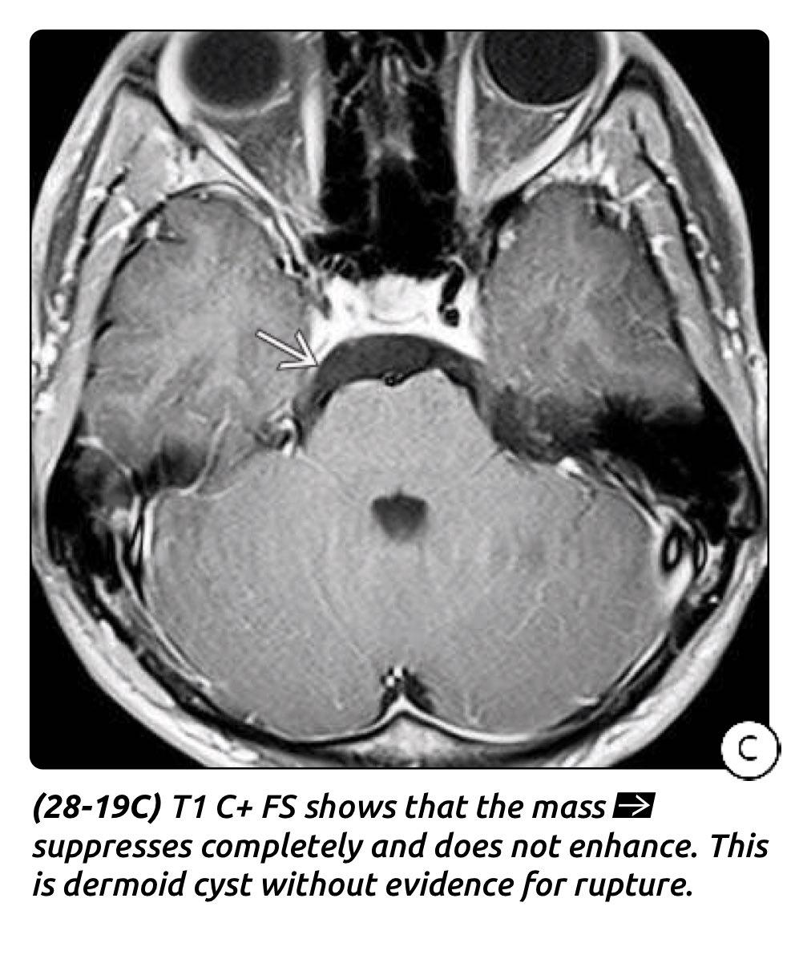
Dermoid Cyst

Slide 22
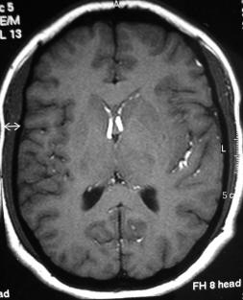
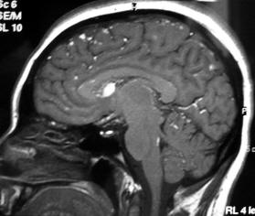
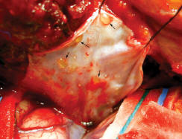
Raptured Dermoid cyst

Slide 23
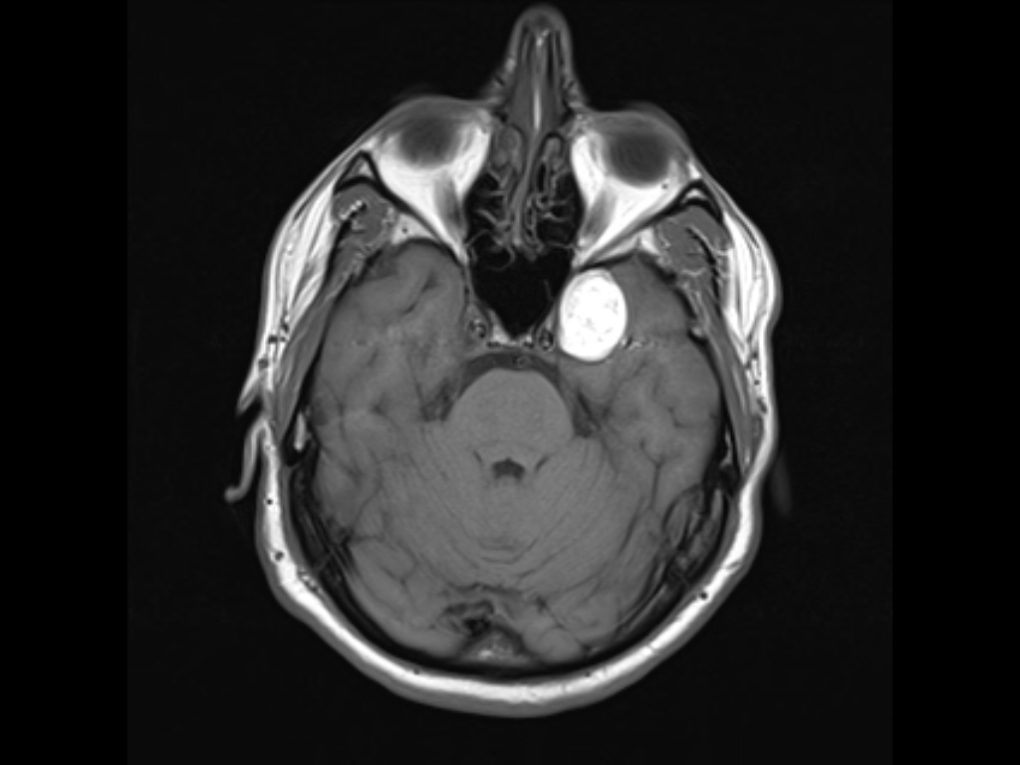
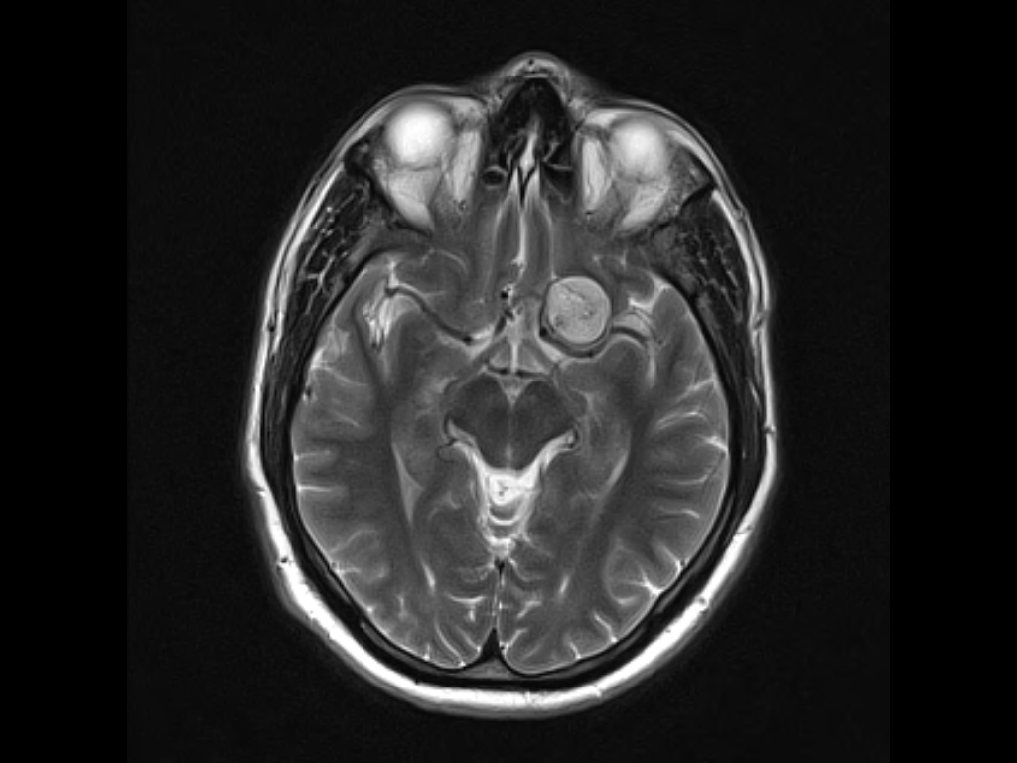
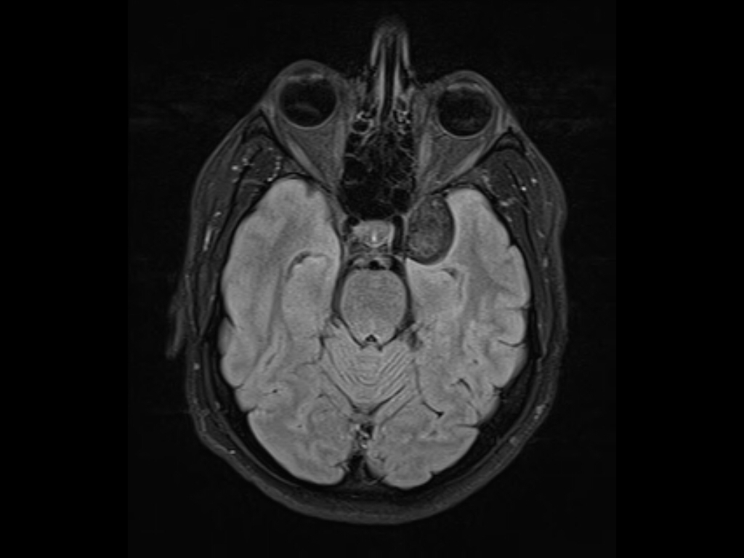

Slide 25
Treatment
Surgical resection is the treatment of choice and may be somewhat less problematic than the removal of epidermoid tumors, due to the firmer consistency of the dermoids.
Complete excision decreases the risk of both postoperative chemical meningitis and tumor recurrence.
There is no current role for radiotherapy or chemotherapy in the treatment of these tumors.
Pathologically, dermoid cysts are benign and demonstrate both dermal and epidermal elements.

Slide 26
Spinal dermoid cyst From radiopedia
Forty percent are intramedullary, and 60% are extramedullary , present in patients younger than 20 years
Spinal dermoid cysts are most often located in the lumbosacral region (60%) and cauda equina (20%)
MRI
T1: hypo or hyperintense
hypointense: water content
hyperintense: due to the presence of fatty secretions of sebaceous glands
T2: hyperintense
FLAIR: hyperintense compared to surrounding CSF
T1 C+ (Gd): no enhancement or mild rim enhancement
DWI: less likely to show diffusion restriction than epidermoid
If rupture occurs, multifocal T1 high signal areas (fat) are demonstrated within the subarachnoid space and/or ventricular system

Slide 27
Differential diagnosis
spinal arachnoid cyst
CSF intensity on all sequences
no restriction on DWI
signal suppression on FLAIR
vertebral anomalies uncommon
spinal epidermoid cyst
does not contain fatty elements
more likely to demonstrate diffusion restriction on DWI
usually present in the second to fourth decades of life
spinal neurenteric cyst
CSF intensity on all sequences
thoracic and cervical regions most common
usually ventral to the spinal cord
associated vertebral anomalies common
spinal lipoma
homogeneously hyperintense on T1 and T2 weighted images
cervical and thoracic regions most common
spinal teratoma
heterogenous appearance on T1 and T2 weighted images (fat, soft tissue, fluid, calcium)
heterogenous enhancement of solid portions
rarely diagnosed in patients older than two years of age

Slide 28
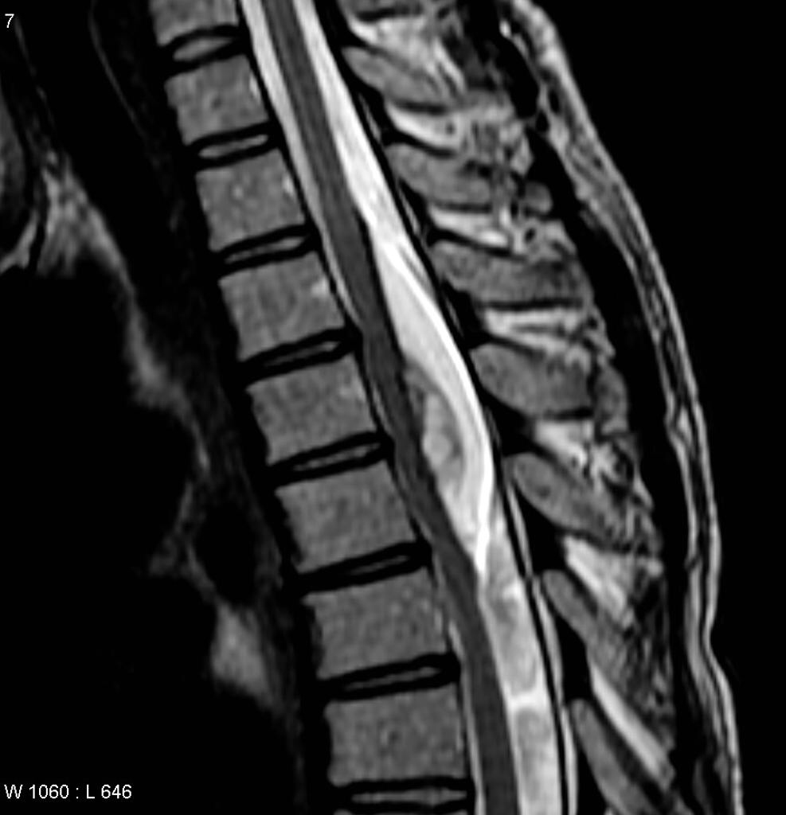
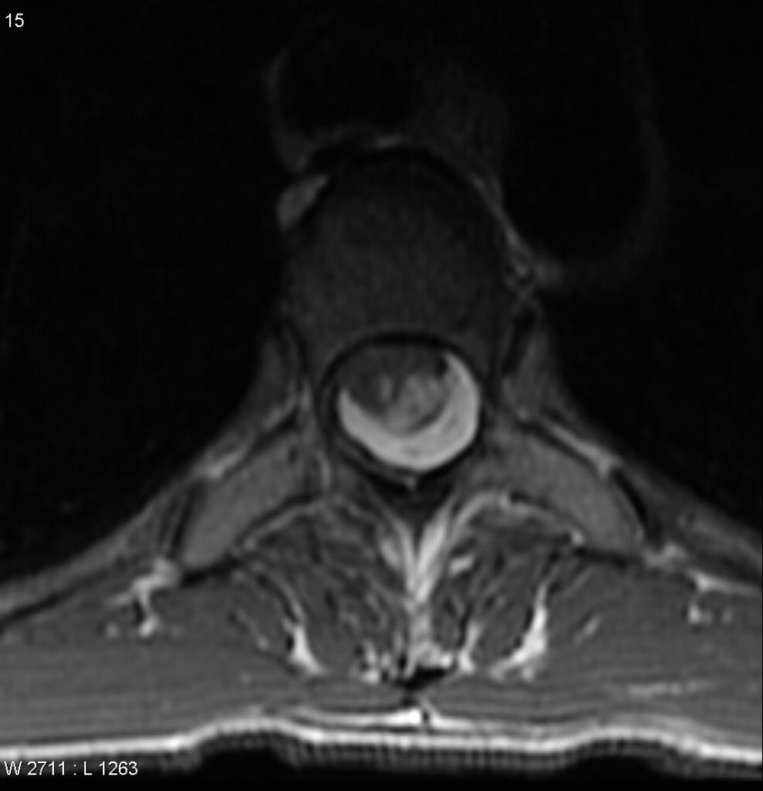
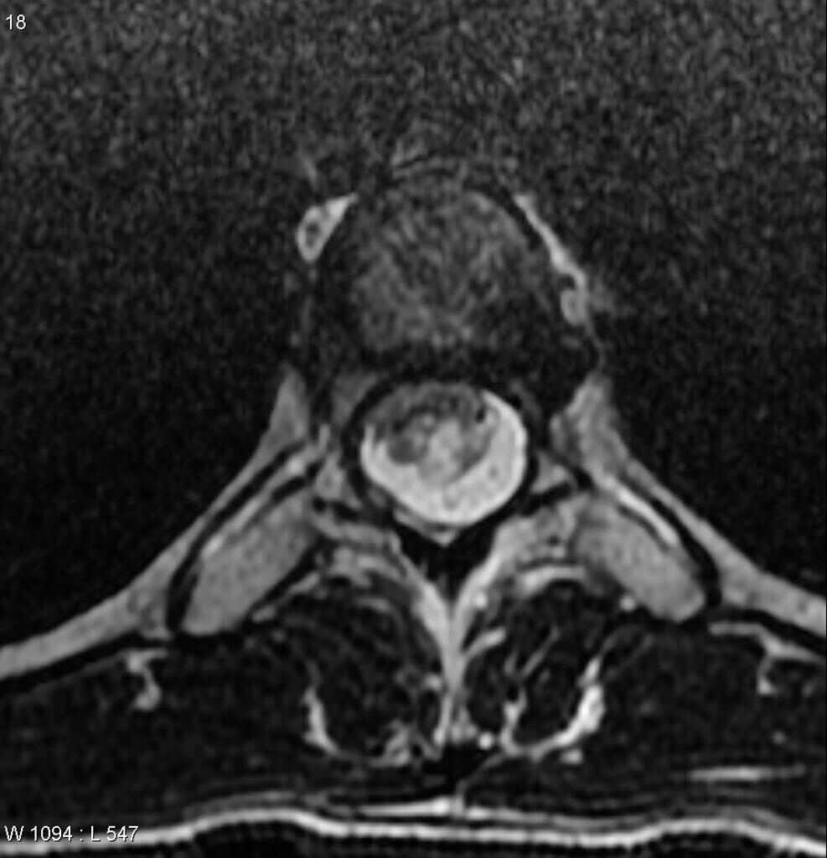
T1
T2
T1
T2

Slide 29
NEURENTERIC CYSTS (Enterogenous cysts, Neuroepithelial cysts)
They are usually extra-axial (cranial),and extra-medullary (spinal) location.
Also called gastrocytomas, and foregut cysts
Pathology
neurenteric cyst is a benign tumor. The cyst wall is composed of well-differentiated cuboidal, columnar, or ciliated epithelium, with or without goblet cells or microvilli , Mucin containing cells show a positive reaction with periodic acid–Schiff stain PAS and are seen in 75% to 80% of specimens.
Presentation
the disease course in adults is slow; the progression is more rapid in children. Patients may present with recurrent meningitis (chemical).

Slide 30
Imaging
The cysts often parallel the CSF signal intensity on T1- and T2-weighted images with no enhancement.
Intracranial neurenteric cysts have been located primarily in the PF , midline 4th ventricle , CPA , sometimes in the parasellar region.
Spinal neurenteric cysts
are almost pathognomonically associated with vertebral anomalies (cleft vertebrae, hemivertebrae, spina bifida, absence of vertebrae, fused vertebrae, and diastematomyelia )
Spinal neurenteric cysts, particularly in the low cervical or high thoracic region
more common than intracranial neurenteric cysts.
Up to 5% of patients with Klippel-Feil syndrome and vertebral fusion abnormalities may have neurenteric cysts and fistulas.
Spinal neurenteric cysts are seen ventral or dorsal to the spinal cord and are rarely intramedullary.
Treatment of these lesions is primarily surgical.

