Slide 1
Craniosynostosis Youmans Chap.192

Slide 2
Normal development
Fontanelles
Anterior fontanelle: the largest fontanelle. Diamond shaped at birth. Normally closes by age 2.5 yrs.
Posterior fontanelle: triangular. Normally closes by age 2–3 mos.
Sphenoid and mastoid fontanelles: small, irregular. Normally, former closes by age 2–3 mos, latter by age 1 yr.
Cranial vault
Growth:
Largely determined by growth of brain. 90% of adult head size is achieved by age 1 yr; 95% by age 6 yrs.
Growth essentially ceases at age 7 yrs.
By end of 2nd yr, bones have interlocked at sutures and further growth occurs by accretion and absorption.
Diplöe appear by 4th yr and reach a maximum by age 35 yrs (when diploic veins form).
Mastoid process: formation commences by age 2 yrs, air cell formation occurs during 6th yr.

Slide 3
Craniosynostosis
The premature fusion of calvarial sutures, classified as being syndromic or nonsyndromic based on phenotypic descriptions.
Nonsyndromic type is more common variant, often had single-suture synostosis without other abnormalities.
Syndromic type often had multiple sutures fused, other associated skeletal abnormalities, and a strong family history.
The inheritance pattern in familial cases tends to be autosomal dominant except (Carpenter’s syndrome) is autosomal recessive.
The most commonly implicated genes in syndromic craniosynostosis are those of the fibroblast growth factor (FGF) and its receptors (FGFRs).
The most commonly affected is the sagittal suture, followed by the unilateral coronal, bilateral coronal, metopic, and lambdoid sutures.
Surgical treatment of the cranial vault alone results in improvement of not only cranial vault but also cranial base pathology (indicates that removing the abnormal influence in the cranial vault suture may improve cranial base shape).

Slide 4
Nonsyndromic Craniosynostosis
OPERATIVE TIMING AND APPROACHES
Sagittal synostosis results in a progressively longer skull, but because the width also increases, the shape does not change as it should, resulting in a marked increase in the deformity.
Preferably within the first 3–6 months of life.
Scapho means “skiff” or “boat,”
dolicho means “long,”
trigono means “triangular,”
brachy means “short,”
plagio means “oblique.”

Slide 5
Diagnosis
The diagnosis of CSO may be aided by:
Palpation of a bony prominence over the suspected synostotic suture.
Gentle firm pressure with the thumbs fails to cause relative movement of the bones on either side of the suture.
Plain skull X-rays:
Lack of normal lucency in center of suture.
Beaten copper calvaria, sutural diastasis and erosion of the sella may be seen in cases of increased ICP.
CT scan:
helps demonstrate cranial contour
show thickening and/or ridging at the site of synostosis
demonstrate hydrocephalus if present
show expansion of the frontal subarachnoid space
three-dimensional CT may help better visualize abnormalities
MRI: usually reserved for cases with associated intracranial abnormalities.
Measurements, such as occipito-frontal-circumference may not be abnormal even in the face of a deformed skull shape.

Slide 6
Some cases of “synostosis” are really deformities caused by positional flattening (lazy lambdoid) If this is suspected,
instruct parents to keep head oﬀ of flattened area and recheck patient in 6–8 weeks: if it was positional, it should be improved, if it was CSO then it usually declares itself.
Primary CSO is usually a prenatal deformity.
Etiologies of secondary CSO include:
Metabolic (rickets, hyperthyroidism).
Toxic (drugs such as phenytoin, valproate, methotrexate).
Hematologic (sickle cell, thalassemia).
Structural (lack of brain growth due to e.g. microcephaly, lissencephaly, micropolygyria).

Slide 7
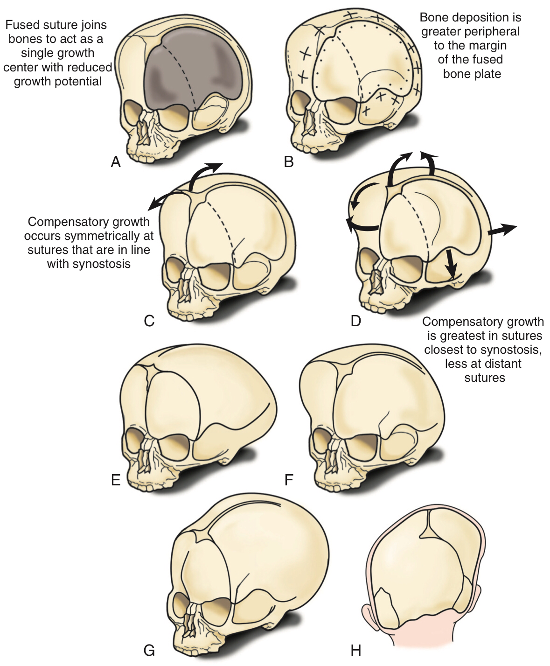
Fused left coronal suture (dashed line) joining the frontal and parietal bone, which act as a single growth center (bone plate) with reduced growth potential.
The margin of the abutting sutures peripheral to the “fused bone plate” deposits a greater amount of bone at the suture (plus signs) than at the margin of the suture adjacent to the fused bone plate (dots).
Compensation for restricted skull growth occurs symmetrically at sutures that are “in line” with the fused suture.
The greatest degree of compensation occurs in sutures closest to the fused suture (curved arrows), and the least degree occurs in sutures distant from the affected suture (straight arrow).
Sagittal synostosis.
Coronal synostosis.
Metopic synostosis.
Lamboid synostosis.

Slide 9
ETIOLOGY OF NEUROCOGNTIVE DISABILITIES
Mechanisms by which craniosynostosis might affect brain development adversely:
Global intracranial hypertension.
Focal brain hypoperfusion.
Mechanical deformation of neuroanatomic structures.
Elevated ICP is a well-recognized feature of the syndromic forms of craniosynostosis, but it can be occur in cases of single-suture synostosis.
The clinical and radiographic diagnosis of elevated ICP can be problematic.
Funduscopic examination has a high specificity in all age groups but does not have a high sensitivity until children are older than 8 years.
Severe diffuse beaten copper pattern and narrowed basal cisterns, have poor sensitivity regardless of age but high specificity in those younger than 18 months.
Sellar erosion and suture diastasis have high specificity in all ages.

Slide 10
Sagittal Synostosis
Results in a skull shape characterized by
Biparietal narrowing.
Ridging of the sagittal suture.
Bilateral bulging of the frontal or occipital region, or both.
Radiographically, fusion of the sagittal suture is evident.
Usually, one of three varieties of sagittal synostosis predominates:
Anterior compensation: dolichocephaly (elongated skull with high forehead/frontal bossing)
Posterior compensation: scaphocephaly (“boat shaped skull” with prominent occiput).
The “golf tee” or bathyrocephalic deformity.
The most common CSO affecting a single suture. 80% male.
OFC remains close to normal, but the biparietal diameter is markedly reduced.
Many of patients with nonsyndromic sagittal synostosis have elevated ICP.
Preferably operated within the first 3–6 months of life.

Slide 12
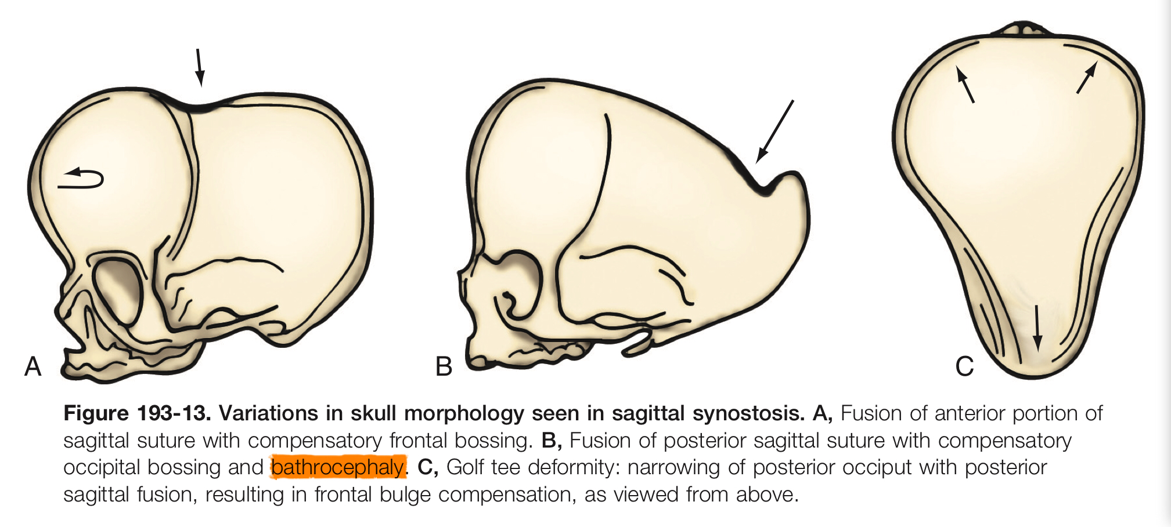

Slide 13
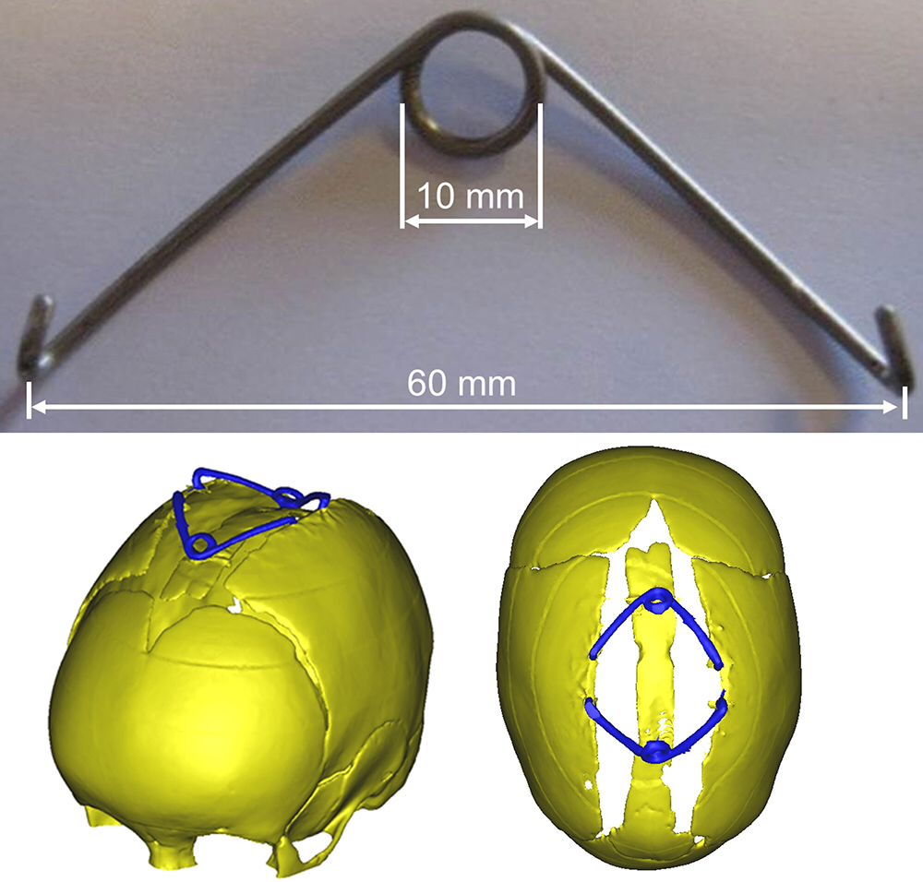
Operative Technique
Anterior type
Milder cases can be successfully treated with removal of the fused sagittal suture and application of distraction devices, such as the spring cranioplasty, to gradually widen the skull.
spring cranioplasty

Slide 14
spring cranioplasty

Slide 15
In more severe cases, a more complete reshaping of the calvarium may be necessary.
After exposure of the skull, the individual sutures (e.g., the coronals, sagittal, and lambdoid) are each removed separately.
The sutures act as points of attachment to the underlying dura and, if not removed, will prevent the overlying bony skull from sliding over the dura during the reshaping process and will result in relapse of the original deformity.
Release of the sagittal suture in particular often results in immediate and spontaneous widening of the entire calvarium as the restraining force of the fused suture is removed.
The frontal bone is removed, especially when significant bossing is encountered, and then radial barrel stave osteotomies are performed and the bone is flattened with a bone bender to remove abnormal curvature of the forehead.
Interpositional bone grafts to widening the skull are harvested and rigidly fixed within the new bone gaps with absorbable plate and screw fixation.

Slide 16
radial barrel stave osteotomies —>

Slide 17
The posterior variety is addressed with a posteriorly oriented modified π procedure.
The bathyrocephalic skull will require removal and reshaping of the occiput, again using radial barrel stave osteotomies and flattening of the abnormal curvature with bone benders.
Shortening of a posterior midline sagittal strut is first performed, and the occipital pieces are then reshaped and fixed to this central strut to recreate the posterior skull.
The width of the strip should be at least 3 cm.

Slide 18
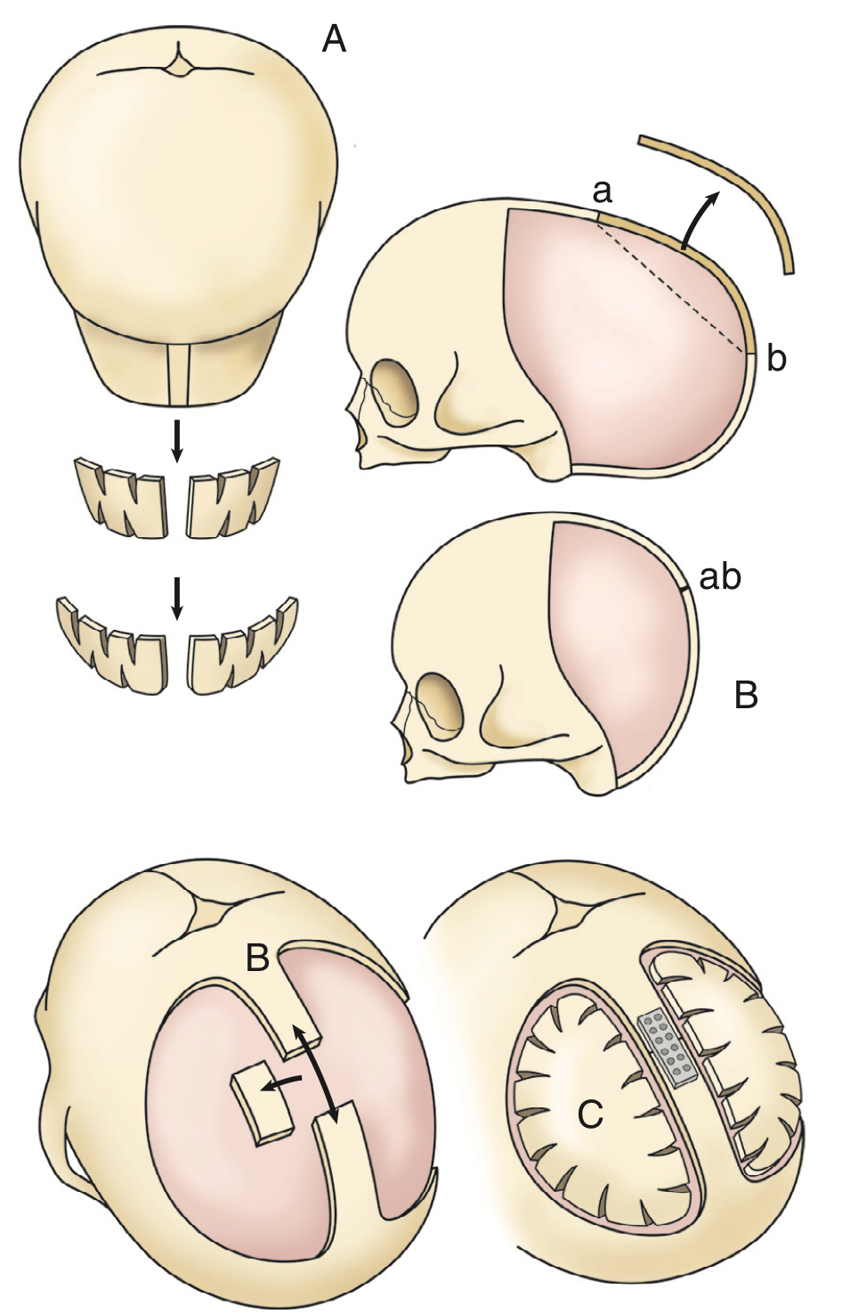
Figure 193-16. Primarily posterior fusion of the sagittal suture.
Posterior π procedure, consisting of occipital craniotomy, parietal craniotomies, and removal of the lambdoid suture to allow forward movement of the occiput. Points “a” and “b” represent the two areas on the skull that come into contact once the intervening bone segment is removed when shortening the sagittal strut.
Shortening of the sagittal strut.
Remodeled bone is returned as the occiput and is fixed to the midline strut.

Slide 19
Unilateral Coronal Synostosis (Anterior Plagiocephaly)
More common in females
Characterized by
Ridging of the prematurely fused half of the coronal suture.
Flattening of the ipsilateral frontal and parietal bones.
Bulging of the ipsilateral squamous portion of the temporal bone.
Bulging of the contralateral frontal and parietal bones.
The bony orbit on the affected side is significantly distorted.
The supraorbital rim is retruded, the vertical axis of the orbit is canted backward and laterally, secondary to the distorted sphenoid wing.
The nasal radix is deviated to the side of the fused suture.
The ear ipsilateral to the fused suture is displaced anteriorly compared with the contralateral ear.
Confirmatory radiographic findings include
The “harlequin” orbit deformity, characterized by elevation of the greater and lesser wings of the sphenoid ipsilateral to the fused coronal suture.
Shortened anterior cranial fossa.
Narrowed sphenopetrosal angle ipsilateral to the fused coronal suture.

Slide 21
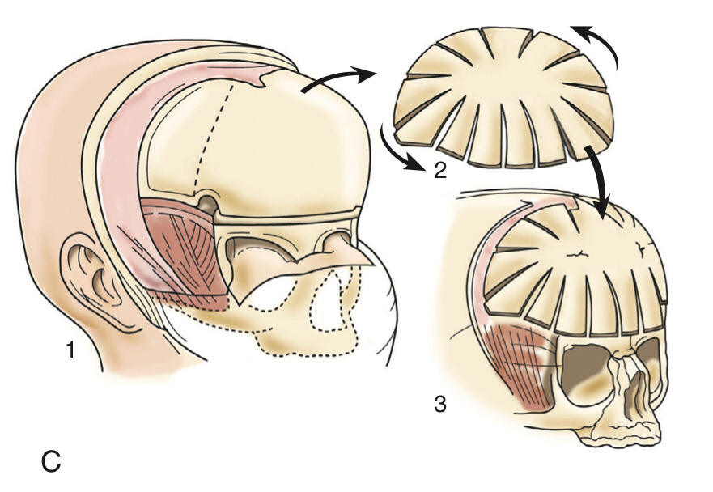
Figure 193-9. Unilateral coronal synostosis correction. A, Bone graft to correct the orbit shape mismatch. B, Ipsilateral supraorbital unit advancement and contralateral unit recession combined with a forward tilt of the entire unit. C, Bifrontal bone reshaping with radial osteotomies and switch.

Slide 22
Bilateral Coronal Synostosis (Turribrachycephaly)
Characterized by
Ridging of the coronal suture.
Flattening of the caudal portion of the frontal bones (Acrocephaly) and supraorbital ridges.
Bulging of the cephalad portion of the frontal bones.
The occiput is flattened.
The squamous portion of the temporal bones is unusually prominent.
The vertex of the skull is more anteriorly situated than normal.
Radiographically.
Bilateral harlequin abnormalities are present in the orbits.
Shortened anterior cranial fossae and bilaterally narrowed sphenoid petrosal angles.
This characteristic head shape is referred to as turribrachycephaly to describe the excessive vertical height, increased overall width, and often severely truncated anteroposterior dimension of the skull.
In more severe cases, orbital proptosis may occur, with both eyes appearing to bulge out owing to inadequate volume within the bony orbital sockets.

Slide 25
Metopic Synostosis(Trigonocephaly)
Characterized by
Metopic suture ridging.
Bilateral lateral retrusion of the frontal bones.
Anterior displacement of the coronal sutures.
Lateral flaring of the posterior parietal regions.
Hypotelorism (abnormal decrease in the distance between the two eyes).
Flattening of the supraorbital ridges.
Viewed from above, the skull has a characteristic triangular shape known as trigonocephaly.
More common in males.

Slide 27
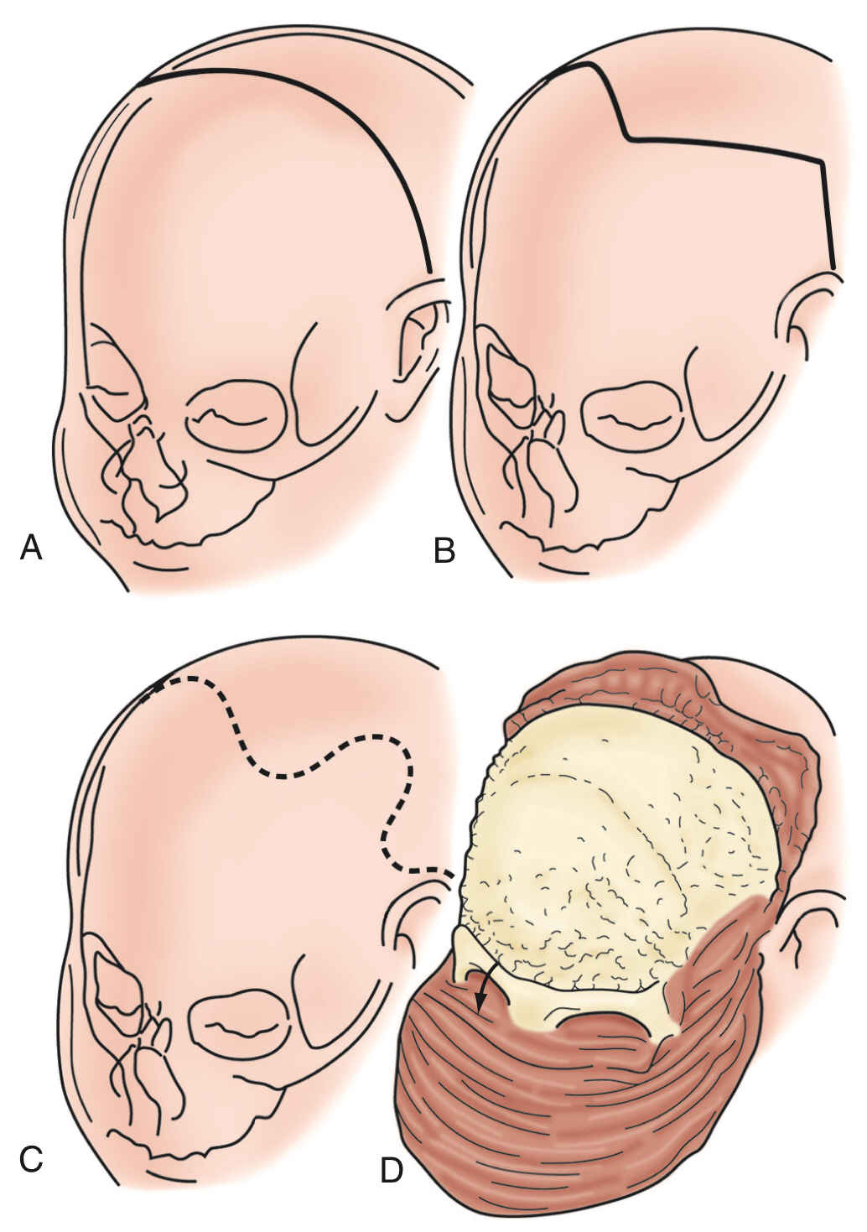
Figure 193-5. Scalp incisions.
Bicoronal skin incision.
Zigzag
wavy coronal incision provides greater access to the anterior and posterior skull, as well as a more acceptable scar owing to hair coverage.
Reflection of anterior scalp flap with subperiosteal dissection in the supraorbital region.

Slide 28
Figure 193-6. Early metopic synostosis.
Extent of bifrontal craniotomy.
Removal of lateral portion of greater wing of the sphenoid bone (intracranial view).
Osteotomy at the junction of the inferior orbital rim and the zygoma, extending superiorly along the inside of the lateral orbital rim.
Extension of the osteotomy laterally to create “tenons.”
Osteotomy across orbital roof into superior orbital fissure, staying anterior to clinoid and cribriform plate.
Completed and removed single supraorbital unit.
Reshaping of the supraorbital unit with burring of inner table and bending with Tessier bone benders.
Placement of interpositional bone graft only if severely hypoteloric.
Advanced lateral orbital rims with fixation at tenon extensions.
Bifrontal bone reshaping with radial barrel stave osteotomies.

Slide 30
Lambdoid Synostosis(Posterior Plagiocephaly)
More common in males (male:female = 4:1).
Involves the right side in 70% of cases.
Usually presents between 3–18 months of age, but may be seen as early as 1–2 months of age.
If synostosis has occurred unilaterally (Posterior Plagiocephaly) characterized by
Assymmetrical occipit.
Flattening of the occiput ipsilateral to the fused suture.
Contralateral bulging evident in the parietal occiput or mastoid region.
The ipsilateral ear is pulled backward toward the fused suture.
If bilateral synostosis has occurred,
Symmetrical flattening of the occiput is seen.
If the synostosis is severe, skull deformities in the frontal region, which may include elevation of the vertex of the skull, are evident.
Mild to moderate forms with late closure of the suture rarely manifest obvious deformities from the frontal view and, as such, do not require surgical correction.

Slide 31
Mimic: “lazy lamboid” (positional flattening).
Lambdoid synostosis must be distinguished from positional flattening, the so-called “lazy lambdoid.”
Flattening of the occiput here is associated with
Anterior displacement of the ipsilateral ear.
Bulging of the ipsilateral cheek and forehead.
Positional flattening (or molding) may be produced by:
Decreased mobility: patients who constantly lie supine with the head to the same side, e.g. cerebral palsy, mental retardation, prematurity, chronic illness.
Abnormal postures: congenital torticollis , congenital disorders of the cervical spine.
Intentional positioning: due to the recommendation to place newborns in a supine sleeping position to reduce the risk of sudden infant death syndrome (SIDS), sometimes with a foam wedge to tilt the child to one side to reduce the risk of aspiration.
Intrauterine etiologies: intrauterine crowding (e.g. from multiparous births or large fetal size), uterine anomalies.

Slide 34
OPERATIVE COMPLICATIONS
The most serious problems associated with cranioplasty procedures are
Blood loss.
Air embolus.
Infection.
Sinus and dural tear.
CSF leak.

Slide 35
Non-synostotic Plagiocephaly
Youmans Chap. 196

Slide 36
The sutures remain open in infants with plagiocephaly without synostosis
Causes
Positional (Supine).
Multiple pregnancies.
Intrauterine abnormalities.
Presentation
Skull deformity: many will exhibit a form of cranial scoliosis, appearing like a “windswept deformity” whereby the vertex of the cranium is pushed off to one side above the ears.
Torticollis where the neck is tilted to the side (95% of referrals for torticollis presented with plagiocephaly or facial asymmetry).
Ophthalmologic findings of unilateral or bilateral astigmatism.
Developmental delay.

Slide 37
Treatment
Conservative or nonoperative.
These include
Sleep repositioning,
Neck stretching exercises to reduce torticollis,
Physical therapy,
Craniosacral massage, external orthotic molding devices
Neck stretching exercises
Place the infant supine and slowly rotate the head and neck to the opposite side of the torticollis, bringing the chin within 1 to 2 cm of the shoulder,
This maneuver should be performed for 1 full minute several times daily for 3 to 4 weeks.
Surgical treatment
Indicated when failure of improvement with conservative interventions

Slide 38
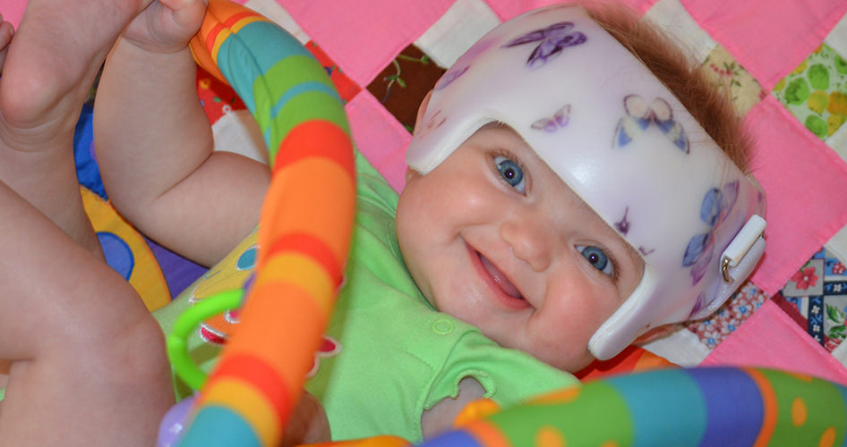
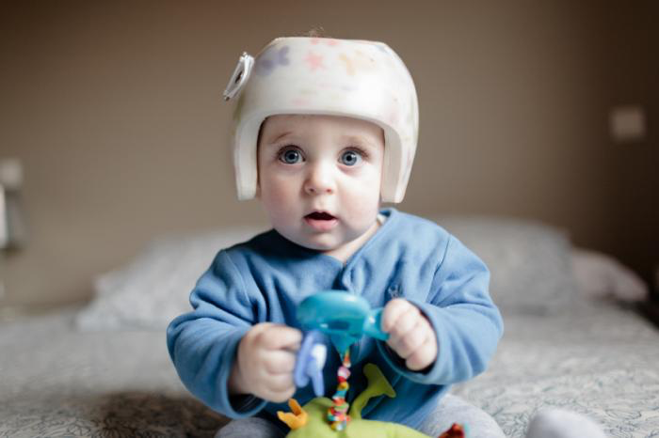
External orthotic molding devices

Slide 39
Syndromic Craniosynostosis Youmans Chap.194

Slide 40
Faciocraniosynostosis accounts for about 15% to 20% of cases.
Crouzon’s, Pfeiffer’s, Apert’s, and Saethre-Chotzen syndromes are the most common conditions.
Skull base anomalies, cerebral malformations, hydrocephalus, upward and downward cerebellar tonsil herniation (CTH), and abnormal venous pattern may occur in most syndromic cases.

Slide 41
Crouzon’s Syndrome
An autosomal dominant disorder.
Mutation of gene FGFR 2 (Fibroblast Growth Factor Receptor)
Crouzonoid syndrome with acanthosis nigricans is a different disorder that is caused by mutation in FGFR 3.
Classical triad:
Bilateral coronal synostosis.
Midfacial hypoplasia.
Exophthalmos.
May also include involvement of
Other calvarial sutures.
Brachycephaly.
Hypertelorism.
Chiari I malformation.
Hydrocephalus.

Slide 43
Pfeiffer’s Syndrome
3 different types based on the severity of deformities:
Type 1
Classical Pfeiffer’s syndrome
Mild entity with autosomal dominant inheritance
Gene mutation FGFR 1
Types 2 and 3
More severe, with early death
Sporadic inheritance
Gene mutation FGFR 2
Features include
Coronal synostosis (cloverleaf skull).
Broad fingers and toes, and partial syndactyly of the fingers and toes.
they may also include maxillary hypoplasia, small nose with a low nasal bridge, hypertelorism, shallow orbits, proptosis, strabismus, limb malformation, and radiohumeral synostosis.

Slide 45
cloverleaf skull

Slide 46
Apert’s Syndrome
Autosomal dominant
Gene mutation FGFR 2
Characterized by
Coronal synostosis
Severe syndactyly in the fingers and toes
Radiohumeral fusion
Mental retardation

Slide 48
Saethre-Chotzen Syndrome
Autosomal dominant
Gene mutation TWIST
Characterized by
Bilateral coronal craniosynostosis.
Limb abnormalities (syndactyly of the second and third digits, bifid hallux)
Facial abnormalities (facial asymmetry, low frontal hairline, ptosis, small ears with prominent aural crura)

Slide 50
FUNCTIONAL ASPECTS
Brain Malformation
Callosal agenesis occur much more frequently in syndromic isolated craniosynostoses ( more common in Apert’s syndrome).
Cerebellar Tonsilar herniation CTH 70% of patients with Crouzon’s syndrome, 50% of patients with Pfeiffer’s syndrome.
Hydrocephalus occurs more frequently in Crouzon’s and Pfeiffer’s syndromes.
HC associated with reduced size of the foramen magnum, especially in Crouzon’s syndrome, in spite of the commonly occurring CTH; this finding differs from that observed in hydrocephalus associated with Chiari type II malformation, in which the foramen magnum is abnormally large.
Optic atrophy and visual loss mainly in patients with Crouzon’s syndrome.
ICP There is a significant relationship between preoperative elevated ICP and decreased IQ level.
Mental retardation is common in patients with Apert’s syndrome and Pfeiffer’s syndrome.
Mental retardation is rare in Crouzon’s and Saethre-Chotzen syndromes.

Slide 51
SURGICAL INDICATIONS
At an early age, the main indication for surgery is to
Prevent intracranial hypertension.
Normalize the cranial volumetric growth.
The functional visual and respiratory abnormalities.
Later, the craniofacial dysmorphy should be corrected to prevent its psychological consequences.
The parameters to be considered for establishing the surgical indications
Abnormalities in ICP dynamics
Focal or global cranial hypoplasia
Hydrocephalus
Upward and caudal CTH; hindbrain compression and distortion
Visual function impairment
Corneal ulcerations
Upper airway obstruction
Mandibular/maxillary, orthodontic, orbit, and facial abnormalities, both morphologic and cosmetic.

Slide 52
Prevention and Correction of ICP
In Apert’s syndrome
The ventricular dilation, commonly present but rarely progressive, and the posterior cranial fossa is competent to accommodate the potential cerebellar growth.
The first therapeutic goal to:
Increase the cranial volume to accommodate brain growth.
Reduce the abnormal growth.
Avoid or at least limit the development of turricephaly.
In Crouzon’s and Pfeiffer’s syndromes
Hydrocephalus is often progressive, and the CSF dynamics is precociously impaired by the hypoplastic posterior cranial fossa.
The first therapeutic goal is
Normalization of the abnormal CSF dynamics.

Slide 53
Craniosynostosis should be addressed first because Placing a CSF shunt, which would reduce the expanding forces of the intracranial content and thus further enable skull stenosis.
The expansion of the posterior cranial vault is the first option because it improves CSF circulation ( decompression of chiari)
Endoscopic third ventriculostomy should be considered if the hydrocephalus persists after cranial expansion.
the correction of the anterior part of the skull is postponed to a later age in order to obtain a better and more persistent cosmetic result.

Slide 54
COMPLICATIONS
Continual blood loss and the risk of sudden massive blood loss.
Temperature control is also essential, particularly in patients younger than 1 year.
Dural tear.
CSF leaks.
Postoperative wound infections
Risk of recurrence of the abnormal skull and facial shape.
Sinus hemorrhage and cortical damage.
Air embolism.

Slide 55
Thank you

