Slide 1
Cranial Dysraphisms
Youmans Chap. 187

Slide 2
Also called Cranium bifidum
Cephalocele a herniation of any of the intracranial contents through a defect in the skull
Encephalocele contains either normal brain or gliotic tissue
Cranial meningocele contains only cerebrospinal fluid (CSF) surrounded by a capsule of arachnoid tissue.
Encephalocystocele when the contents of the herniated sac contain ventricular tissue
Classification according to etiology
  Primary (congenital)
  Secondary (acquired) due to
    Trauma
    Infection
    Inflammation
    Tumor
    Previous surgical procedure

Slide 3
Anatomic classification
Posterior : Temporal, parietal, occipital, and occipitocervical
Anterior : subdivided into
  Sincipital or frontoethmoidal (when the herniation is anterior to the cribriform Plate) divided into 3 region:
    Nasofrontal
    Naso-ethmoidal
    Naso-orbital
  Basal (when the herniation is through the sphenoid sinus) occur with sphenoid wing hypoplasia commonly associated with NF1
    Transethmoidal
    Spheno-ethmoidal
    Transsphenoidal
    Fronto-sphenoidal or spheno-orbital
Occipital and sincipital encephaloceles are usually midline in location.
Temporal encephalocele is located laterally at the pterion.

Slide 4
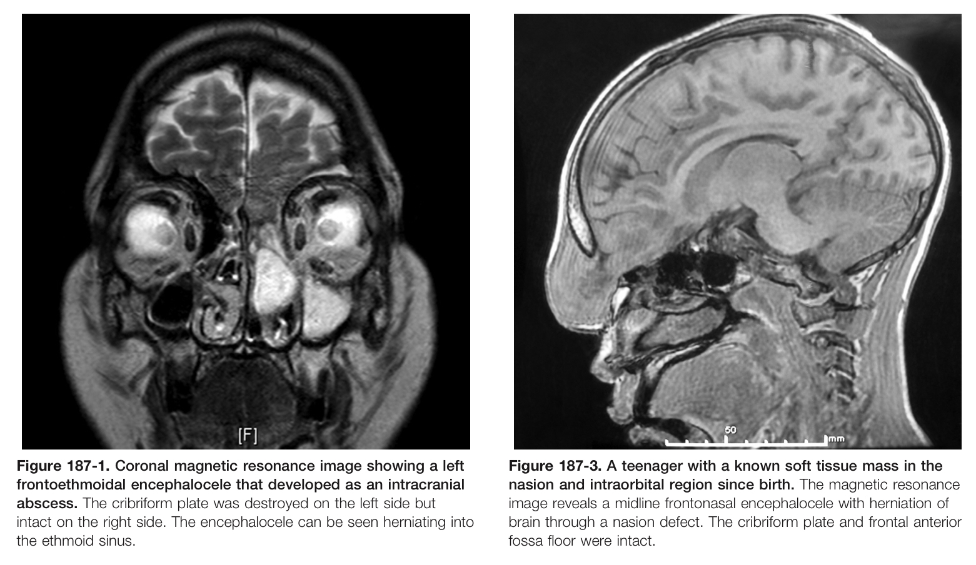
Embryology
Aberrations of development of the foramen cecum is sources of nasal encephaloceles.
Persistent development of a lateral craniopharyngeal canal (Sternberg’s canal) caused by incomplete development of the medial sphenoid bone which can act as gateway for encephaloceles to protrude into the lateral sphenoid sinus.

Slide 5
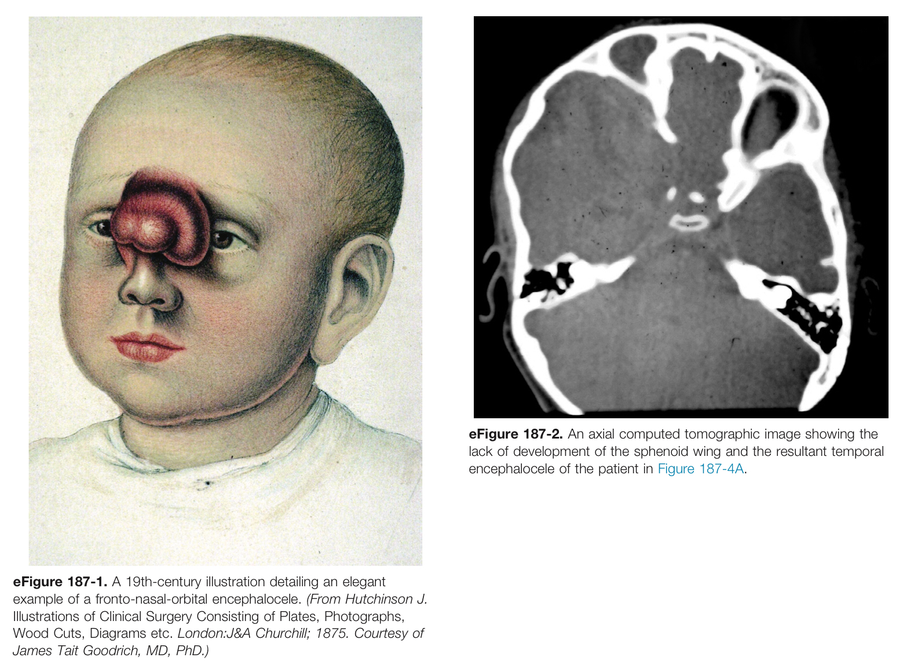

Slide 6
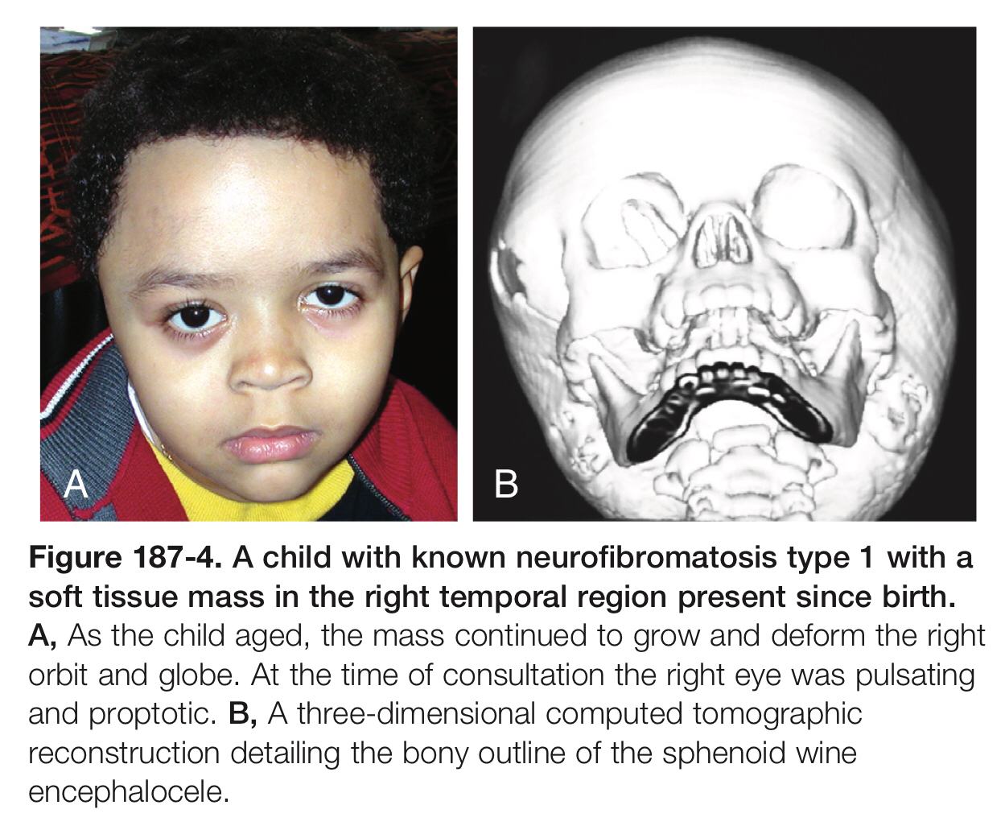

Slide 7
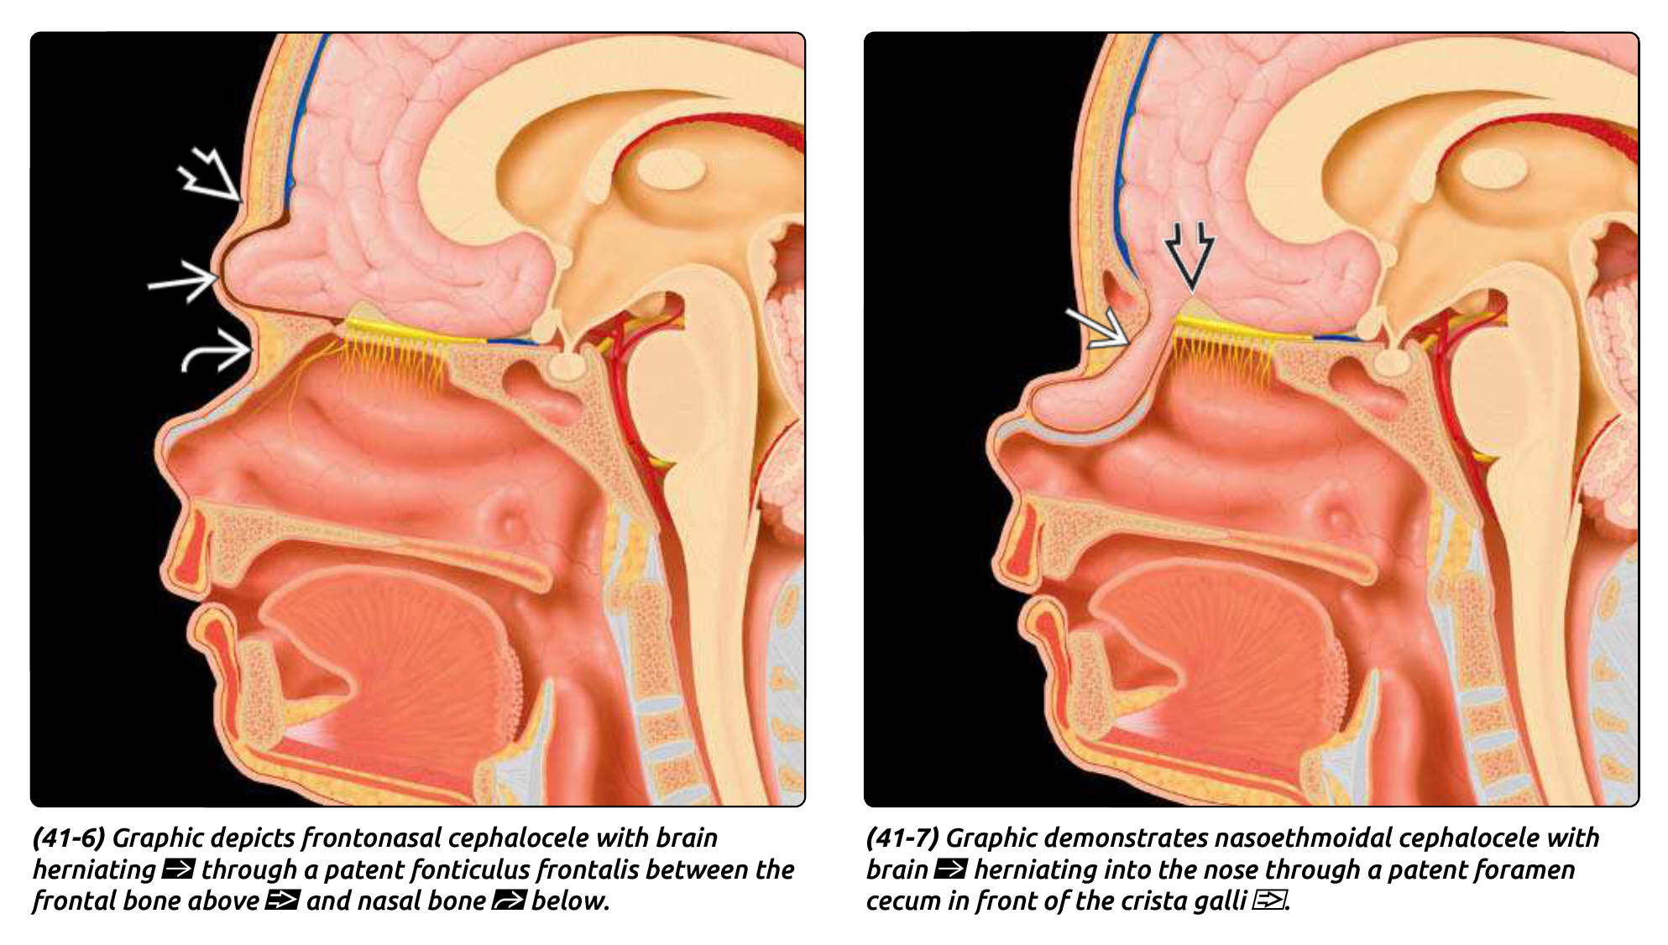

Slide 8
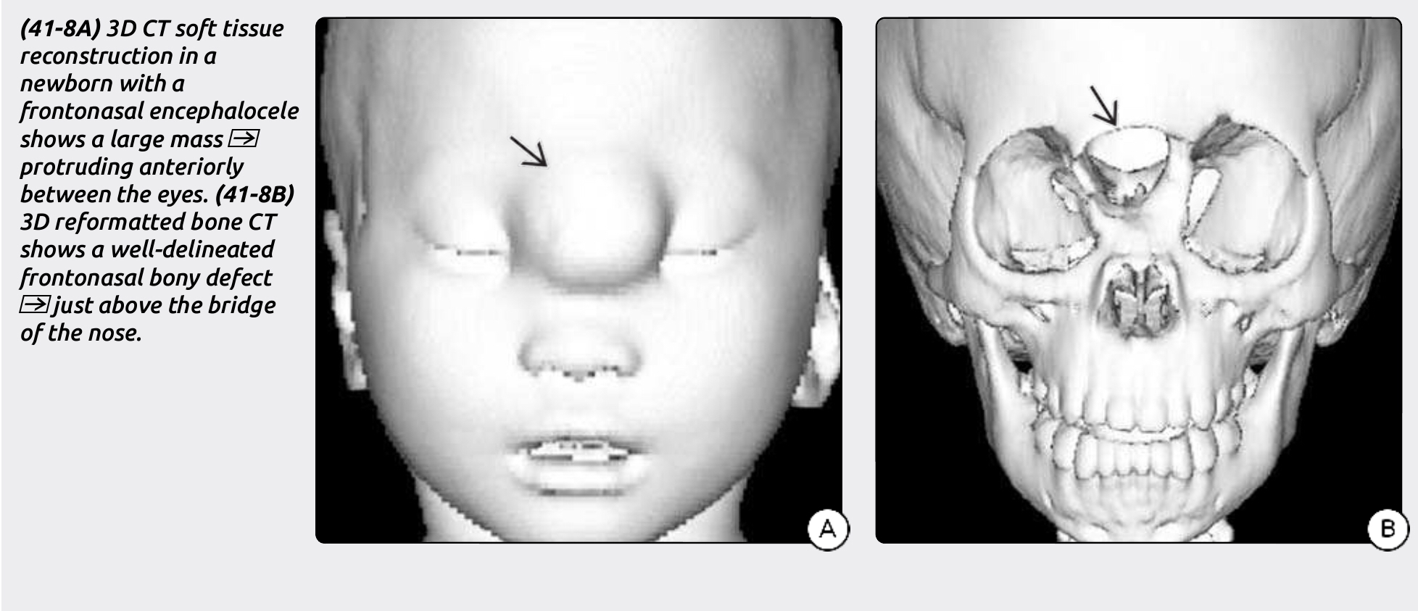

Slide 9
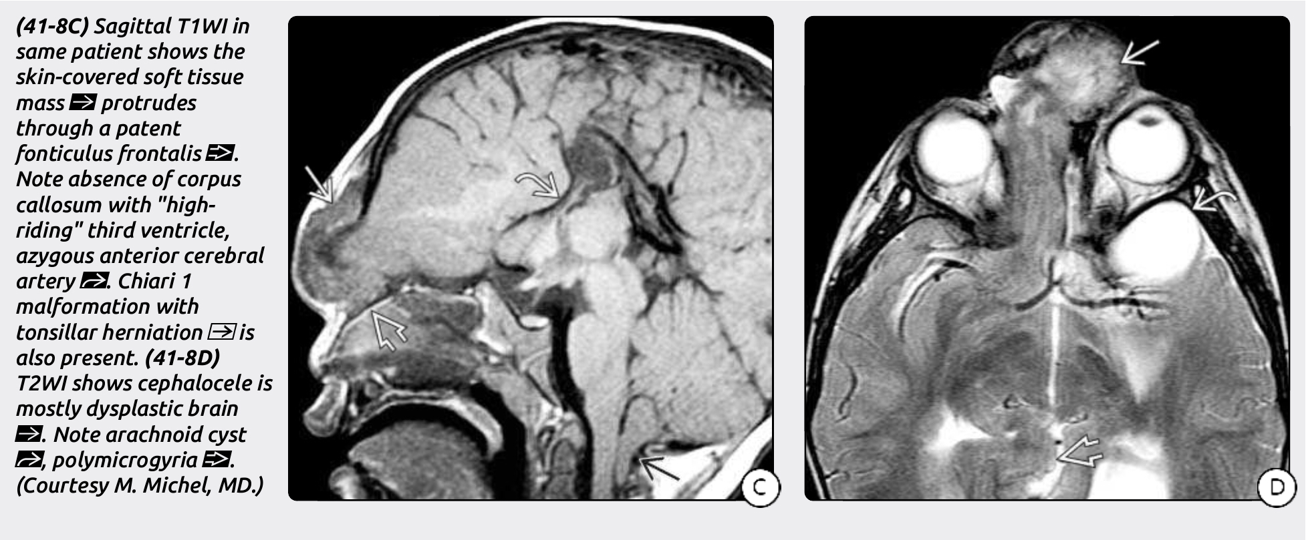

Slide 10
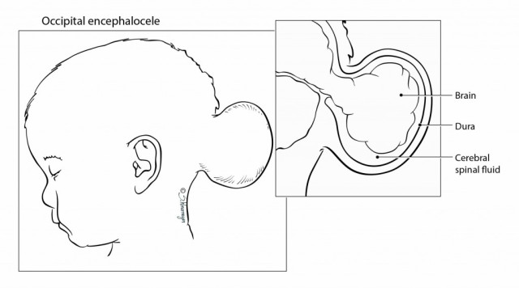
Frontonasal encephalocele

Slide 11
An example of lt. temporal encephalocele
A child with a large occipital encephalocele with almost complete herniation of the brain into the sac

Slide 12
Genetics
Most encephaloceles are believed to be sporadic.
Some are likely related to environmental factors (association of pesticides and excessive tea consumption).
Encephaloceles tend to occur in families with a history of neural tube defects.
Morning Glory syndrome : congenital dysplasia of the optic disk and craniofacial abnormalities, has been found in basal encephalocele.
Diagnosis
  Abnormal maternal serum AFP values
  Prenatal ultrasound
  MRI
  MRV
  3D CT reconstruction : used to evaluate bony defect
  Angiography : useful in delineating specific vessels supply the sac.

Slide 13
Clinical presentation
Sincipital or posterior encephaloceles
  Can be readily apparent at birth as visible masses.
Basal encephaloceles can present as
  Nasal obstruction
  Obligate oral breathing
  Snoring
  Potential CSF rhinorrhea and meningitis
  Purulent nasal discharge
Temporal encephaloceles
  Appear spontaneously in childhood or adulthood, with sudden CSF otorhinorrhea, or with repeated bouts of meningitis.

Slide 14
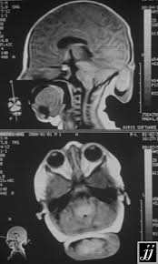
Sagittal MRI of a child with a frontobasal meningocele arising from the sella region and extending to the level of the posterior palate
Sagittal and axial image of an occipital encephalocele

Slide 15
MANAGEMENT
Cesarean section to
  Improve outcomes by minimizing birth trauma and infection risk.
  Recommended in infants presenting with particularly large and solid encephaloceles.
Once the child has been delivered, the encephalocele is wrapped in gauze sponges moistened with physiologic saline solution and covered with a plastic adhesive drape.
It is best to place the newborn child in the prone or lateral position to prevent pressure on the sac.
If the herniating sac has ruptured and is leaking CSF, the lesion should be treated emergently.
Otherwise, most cases of occipital encephaloceles can be managed electively.
Anterior cephaloceles should be treated in early life to
  Prevent further distortion of the facial skeleton during growth.
  Protect against possible development of meningitis.

Slide 16
Encephaloceles and Hydrocephalus
Posterior encephaloceles is generally more common associated with HC than anterior one.
Parietal encephaloceles are associated with dorsal interhemispheric cysts, which can communicate with the ventricles.
Its recommended to treat the hydrocephalus first, as this will facilitate dural reconstruction and decrease the potential for postoperative CSF leaks.
Patients without hydrocephalus initially may develop HC postoperatively after closure of the cranial defect.
Suction sign on post op. imaging may be seen, (where the ventricle and other cranial structures on the involved side extend toward the bony defect)

Slide 17
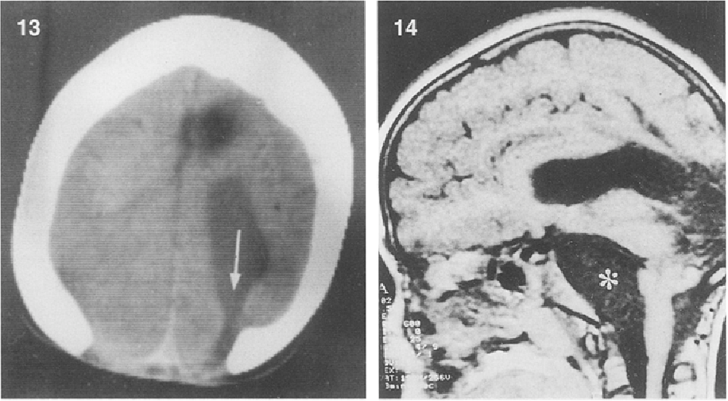
Postoperative computed tomographic scan of a girl with an occipital encephalocele.
Note the stretching of the lateral ventricle (arrow) entering the occipital bone defect: the "suction sign"

Slide 18
The goal of surgery
Reduction of the herniation with preservation of as much viable brain as possible.
Water-tight dural closure with adequate skin coverage,
Repair of any cosmetic deformity, and cranial or craniofacial reconstruction.
With anterior encephaloceles in particular, the goal is to remove the lesion before it can further distort facial growth.

Slide 19
Posterior Encephaloceles Surgical Technique:
Position : prone position with the head and face placed on a padded pediatric horseshoe head holder.
Surgical technique
The encephalocele is grasped and raised with tissue forceps, and an elliptical incision is made around the sack close to the neck of the herniation.
An adequate full-thickness margin is maintained to allow for adequate skin closure later.
The skin is separated from the dura using blunt dissection until the margins of the bony defect have been established.
The dural sac is then cut and CSF is drained.
Dysplastic brain removed by the combination of both suction and bipolar cautery (most of the herniated tissue is not viable tissue).
The surrounding dura is then re-approximated.

Slide 20
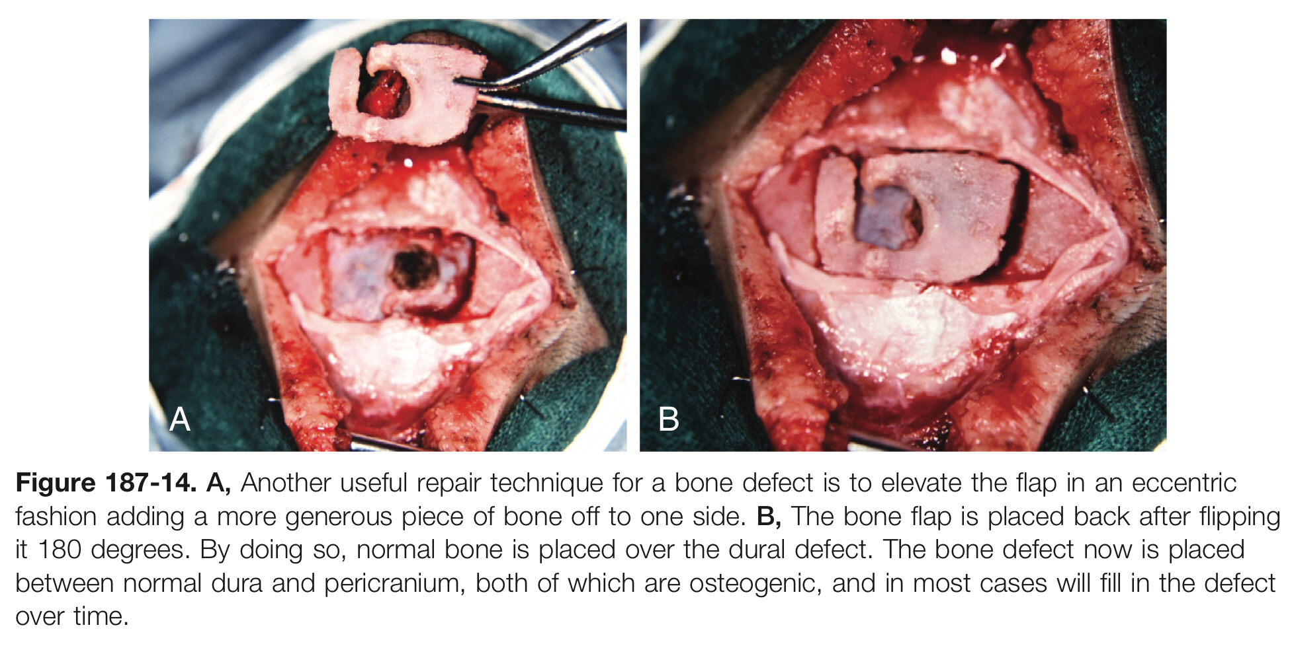
It is common to use autologous split calvarial bone to repair the cranial defect.
Wide craniotomy incorporating both normal bone and the cephalocele defect.
At the time of closure, the bone is rotated 180 degrees so that normal bone is over the dural defect. The bone defect is then placed between normal dura and pericranium, which often fills in naturally with native bone.

Slide 21
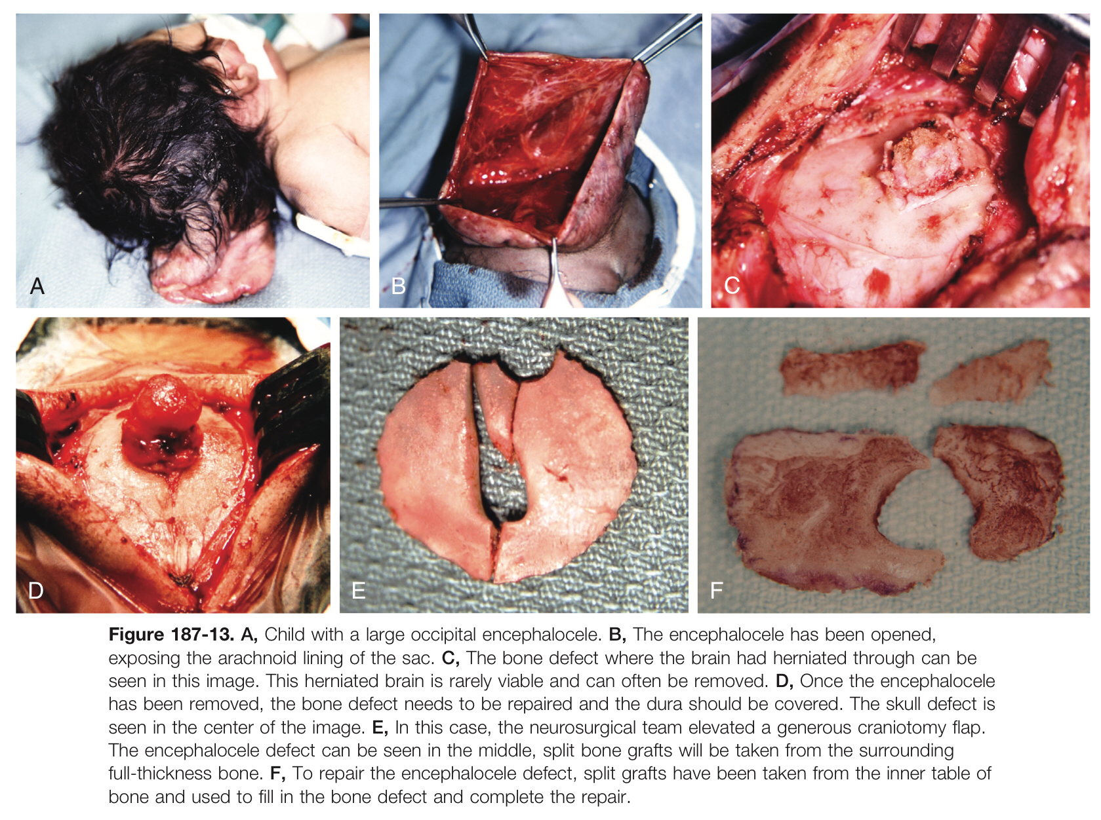

Slide 22
Anterior Cephaloceles Surgical Technique:
Approach including team work consist of : neurosurgery; (OMFS); (ENT) and plastic surgery.
The standard procedure
  The transcranial approach typically involves a Bicoronal scalp flap.
  Bifrontal craniotomy, and an extradural dissection of the anterior cranial fossa to separate the sac from the surrounding tissue and skull base.
  Then intradural transection of the encephalocele stalk is performed.
“Sun Visor” approach
  bicoronal scalp flap plus facial degloving.
To repair the skull base defect, split calvarial bone grafts are used.
The transpalatal approach can also be considered for children who have large posterior skull base defects in the tuberculum region and clinoids

Slide 23
Endoscopic Endonasal approach is an adjunct but its limitation is
  It can only be used once the paranasal and frontal sinuses have pneumatize approximately 2 to 3 years of age.
  Cause it need osteoplastic flap which is difficult to perform (Encephalocele originate from posterior frontal sinus wall).
Lumbar drain is placed
  Preoperatively when there is an obvious potential CSF leak.
  Intraoperative for fluorescein injection to visualize the source of the leak.
  Postoperatively for 7 to 10 days to decreases the CSF pressure on the repair site and thereby reduces risk of leak and infection, and enhance surgical repair.

Slide 24
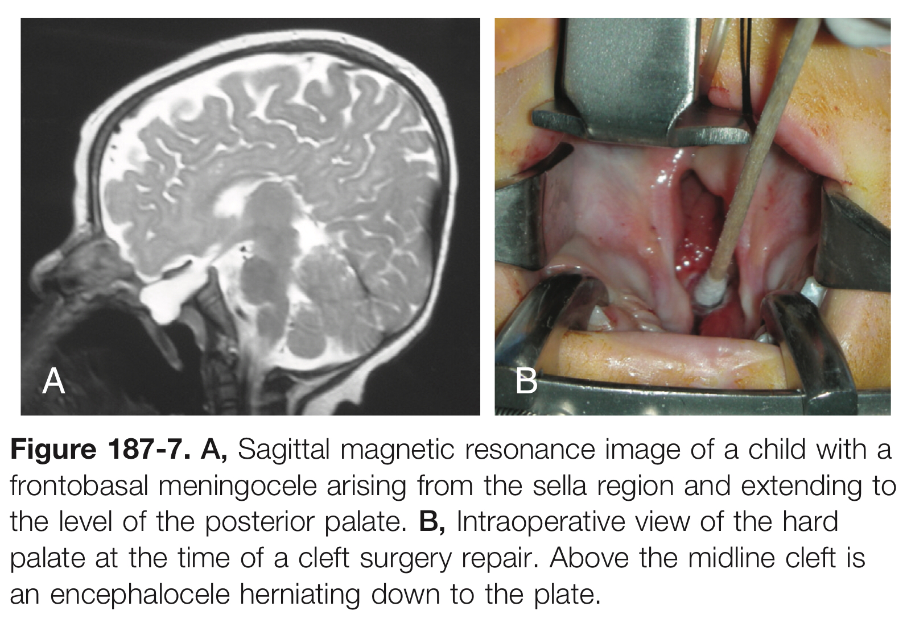

Slide 25
For fronto-nasal-basal encephaloceles, the authors have developed a “sunvisor” exposure that involves a bifrontal craniotomy from above and a wide facial degloving from below.

Slide 26
Prognosis
Patient’s outcome depends on the amount of brain tissue contained within the herniated sac.
Patients with anterior encephaloceles have better prognosis then those of posterior ones which suggests that the loss of frontal cortex is better tolerated than the loss of occipital or cerebellar tissue.
The coexistence of hydrocephalus is poor prognosis.
Factors of good outcomes with
  Normal head size at birth.
  Intact initial neurologic examination
  Absence of hydrocephalus.

Slide 27
Cranial meningocele
Are congenital herniations of meninges and CSF through the skull and are deprived of any cerebral tissue.
Common location over the anterior fontanelle (vertex meningocele).
Presentation :
  Recurrent meningitis at the skull base
  Epileptogenic focus in the temporal lobe
Pseudomeningoceles
  Can be formed following craniectomy and violation of the dura.
  CSF escapes from the subarachnoid space and becomes entrapped within the soft tissues of the scalp.
  Unlike true meningoceles, there is no arachnoid capsule in a pseudomeningocele.
Conservative Tx involve needle aspiration and pressure dressing or lumber drainage or both.
Surgical resection involves a circumferential dissection following what is typically a thick capsule to the dural surface.

Slide 28
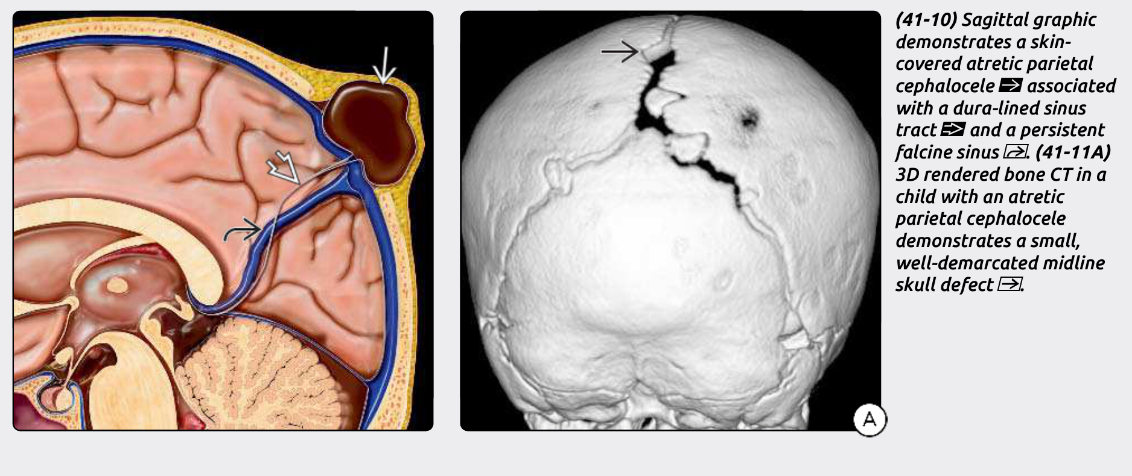

Slide 29
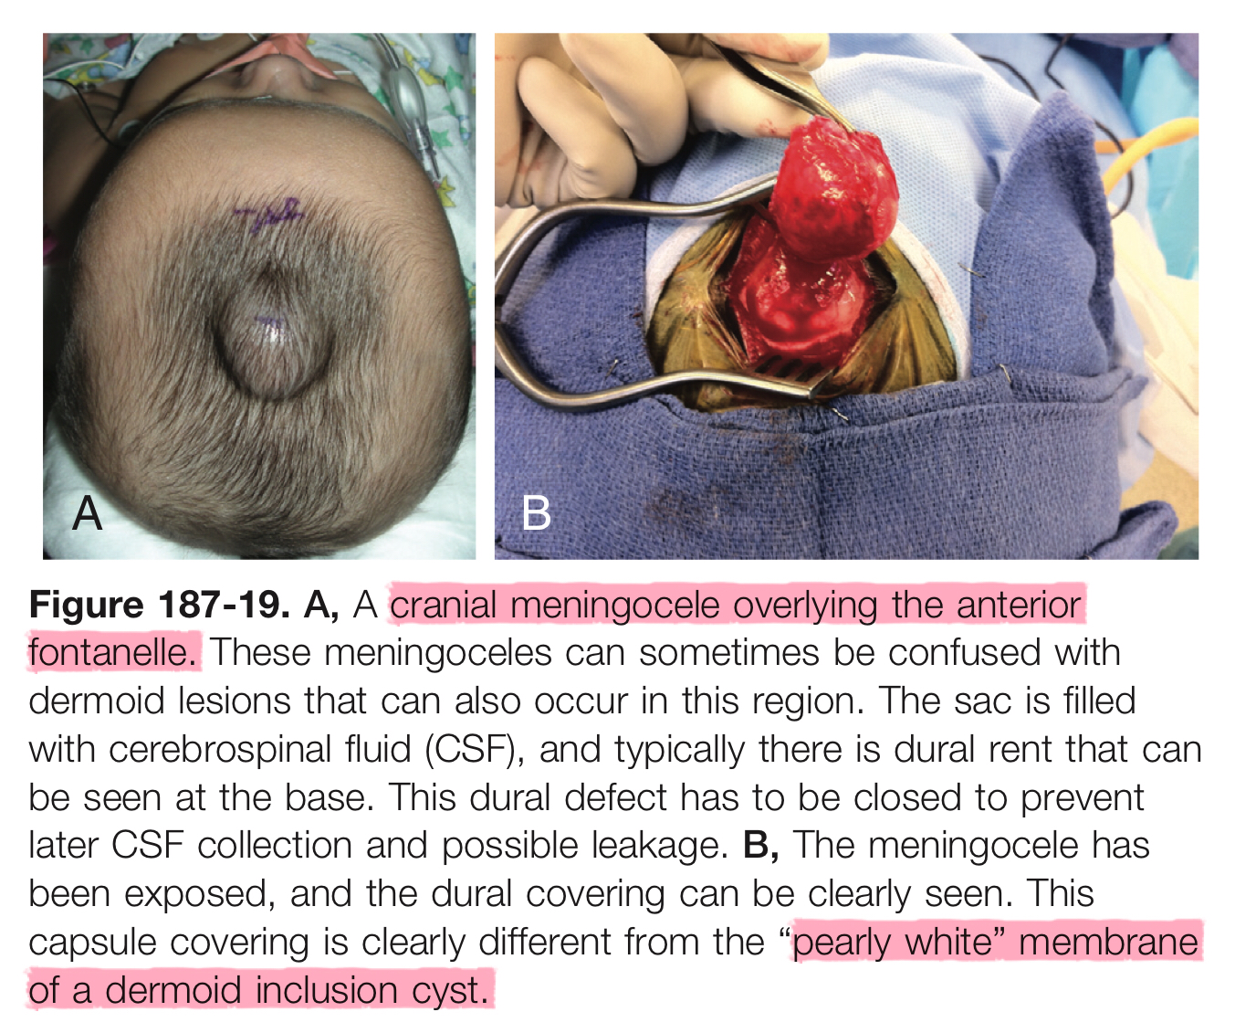

Slide 30
CRANIAL DERMAL SINUS TRACTS
C.D.S.T.

Slide 31
Clinical notes
In the presence of an unexplained meningitis, especially due to Staph aureus hemolyticus, the entire skin surface along the midline should be examined carefully for dimples, palpable thickening, or sinus openings.
Uncommon, potentially deleterious, congenital, epithelialized tunnels that originate at the skin surface and can occur anywhere along the neuraxis.
The most common sites are at the occipital protuberance or nasion.
They occur most frequently in the midline.
Result from failure of dysjunction of neuroectoderm and cutaneous ectoderm.
It usually sporadic with female predominance.
Nonmidline dermal sinus occur in
  Retroauricular
  Pterional ( lateral temporal )
  Lateral, parietal, anterior temporal
Meningitis caused by staphylococcus aureus commonly followed by Gram -ve

Slide 32
Diagnosis
Clinically
  Cranial DST
    They may appear as a sources of fulminant meningitis 50%
    Commonly appear as a small, asymptomatic cutaneous dimple or pit. 33%
    Acute hydrocephalus with bulging fontanelles, lethargy, and paresis. 5%
  Nasal DST
    Stridor and difficulty feeding
By examination
  The cutaneous dimples may be associated with fine or thick hairs, hyperpigmented patch, or a soft tissue mass.
Imaging
  MRI with contrast (tracts less than 1 to 2 mm in diameter may be missed on routine MRI)

Slide 33
Management
For asymptomatic cranial DSTs: prophylactic surgical removal of the tract and any associated dermoid or epidermoid cyst is warranted “as soon as the child can tolerate the operation.
Delayed surgery of DSTs associated with prior infection can be complicated by fibrosis and inflammatory scarring.
Elective surgical time at 5 to 8 months of age.
The goal is to eliminate the risk of meningitis and abscess formation
In the presence of CSF leak, infection, or raised intracranial pressure, surgery should be performed emergently
If associated with demoid or epidermoid cysts should be removed en bloc to prevent recurrence.
The most common surgical error is leaving some capsule remnants behind that later lead to regrowth of the lesion.

Slide 34
Dermoid and epidermoid cysts association with DST
Can be found at any depth along the tract in up to 50% of cases
Present as:
  Mass effect
  2ry infection causing abscess formation within scalp , below dura or within the brain.
  Can rupture spontaneously and cause an aseptic (or Mollaret’s) meningitis.
  Obstruct CSF pathway causing hydrocephaly.
Prognosis
When completely resected, cranial DSTs rarely recur, and the prognosis is usually favorable; however, recurrence following partial removal has been documented as late as 20 years from the original operation.

Slide 35
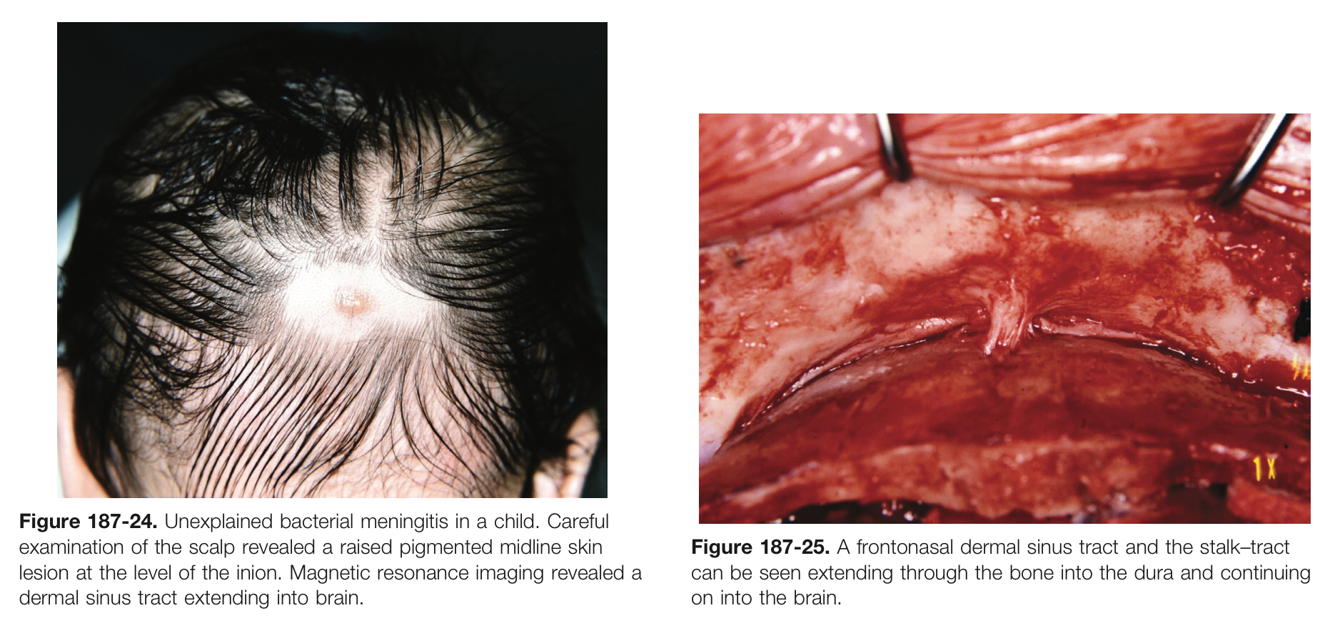
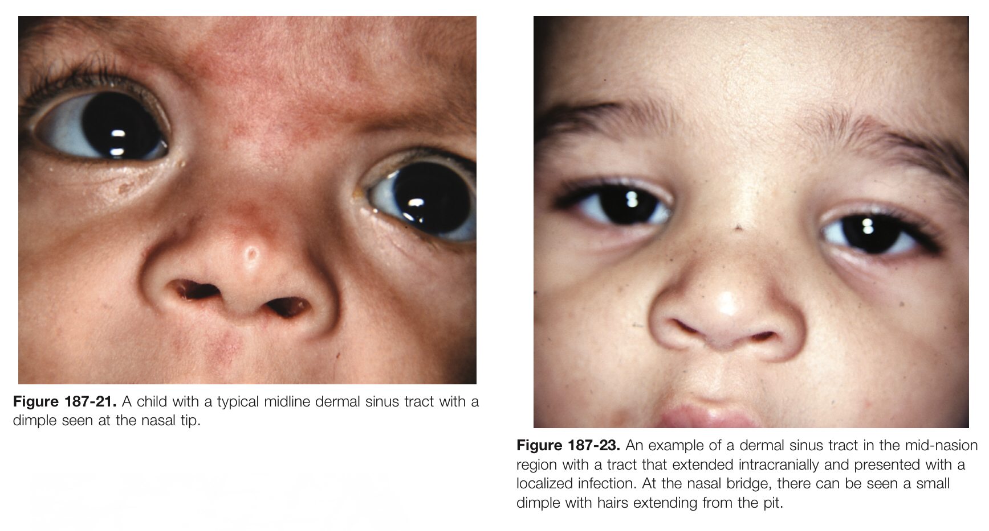

Slide 36
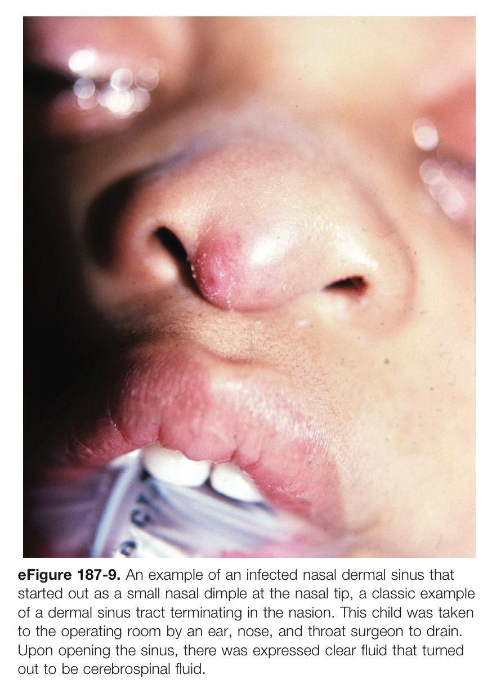
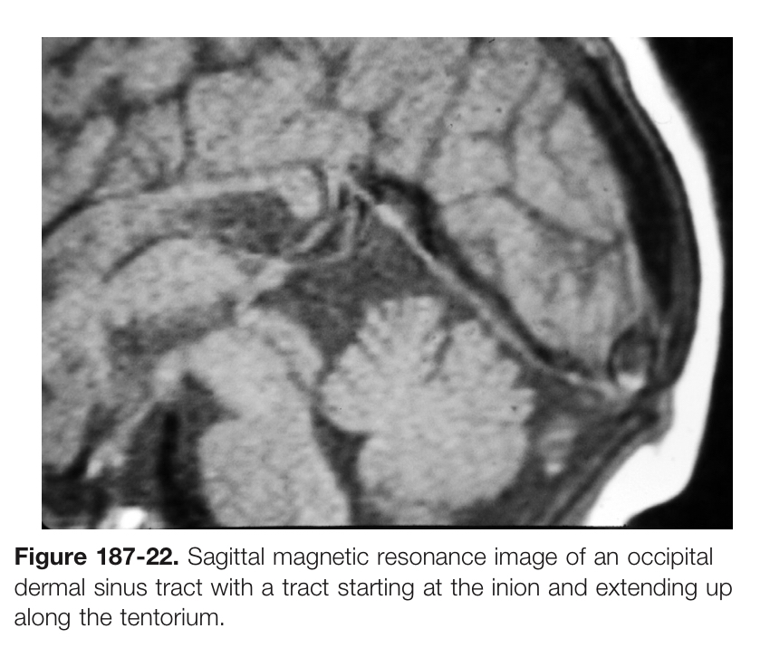

Slide 37
Dandy-Walker Syndrome
Youmans Chap. 188

Slide 38
It’s characterized by agenesis or hypoplasia of the cerebellar vermis, cystic dilation of the fourth ventricle, and enlargement of the posterior fossa with or without hydrocephalus.
Embryology
  Dysgenetic development of the anterior membranous area of the rhombencephalon.
Six Radiographic Features Necessary for Diagnosis
Large posterior fossa cyst communicating with the fourth ventricle.
Absence of a portion of the inferior vermis.
Hypoplasia, anterior rotation, and upward displacement of the remaining vermis.
Absence or flattening of the angle of the Fastigium (highest point in the roof of the 4th ventricle).
Large posterior fossa with elevation of Torcular Herophili (confluence of sinuses).
Anterolateral displacement of the cerebellar hemispheres.
Note/ Bucy’s sign: elevated Torcula herophili

Slide 39
Dandy-Walker syndrome (DWS)
  agenesis or hypoplasia of the cerebellar vermis, cystic dilation of the fourth ventricle, and enlargement of the posterior fossa with or without hydrocephalus.
Dandy-Walker variant (DWV)
  consists of an inferior cerebellar vermian defect and communication between a normal-sized cisterna magna and fourth ventricle
Dandy-Walker complex (DWC) categorized from
  Mild (mega–cisterna magna only)
  Moderate (mild hypoplasia of vermis, enlarged fourth ventricle)
  Severe (agenesis of vermis, dilation of posterior fossa cyst & 4th ventricle)
Differential Diagnosis
  Mega cisterna magna
  Posterior fossa arachnoid cyst
  Persistent Blake's pouch cyst
  4th ventriculocele (encephalocystocele)
  Congenital vermian hypoplasia
  DWV

Slide 40
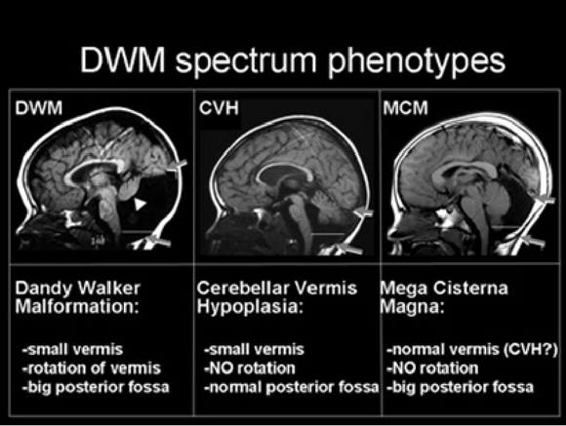

Slide 41
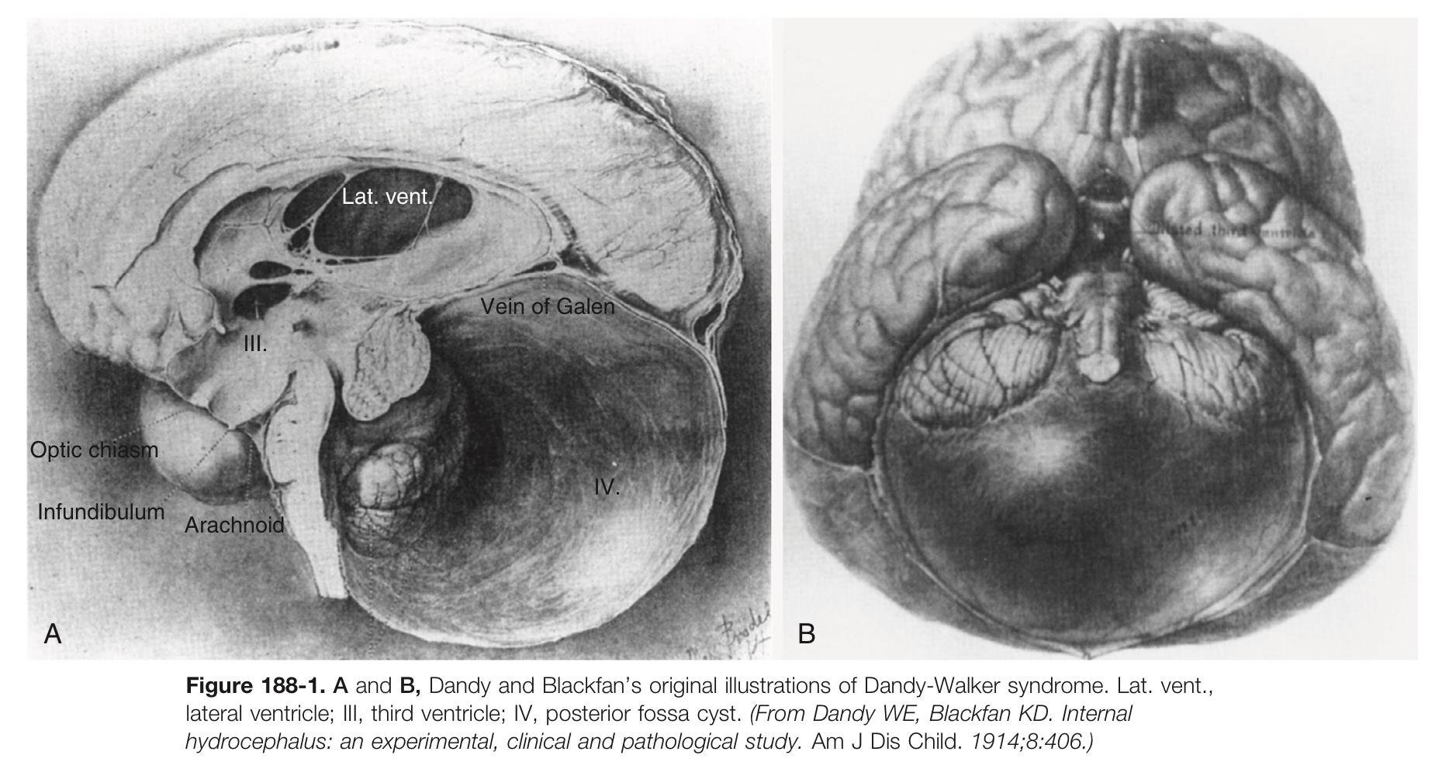

Slide 42
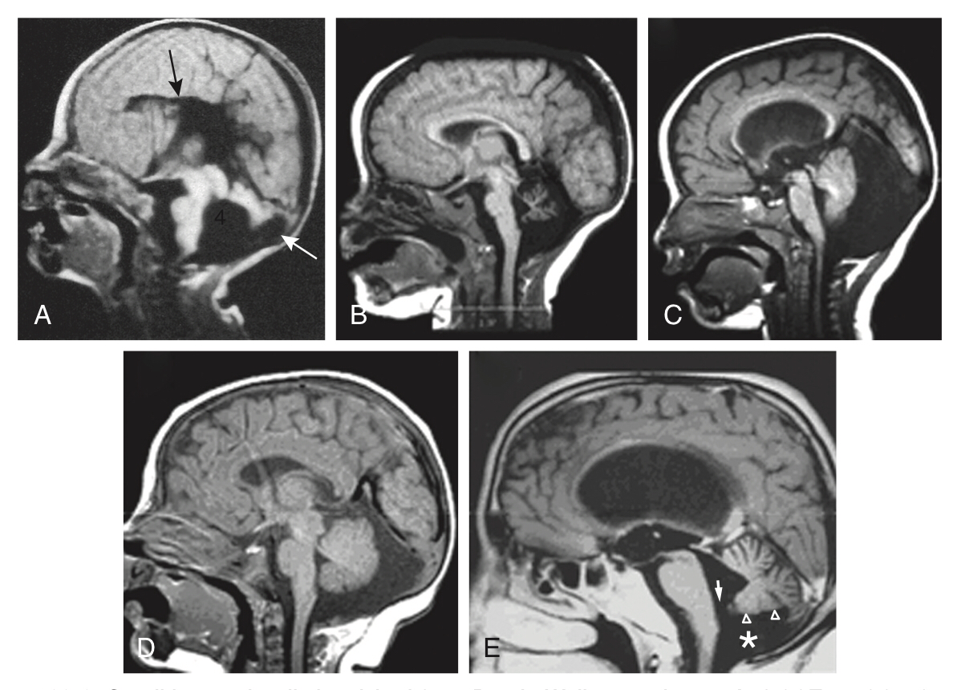
Dandy-Walker variant with a 4th ventricle communicating with a retrocerebellar cyst (white arrow), absence of the inferior vermis, absence of the corpus callosum and lissencephaly.
Cerebellar vermis hypoplasia/atrophy. Note the normal size of the posterior fossa
Retrocerebellar cyst with anterior shift of cerebellum
Mega–cisterna magna. Note enlarged size of the posterior fossa but normal size of the cerebellum, normal size 3-8 mm.
Blake’s pouch cyst. posterior ballooning of the inferior medullary velum into the cisterna magna, below and posterior to the vermis, that communicates with an open fourth ventricle

Slide 43
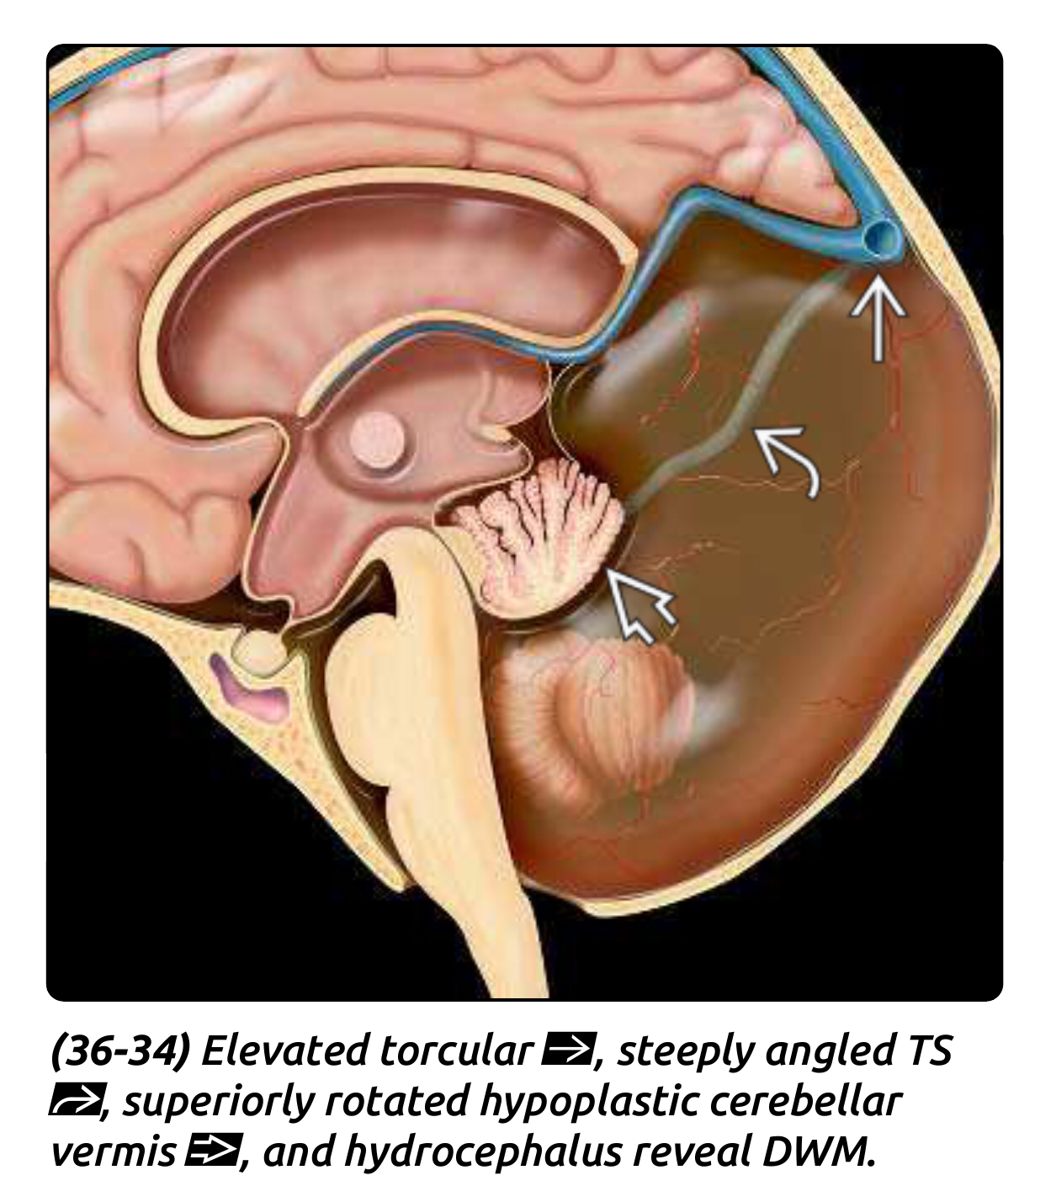
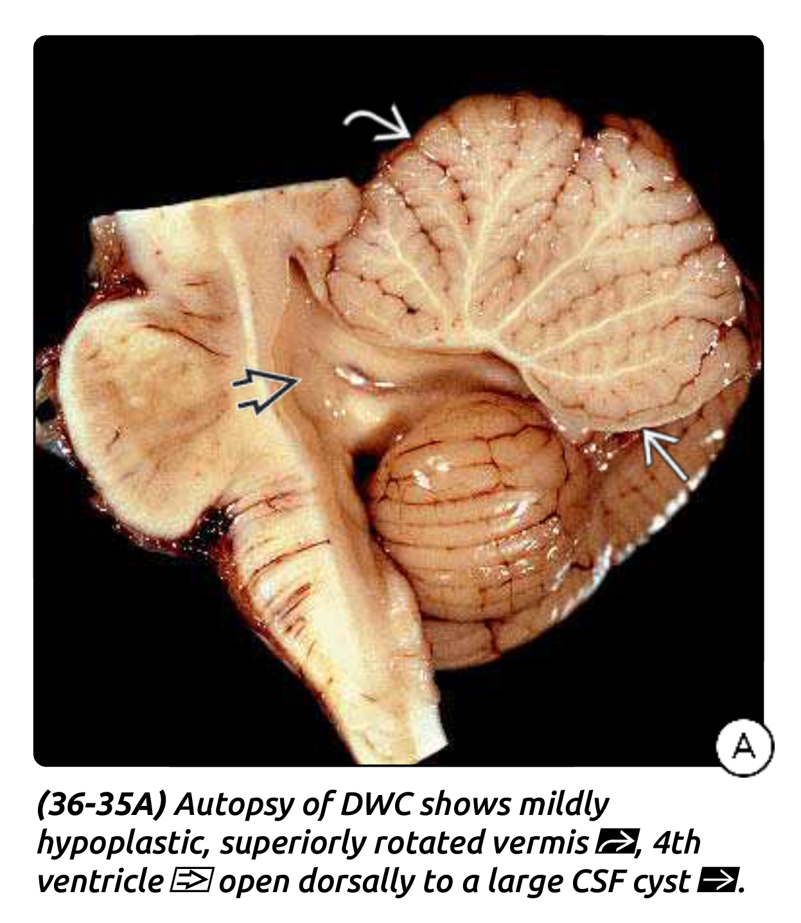
Bucy’s sign: elevated torcula

Slide 44
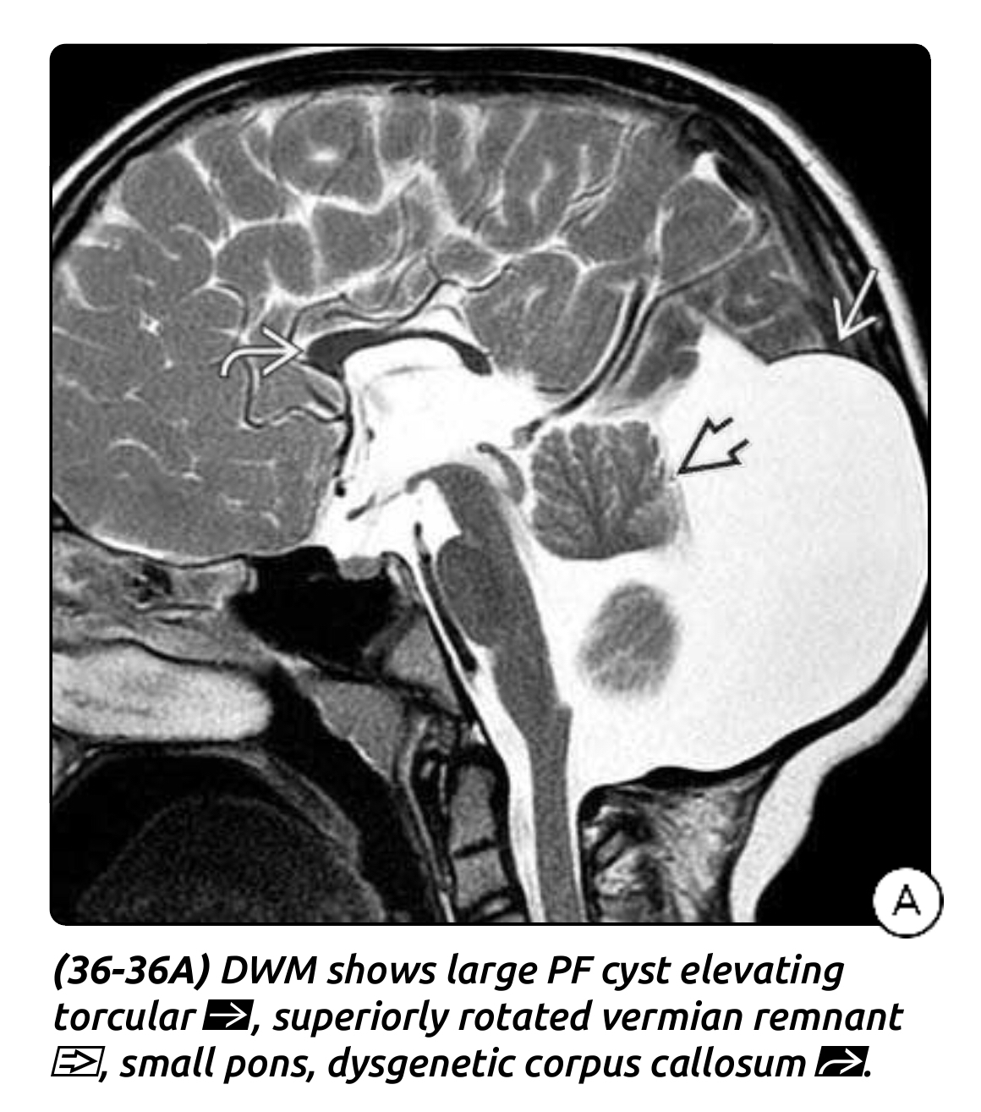
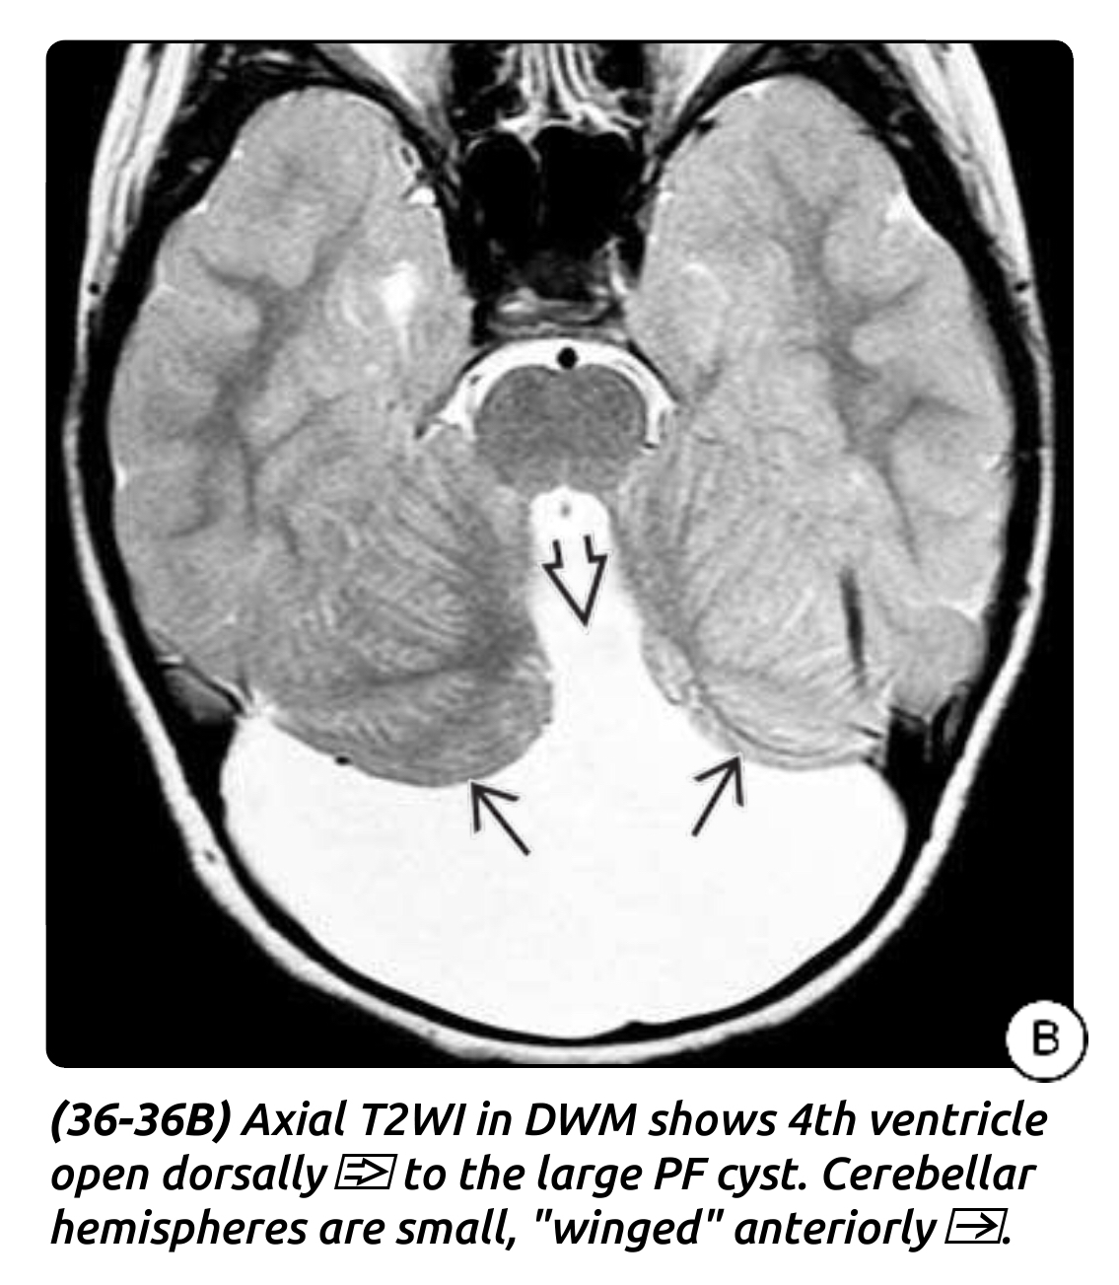

Slide 45
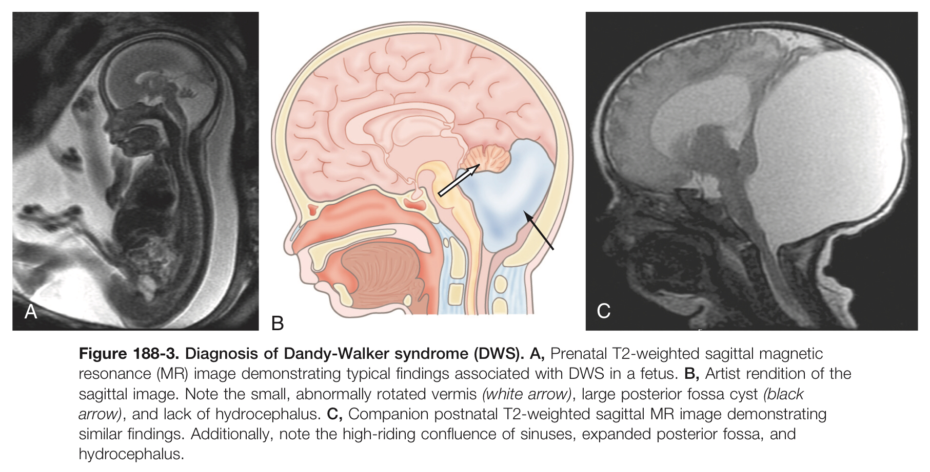

Slide 46
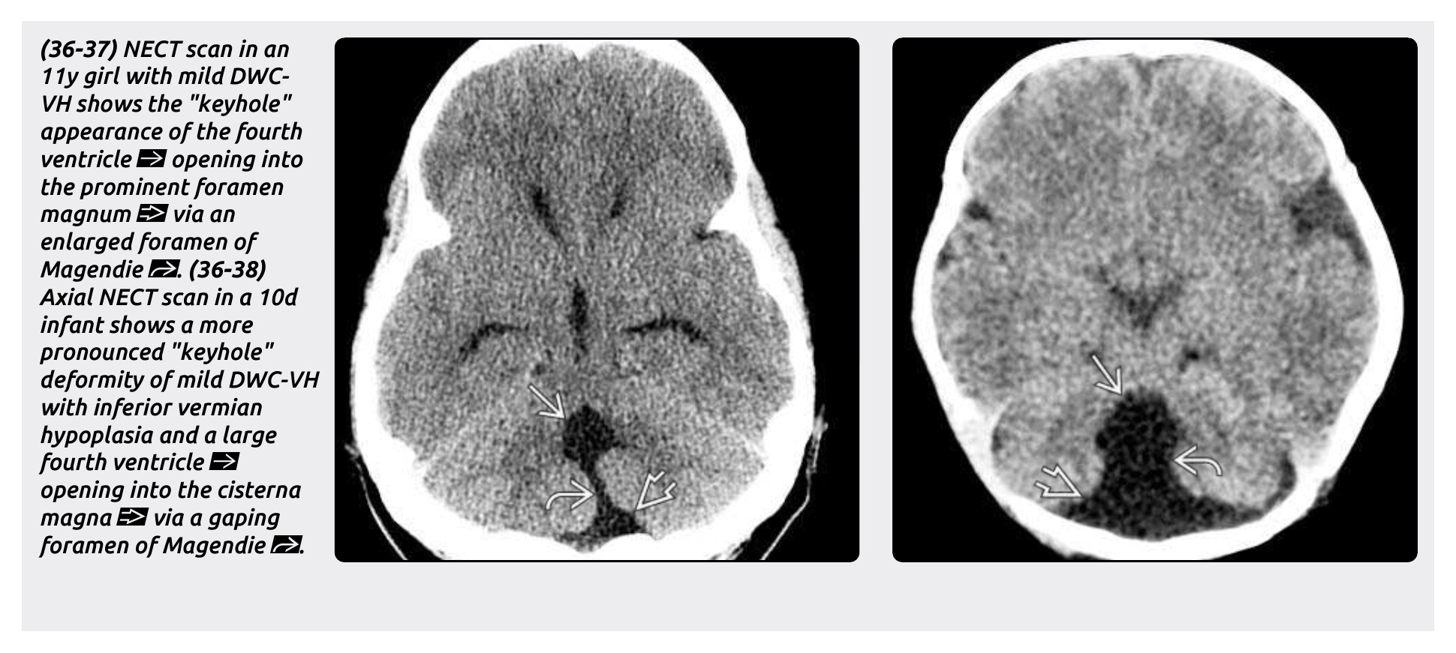

Slide 47
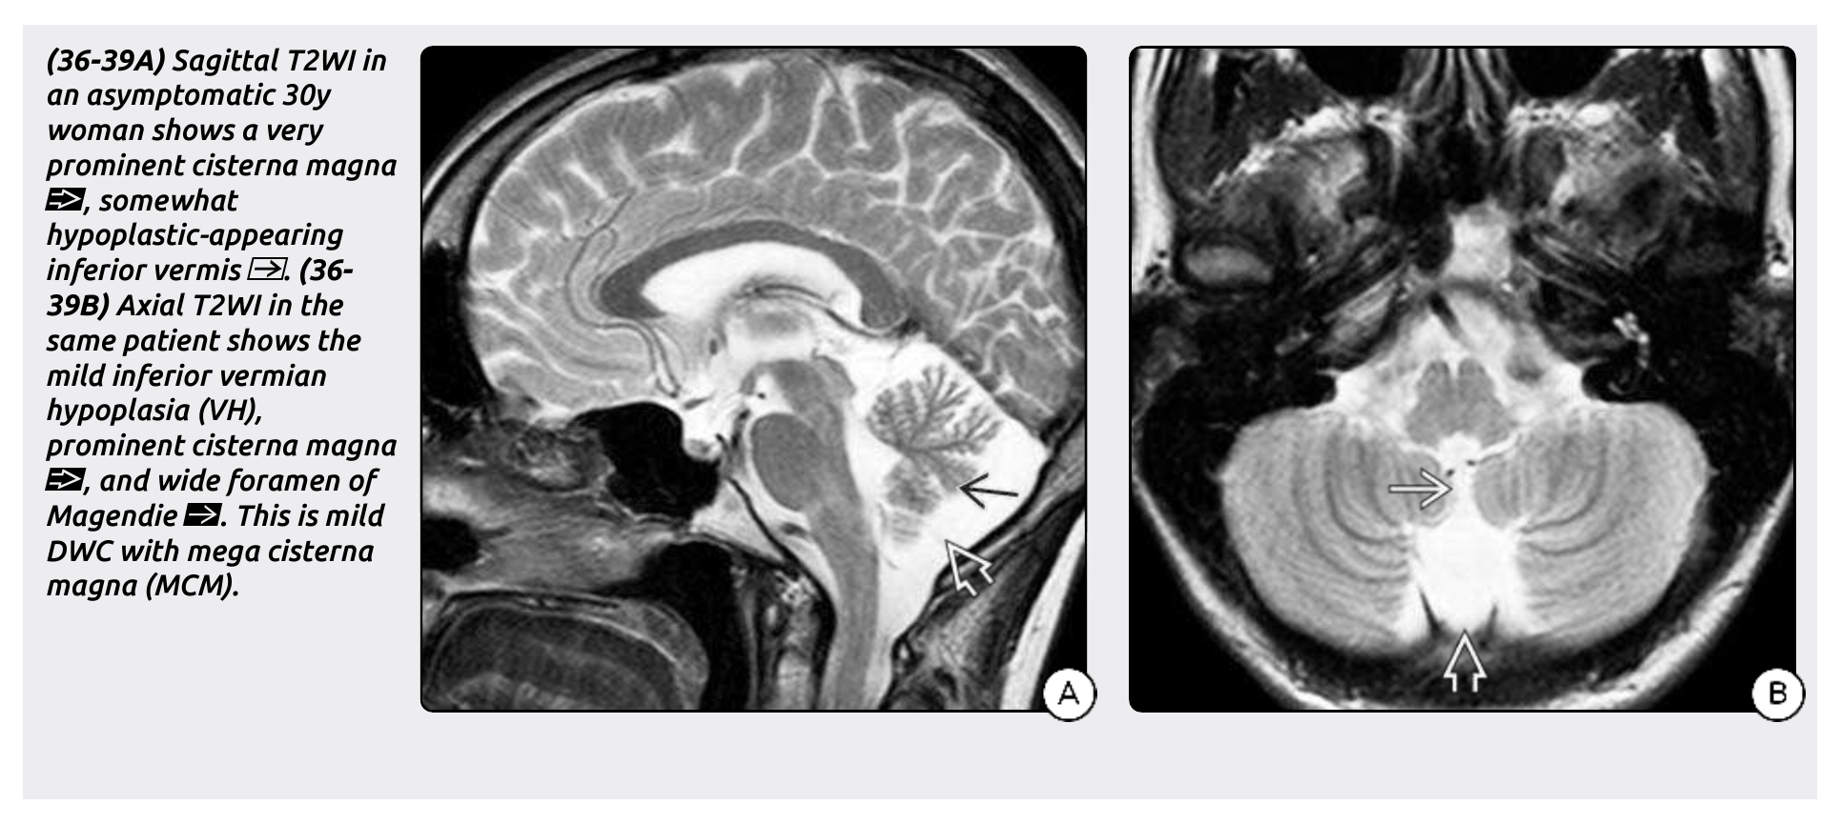

Slide 48
Clinical presentation
The majority of patients presenting in the first year.
Diagnosis may be delayed until adolescence or even adulthood in less severe cases
Postnatal presentation
  The most common postnatal presentation is macrocrania
  Other signs include the sunset sign, a large posterior fossa, seizures, spasticity, lethargy, delayed milestones, respiratory failure, apnea, deafness, visual problems, increased intracranial pressure, and hydrocephalus.
  Hydrocephalus occur in 80% of all patients.
Older children and adults presentations
  Headache, vomiting, cranial nerve palsies, nystagmus, and ataxia.
Central Nervous System and Systemic Anomalies
  Most common of which is agenesis of corpus callosum.
  Most common systemic manifestations include capillary hemangiomas and cardiac defects.

Slide 49
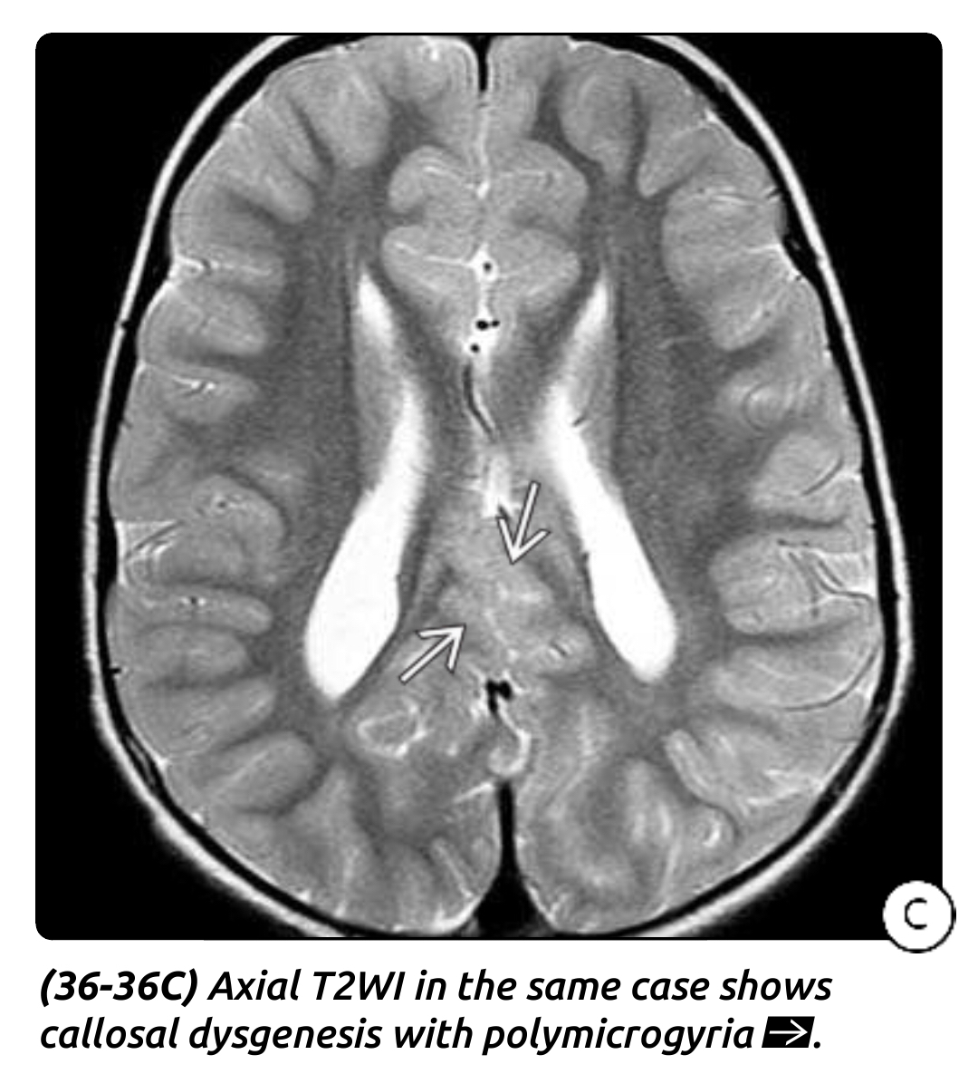

Slide 50
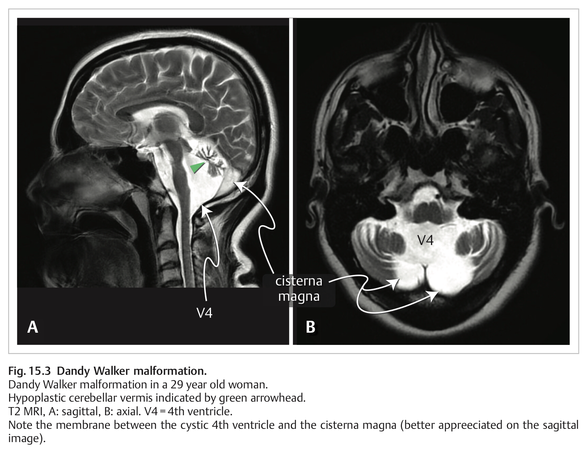

Slide 51
Management
Cyst membrane excision
Shunting
Neuroendoscopic intervention
Currently, diversion of CSF through shunting is the most widely accepted first-line treatment of DWS.
Shunt Options Include:
  Shunting the Supratentorial compartment,
  Shunting the Cerebellar cyst,
  Shunting both components ( Dual shunt )
Supratentorail shunting >>> aqueductal stenosis >>>> isolated 4th ventricle
>>>> Upward herniation with hypothalamic dysfunction.
A dual drainage system that includes a ventricular catheter and a cyst catheter that are Y-connected has proved superior to other methods in successfully alleviating the hydrocephalus and posterior fossa symptoms.

Slide 52
Cystoperitoneal shunting minimizes the risk of entrapping the fourth ventricle and is at present the surgical procedure preferred by most neurosurgeons.
Other Interventions
  Endoscopic Third Ventriculostomy (ETV)
  Aqueductal “stent” with shunting
  Endoscope-assisted Transtentorial Proximal Catheter Placement With Shunting.
The Recommended Treatment Is :
VPS with progressive hydrocephalus the most successful in Pt < 1y.
ETV > 6 month
Fenestration and shunting of cyst , excision of posterior fossa membrane in refractory cases.
Dual shunt in case of failure.
ETV and aqueductal stenting or dual shunt in case of Aqueduct stenosis.

Slide 53
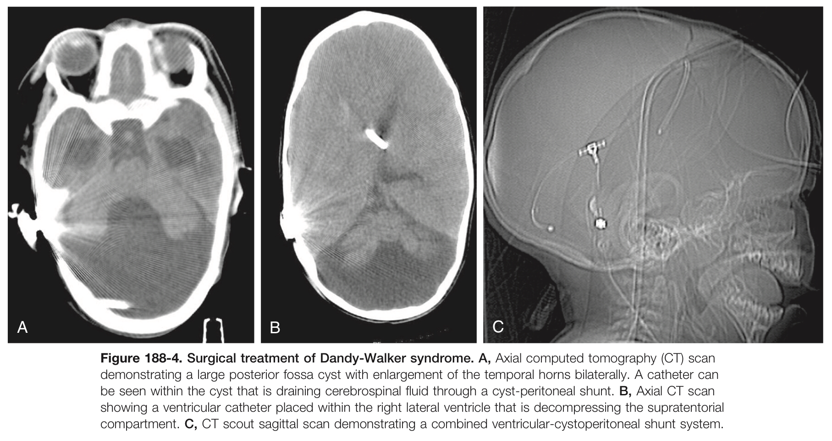

Slide 54
Thank you

