Slide 1
Chiari Malformations Youmans Chap. 190

Slide 2
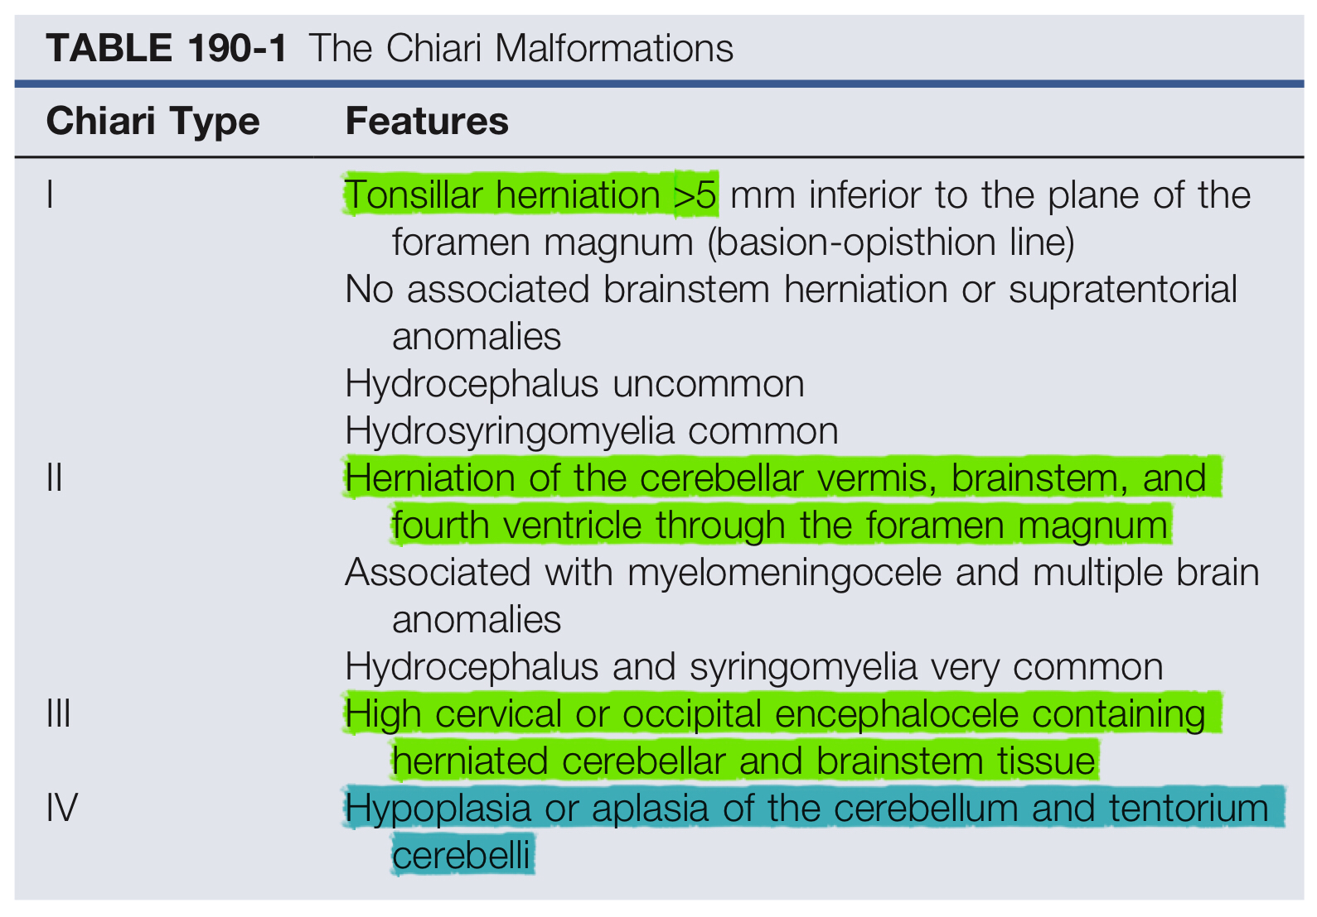
Chiari malformations are a collection of hindbrain abnormalities ranging from simple herniation of the cerebellar tonsils through the foramen magnum to complete agenesis of the cerebellum.

Slide 3
Chiari I Malformation
AKA primary cerebellar ectopia
5-mm or more caudal displacement of the cerebellar tonsils inferior to the foramen magnum.
The most commonly associated findings are cervical syringomyelia.
Hydrocephalus (<10%)
Syrinx location is most often cervical, followed by cervicothoracic.
Age at presentation in young adult.
Pathophysiology :
The foramen magnum potentially compresses the herniated cerebellar tissue and restricts normal CSF flow across the craniocervical junction.
Pathologic descent of the cerebellar tonsils due to raised intracranial pressure (e.g., tumor) as CIM

Slide 5
Pathophysiology
Idiopathic CIM may be the result of mesodermal defects that create a congenitally small posterior fossa, leading to compression of the neural elements and herniation through the foramen magnum.
Craniosynostosis and CIM is known and appears strongest in cases of syndromic, multisuture, and lambdoid synostosis
Lambdoid suture closure, typical in Crouzon’s syndrome —> reduce posterior fossa volume.
Multisuture synostosis can elevate ICP —> herniation of posterior fossa elements.
Familial vitamin D–resistant rickets causes bony overgrowth of the posterior fossa, thus reducing its volume
Growth hormone deficiency.
Iatrogenic cause
LP shunting
Repetitive lumbar punctures, lumbar drainage.
Chronic spinal CSF leaks
occur sporadically, inheritable genetic factors may be responsible for a minority of cases

Slide 6
Signs & Symptom
Cranial symptom
Pain (Occipitocervical headaches) 60-70% often induced by Valsalva maneuvers.
Ophthalmologic symptoms include blurry vision, nystagmus, extraocular muscle palsies, diplopia, and visual field deficits
Down-beat nystagmus specific for lesions involving the cervicomedullary junction.
Otologic complaints consist of tinnitus, fluctuating hearing loss, vertigo, and nausea
Lower cranial nerve dysfunction
Inability to maintain airway patency —> sleep apnea —> sudden death.
Diminished gag reflex is common.
Vocal cord paralysis with stridor or hoarseness.

Slide 7
Spinal symptom
Nonradicular pain in the back, shoulders, and limbs.
Weakness, atrophy, hyperreflexia, cape-like sensory loss.
Loss of pain and temperature sensation occurs only at the levels that are served by stretched spinothalamic fibers
Abnormal abdominal reflexes are often seen in patients with associated syringomyelia
Spinal cord dysfunction result of direct cord compression or syringomyelia
Scoliosis due to an underlying syrinx
Clinical and radiologic signs that raise the suspicion of an underlying neurological defect in a patient with scoliosis
Scoliosis convexity to the left
Leg or foot asymmetry
Male gender or prepubescent female
Any neurological deficit

Slide 8
Diagnosis
MRI is the imaging of choice
The diagnosis of CIM should include the absence of an
Intracranial mass lesion
Dandy-Walker malformation
Hydrocephalus
All of which may cause tonsillar displacement secondary to raised ICP.
Associated radiologic anomalies include most commonly
Atlanto-occipital assimilation (fusion)
Basilar invagination.
Fused cervical vertebrae.
The tonsillar herniation was noted to be clearly pathologic when it exceeded 5 mm and borderline between 3 and 5 mm.
Syringomyelia occurs commonly with CIM and can be seen in 30% to 70% of patients.

Slide 9
Configuration of the tonsil tip is important.
Pointed and drawn out —> more pathologic significance, or it may be
Blunt and rounded —> less concerning
CSF Flow Metry and Cine-Mode MRI
The presence of a CIM and a syrinx resulting from disturbed CSF flow, can be demonstrated by this technique.
Flexion-extension radiographs of the cervical spine are suggested for individuals in whom there is a concern for instability.
Plain skull X-rays showed basilar impression, platybasia
Electrophysiologic Studies
For type II CM
The potential uses of BAEPs to evaluate neonatal myelomeningocele patients is still evolving, so this test alone is not a reliable indication for surgical intervention but instead should only be used as added criteria to a detailed history and physical examination

Slide 10
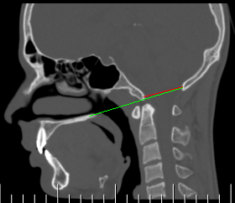
Basilar impression: congenital or acquired craniocervical junction abnormality where the tip of the odontoid process projects above the foramen magnum

Slide 11
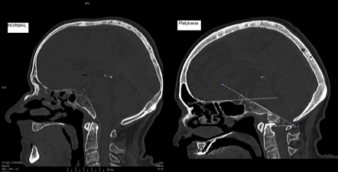
Platybasia is characterized by abnormal flattening of the skull base as defined as a base of skull angle over 143

Slide 12
Treatment
There is no effective nonsurgical alternative to operative decompression for patients with symptomatic CIM.
Syrinx is less likely it is to respond to posterior fossa decompression when occur in the (lower thoracic, lumbar) from the craniocervical junction.
Indications for decompression :
All patients with a syrinx, regardless of the size, location, or other associated symptoms.
Symptomatic Patients (headaches or neurological abnormalities, especially respiratory or cranial nerve dysfunction).
Presence of hydrocephalus or sings of raised ICP (treat Hydro before decompression). (Look like encephalocele)
Persistance of symptoms After shunting or ETV, or an associated syrinx is large and unchanged for months.

Slide 13
Operative notes
The purpose of the operation is to enlarge the bony area of the craniocervical junction and expand the dura surrounding the brainstem.
The foramen magnum and posterior arch of C1 are exposed the entire width of the dura.
The bone of the occiput is removed first, followed by the posterior arch of C1.
Remove about 2.2 cm of the posterior arch of C1 and a 2.2 c.m wide × 2.5 c.m long piece of occipital bone.
Leaving the muscle attachments and laminae of C2 intact to reduce postoperative pain and potential spinal instability.
It may be necessary to remove the superior aspect of the C2 laminae to fully visualize the caudal tip of the cerebellar tonsil.
Opening the dura
Always open the dura because we have so often identified intradural pathology (arachnoid webs at the fourth ventricular outlet) as a cause of an associated syrinx.

Slide 14
Tonsillar separation
Tonsils are gently separated to visualize the fourth ventricular floor, This reestablishes free flow of CSF from the foramen of magindie.
Visualization of the relatively avascular floor of the fourth ventricle and free flow of CSF into the subarachnoid space as evidence of adequate decompression.
In severe tonsillar ectopia
The foramen of Magendie remains occluded (from arachnoid veils) and CSF egress is limited, Extrapial coagulation of one or both tonsillar tips shrinks the tonsils sufficiently to restore CSF flow.
Surgically recalcitrant ( refractory ) syringomyelia
When the primary operation failed to diminish the size of the syrinx,
Small piece of Silastic tubing is placed from the fourth ventricle to the upper cervical subarachnoid space, anterior to the denticulate ligament to prevent irritation of dorsal roots from tubing and postop pain.

Slide 15
Maintain complete hemostasis to minimize arachnoiditis and the risk for chemical meningitis.
Dural graft allows for protection of the neural tissues from chemical contamination while providing a capacious dural sac, which probably optimizes the decompression and minimizes postoperative adhesions.
In patients who initially improved clinically and radiologically with decompression, and then worsened
The most likely is a reclosure of the outlet foramen, treated with repeat decompression and possibly resection of a portion of the tonsil
If reexamination of the operative site does not result in improved symptoms and syrinx size, consideration should be given to insertion of a syringopleural or syringoperitoneal shunt.

Slide 16
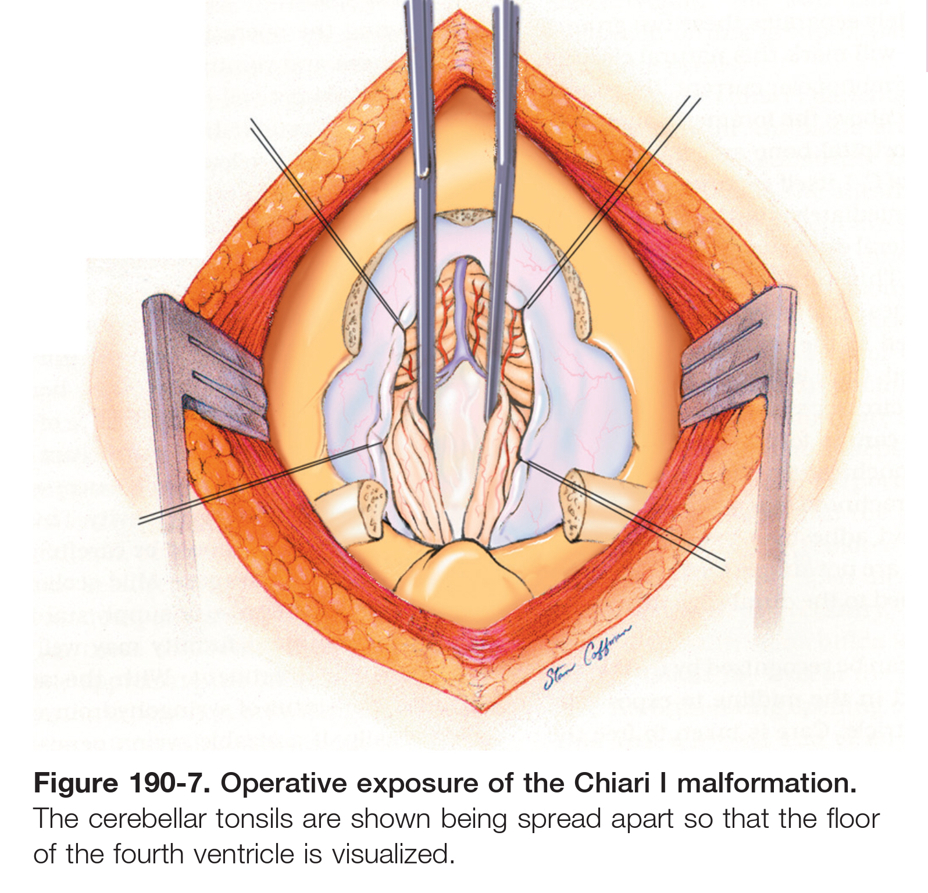

Slide 18
In case of Ventral compression
How to measure
> 9 mm of reclination of the odontoid process from a line connecting the basion to the posterior aspect of the body of the axis.
Presentation
Brainstem symptoms which not relieved by posterior decompression:
Respiratory compromise
Swallowing difficulty
Hemodynamic instability
Work up
Spinal stability should be ensured by performing dynamic cervical radiographs in flexion and extension before decompression.
occipitocervical stabilization and possibly ventral decompression.

Slide 19
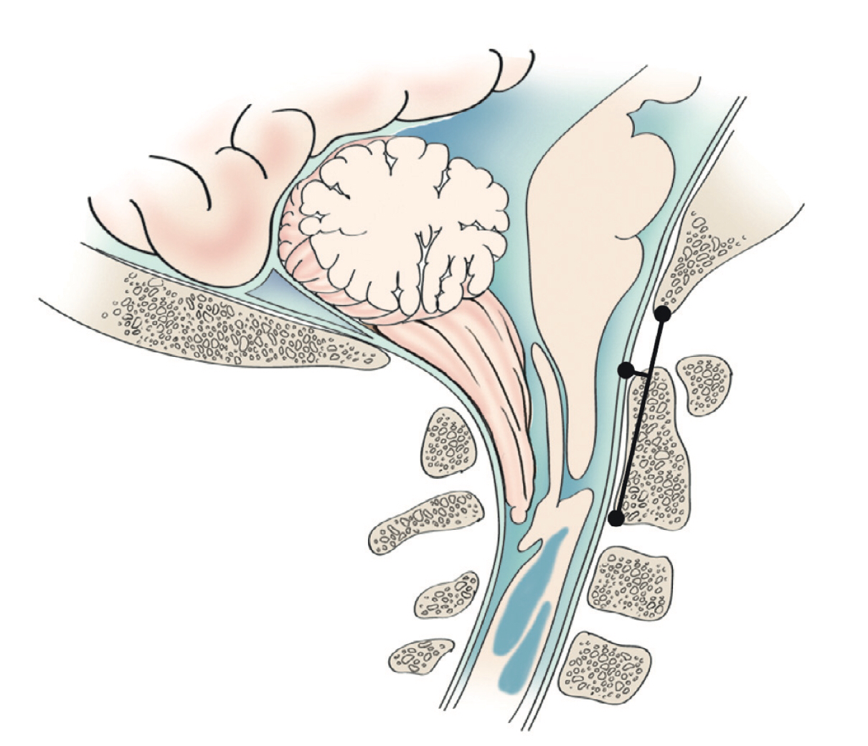
Figure 190-9. Measurements used to examine for ventral compression.
A line is drawn from the basion to the posterior lower border of C2, and then a perpendicular line from there to the anterior dural edge.
A distance of more than 9 mm would be concerning.

Slide 20
Prognosis
The poorest prognosis was seen in patients with central cord signs; the best prognosis was found in patients with paroxysmal intracranial hypertension.
Follow up
Patients without a syrinx and symptomatic improvement follow at 1, 6, and 12 months, then every 12 to 24 months thereafter without repeat imaging.
Patients with a preoperative syrinx receive a follow-up MRI in 6 to 12 months.
if symptoms improve or the syrinx decreases in size significantly, No further imaging is required.
If the syrinx improves minimally, additional imaging is required.
If the syrinx fails to improve or symptoms referable to a persistent syrinx are present, a second surgery is performed.

Slide 23
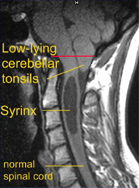

Slide 25
Chiari II Malformation
almost exclusively in the setting of myelodysplasia and hydrocephalus.
the structures herniating through the foramen magnum include
Cerebellar vermis
Brainstem
Fourth ventricle
Choroid plexus
The associated basilar artery and PICA may also be caudally displaced.
The posterior fossa is often small and the foramen magnum larger than normal and syringomyelia is seen in many of these patients.
PATHOPHYSIOLOGY
Because the cerebellar vermis develops before the tonsils, an abnormal pressure differential that develops in utero would cause abnormal displacement of the vermis and brainstem structures, without any tonsillar involvement.
Such a pressure differential could occur with fluid leakage from the myelomeningocele.

Slide 26
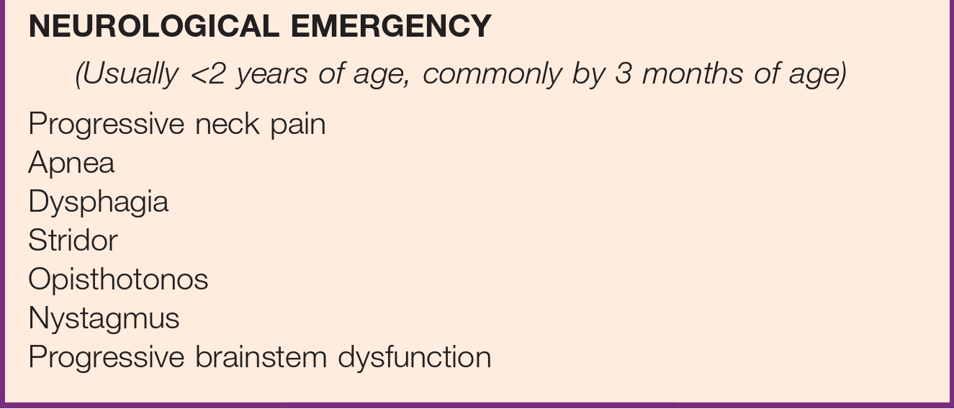
Sings & Symptom
The CIIM occurs in 95% of patients with myelomeningocele.
1/3 of these patients develop brain-stem symptoms by 5 years of age, and in excess of one third of those die, usually of respiratory failure
20% may present as a neurological emergency (dysfunction of the 9th and 10th cranial nerves, affecting respiration, swallowing, and vocal cord function; this is often accompanied by stridor, opisthotonos, and nystagmus).
Symptomatic deterioration with progressive brainstem dysfunction may be irreversible and lead to death
catastrophic syndrome occurs most frequently in infants younger than 2 years, particularly younger than 3 months, and has been shown to be unrelated to intracranial pressure and the size or extent of symptoms of the neural tube defect.

Slide 27
Diagnosis
MRI Findings :
Elongation and caudal displacement of the cerebellar vermis and brainstem
Syringomyelia is common in these patients and occurs in 40% to 95%.
Associated neurological anomalies include
Tectal beaking, secondary to partial or complete fusion of the colliculi into a single backward pointed peak.
kinking at the level of the cervicomedullary junction.
The cerebellum is usually smaller than usual, and upward herniation of the cerebellum may be evident.
Callosal agenesis or dysgenesis.
Abnormalities of the cerebral cortical pattern termed polygyria (not to be confused with the abnormal four-layered cortex seen in polymicrogyria).

Slide 28
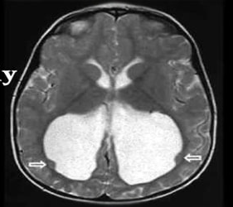
the ventricular system displays multiple abnormalities.
The 3rd ventricle mildly dilated and contain a large massa intermedia.
The 4th ventricle is typically small or nonvisualized, flattened and elongated, and extends into the cervical canal.
The lateral ventricles may be
Asymmetrically dilated.
Prominence of the atria and occipital horns (colpocephaly).
Septum pellucidum is frequently absent.
This sharpness of the frontal horn (lemon sign) and the caudal displacement of the fourth ventricle (banana sign) are relatively easily seen on in utero ultrasound examinations.
Spinal anomalies
The posterior arch of the atlas is often missing.
Klippel-Feil fusion anomalies of the cervical spine are present in a small group of patients.
Basilar impression and C1 assimilation are uncommon in CIIM.
Significant shortening and scalloping of the clivus can be seen (platybasia)

Slide 32
Treatment
Early surgical intervention may prove life sustaining in Chiari II patients whose symptoms are referable to the medullary dysfunction.
Timing of decompression before bilateral vocal cord paralysis may predict a better outcome.
Indications for surgical intervention
The presence of a significant syrinx, or progressively enlarged.
Symptomatic
Before surgical decompression, ventricular shunt can often obviate the need for decompression of hindbrain herniation.
Shunt revision can reverse acute respiratory arrest.
Lower cranial nerve findings may not improve after the shunt revision but rather only after posterior fossa decompression.
if the symptoms are progressive or serious, despite adequate shunt function consideration should be given to surgical decompression.

Slide 33
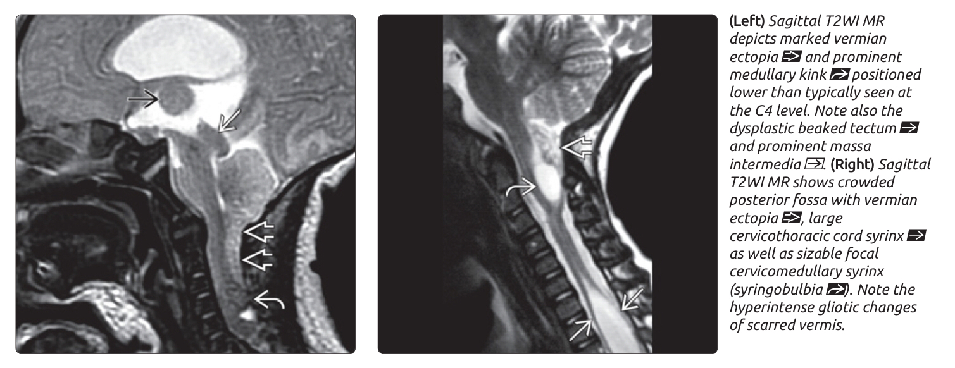
The confluence of sinuses can be as low as the rim of the foramen magnum, and the dura may contain large venous sinuses.
The choroid plexus is identified by its yellow-orange color and granular appearance.
The interface between vermis and medulla is usually densely adherent and difficult to separate.
The procedure is not thought to be finished until the avascular floor of the fourth ventricle is well visualized.

Slide 34
COMPLICATIONS
Common
Direct vascular or neural injury
Pseudomeningoceles.
CSF leaks
Meningitis
Bleeding from dural venous lakes can be profuse at times
Less common
Occipital-cervical instability.
Acute postoperative hydrocephalus secondary to Infratentorial hygromas.
Anterior brainstem compression from a retroflexed odontoid.
Cerebellar slump or ptosis:
Which results from extending a craniectomy so far laterally that the cerebellum herniates through the craniectomy defect.

Slide 35
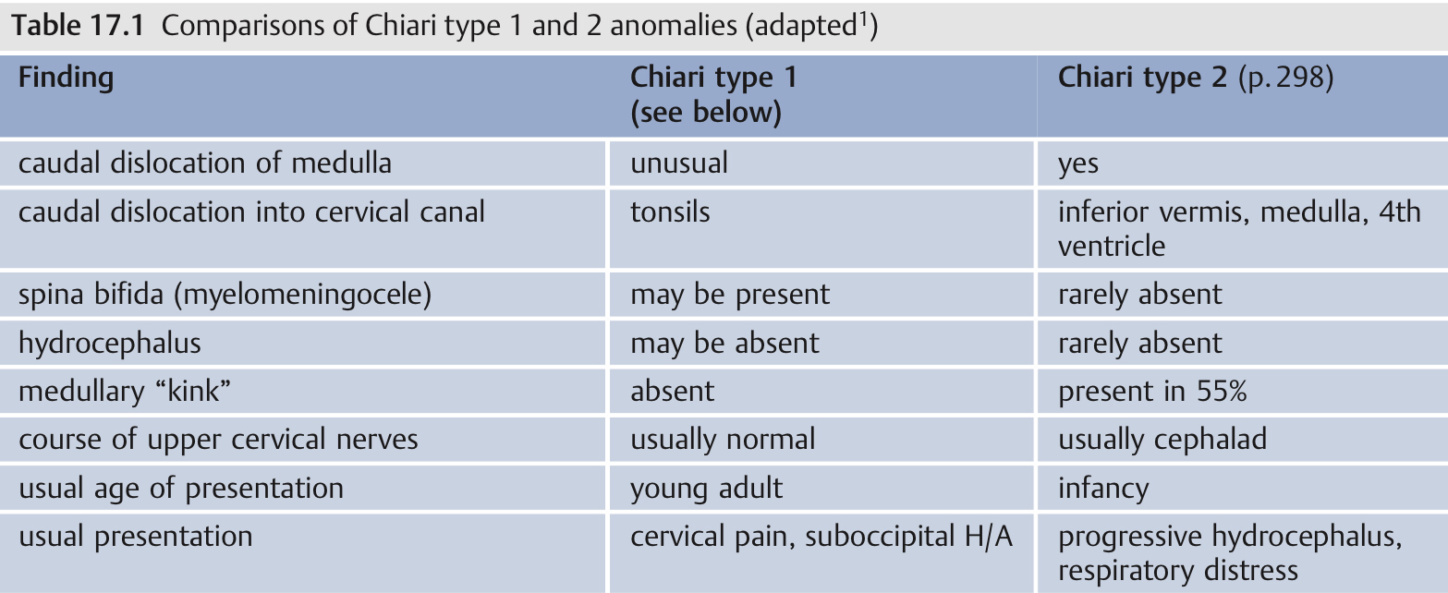
Prognosis
Early recognition and treatment of brainstem compromise in Chiari II patients produces prompt and long-term clinical recovery.
FOLLOW-UP
Children with symptomatic CIIM require closer follow-up.
MRI is performed at 3 months to evaluate ventricular size .

Slide 36
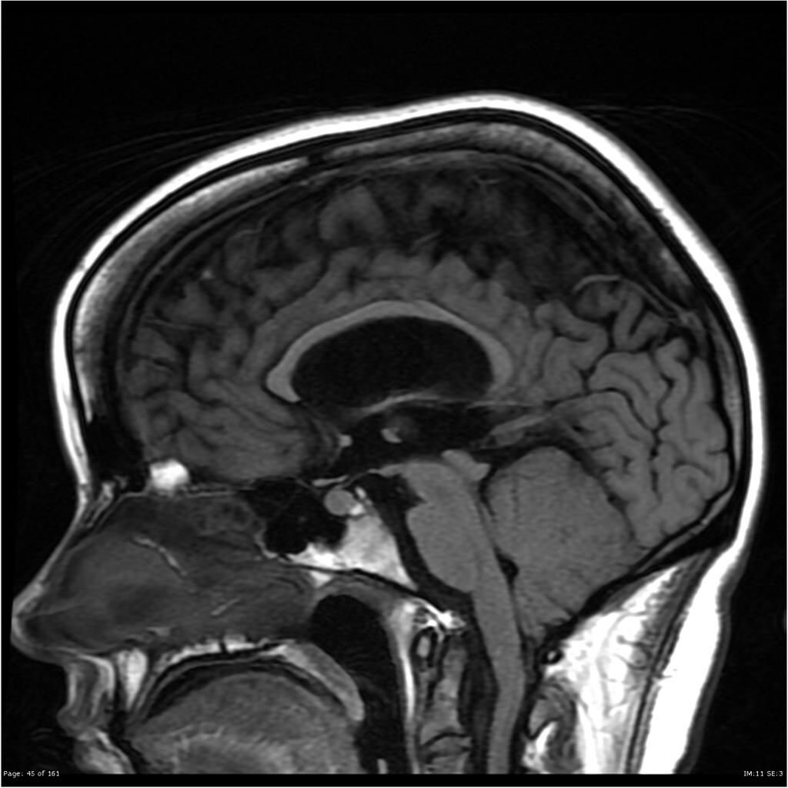

Slide 37
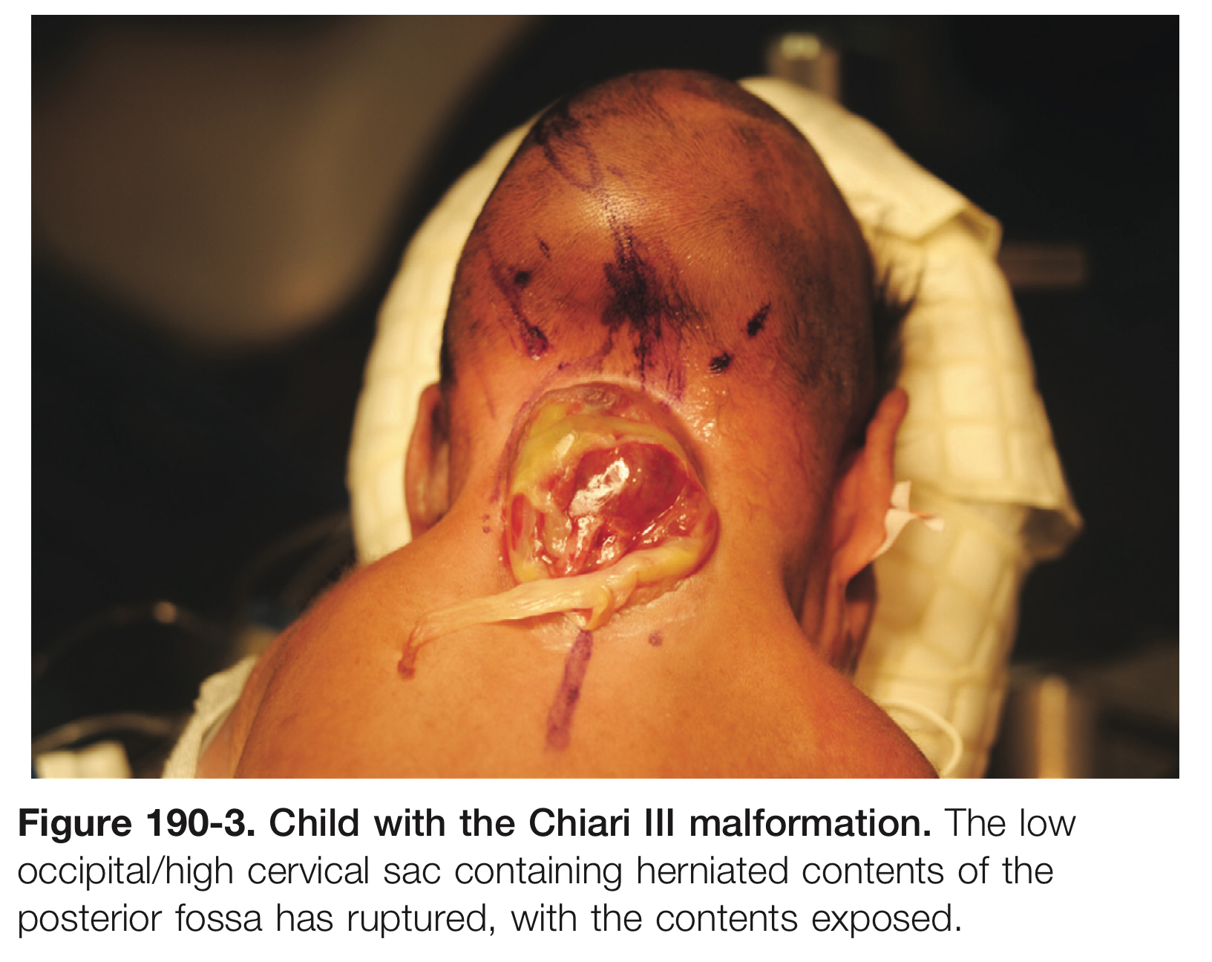
Chiari III Malformation
AKA rhombencephalocele
The rarest & the most severe form
Herniation of cerebellum and brainstem into a posterior encephalocele.
Severe neurological, developmental, and cranial nerve defects, in conjunction with seizures and respiratory insufficiency, are common.
Surgical planning follows the same basic principles of any encephalocele closure.
Poor prognosis.

Slide 39
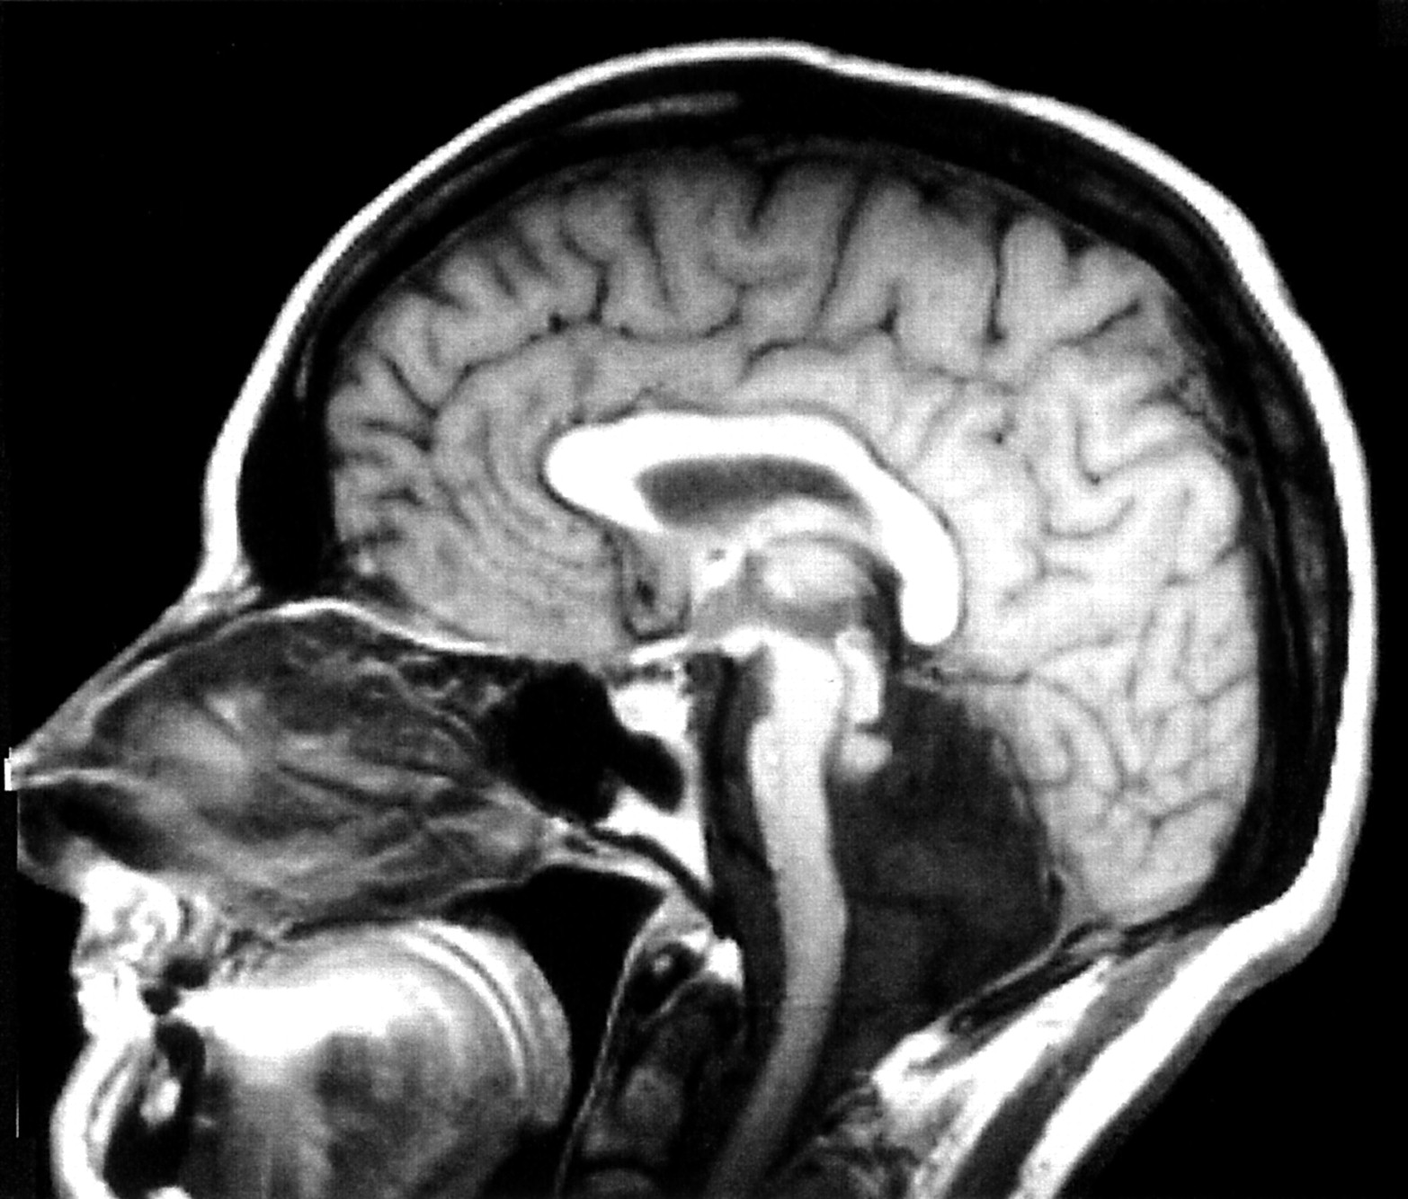
Chiari IV Malformation
Consisting of
Cerebellar hypoplasia or aplasia.
Posterior fossa is normal in size.
Absence of any hindbrain herniation.

Slide 40
Chiari 0 Malformation
Syringomyelia without tonsillar herniation that responds to posterior fossa decompression.
Abnormal CSF flow at the posterior fossa or foramen magnum was the suspected cause.
Causes include
Crowded foramen magnum.
Multiple arachnoid adhesions.
4th ventricular arachnoid veil.
Respond to posterior fossa decompression and duraplasty without direct fenestration or management of the syrinx.
Exclude other causes of syrinx is necessary before consideration of posterior fossa decompression.

Slide 41
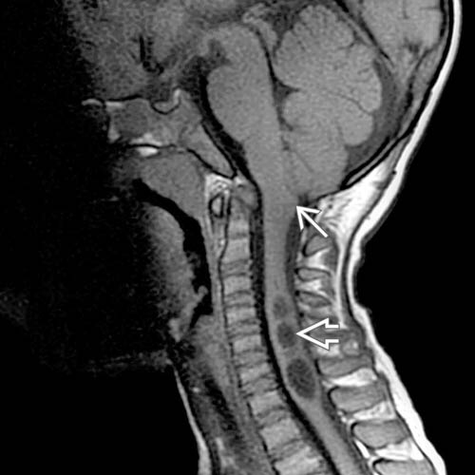
Sagittal T2WI MR reveals syringohydromyelia of the midcervical spinal cord in conjunction with low obex position. The cerebellar tonsils are rounded without abnormal caudal descent.
Sagittal T1WI MR confirms midcervical syringohydromyelia . No cerebellar tonsillar ectopia is present to explain syringohydromyelia, although the obex is low, prompting clinical consideration of Chiari 0 malformation.

Slide 42
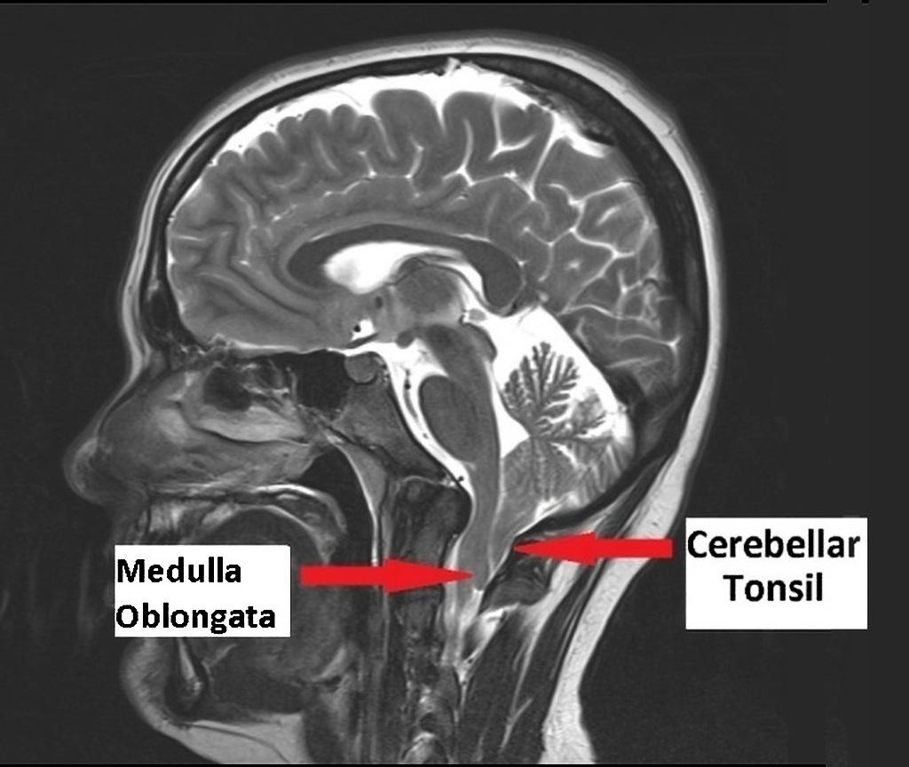
Chiari 1.5 Malformation
bulbar variant of Chiari I malformation
Is the combination of cerebellar tonsillar herniation (as seen in CIM) along with caudal herniation of some portion of the brainstem (often obex of the medulla oblongata) through the foramen magnum.
It is considered a progression of Chiari I malformation.

Slide 43
Syringohydromyelia
Syringomyelia is the development of a fluid-filled cavity or syrinx within the spinal cord.
Hydromyelia is a dilatation of the central canal by cerebrospinal fluid (CSF) and may be included within the definition of syringomyelia.
If the 4th ventricular pulsations were overactive
the tentorium would be pushed upward, and a Dandy-Walker malformation could develop.
If the supratentorial pulsations were overactive
Tentorial migration would become such that the posterior fossa is small, allowing the development of a Chiari malformation.

Slide 44
Valsalva maneuvers resulted in
Epidural venous congestion —> increase ICP & intraspinal pressure —> fluid to flow both cranially and caudally.
Although flow into the cranial compartment meets no resistance, caudal flow is delayed by hindbrain adhesions and outlet obstruction, thus creating a pressure differential between the cranial and spinal compartments.
During systole, there is normally movement of CSF in a caudal direction across the foramen magnum to counter the increased intracranial volume of blood and maintain physiologic intracranial pressure. This flow reverses in diastole.

Slide 45
Thank you

