Slide 1
INTRATHECAL DRUG PUMP Baclofen & Morphine Pump Youmans Chap. 242

Slide 2
Introduction
Baclofen, a γ-aminobutyric acid B receptor (GABAB) agonist is produced as both an oral agent and an intrathecal agent.
The use of the oral agent can be limited by its side effects.
In children, these are excessive sedation and academic difficulties, both of which are much less prevalent in ITB therapy.
The short half-life of the drug in cerebrospinal fluid (CSF) mandates use of a continuous delivery system.
Intrathecal drug pump
Intrathecal drug delivery, or “pain pump” is a method of giving medication directly to your spinal cord.
The system uses a small pump that is surgically placed under the skin of abdomen and delivers medication through a catheter to the area around spinal cord.
The goal of a drug pump is to better control of symptoms and to reduce oral medications; thus reducing their associated side effects.

Slide 3
Intrathecal Morphine Pump
They used as palliative management of
oncologic pain
neuropathic pain syndromes.
As a hydrophilic opioid, morphine is the most commonly used intrathecal drug because of limited sequestration in adipose tissue and delayed clearance from the cerebrospinal fluid compared to other lipophilic opioids.
Risk of respiratory depression and pruritus.
complications including catheter malfunction, catheter granulomas.
Long-term use → hypogonadotropic hypogonadism and other hormonal disturbances.

Slide 4
The intrathecal pump system
The intrathecal pump system consists of a pump/reservoir implanted between the muscle and skin of your abdomen and a catheter that carries pain medication from the pump to the spinal cord and nerves.

Slide 5
INDICATION
Chronic pain caused by:
Failed back surgery syndrome:
Reflex sympathetic dystrophy:
a progressive disease of the nervous system in which patients feel constant chronic burning pain.
Causalgia: a burning pain caused by peripheral nerve injury.
Arachnoiditis: painful inflammation and scarring of the meninges.
Cancer pain:
constant pain caused by tumors compressing the spinal nerves, or scarring from previous radiation therapy.
Chronic pancreatitis.
Spasticity caused by
Cerebral palsy:
a nervous disorder that impairs control of body movement.
Multiple sclerosis.
Stroke.
Brain injury.
Spinal cord injury.

Slide 6
Management of Hypertonia and Spasticity in Cerebral Palsy
Oral Medications (first line of intervention for spasticity)
Baclofen
(GABA) type B agonist. The initial dosage is 2.5 mg/day and is gradually increased to a maximum of 20-60 mg/day.
Tizanidine, Diazepam, Dantrolene Sodium.
Focal Spasticity
Botulinum Toxin, Phenol and Alcohol.
Multisegmental and Generalized Spasticity
Selective Dorsal Rhizotomy (SDR)
“Best typical” SDR candidate among patients with CP
Spastic diplegic pattern,
Born prematurely, who is already ambulating (or showing signs of developing ambulation, such as being a kneewalker).
(GMFCS levels I and II), are between 4 and 7 years of age
Intrathecal Baclofen (ITB)
GMFCS class III, IV or V

Slide 7
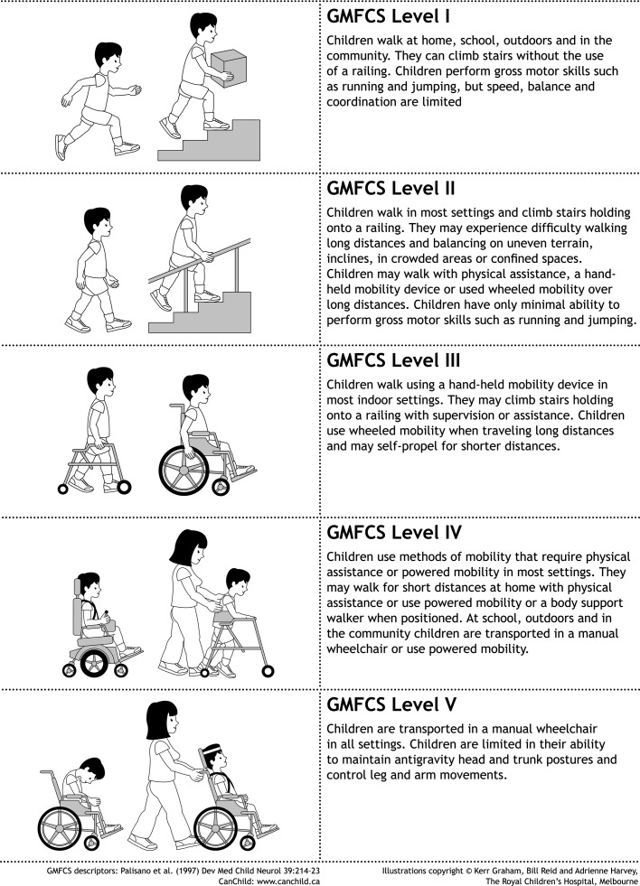
Gross Motor Function Classification Scheme (GMFCS)

Slide 8
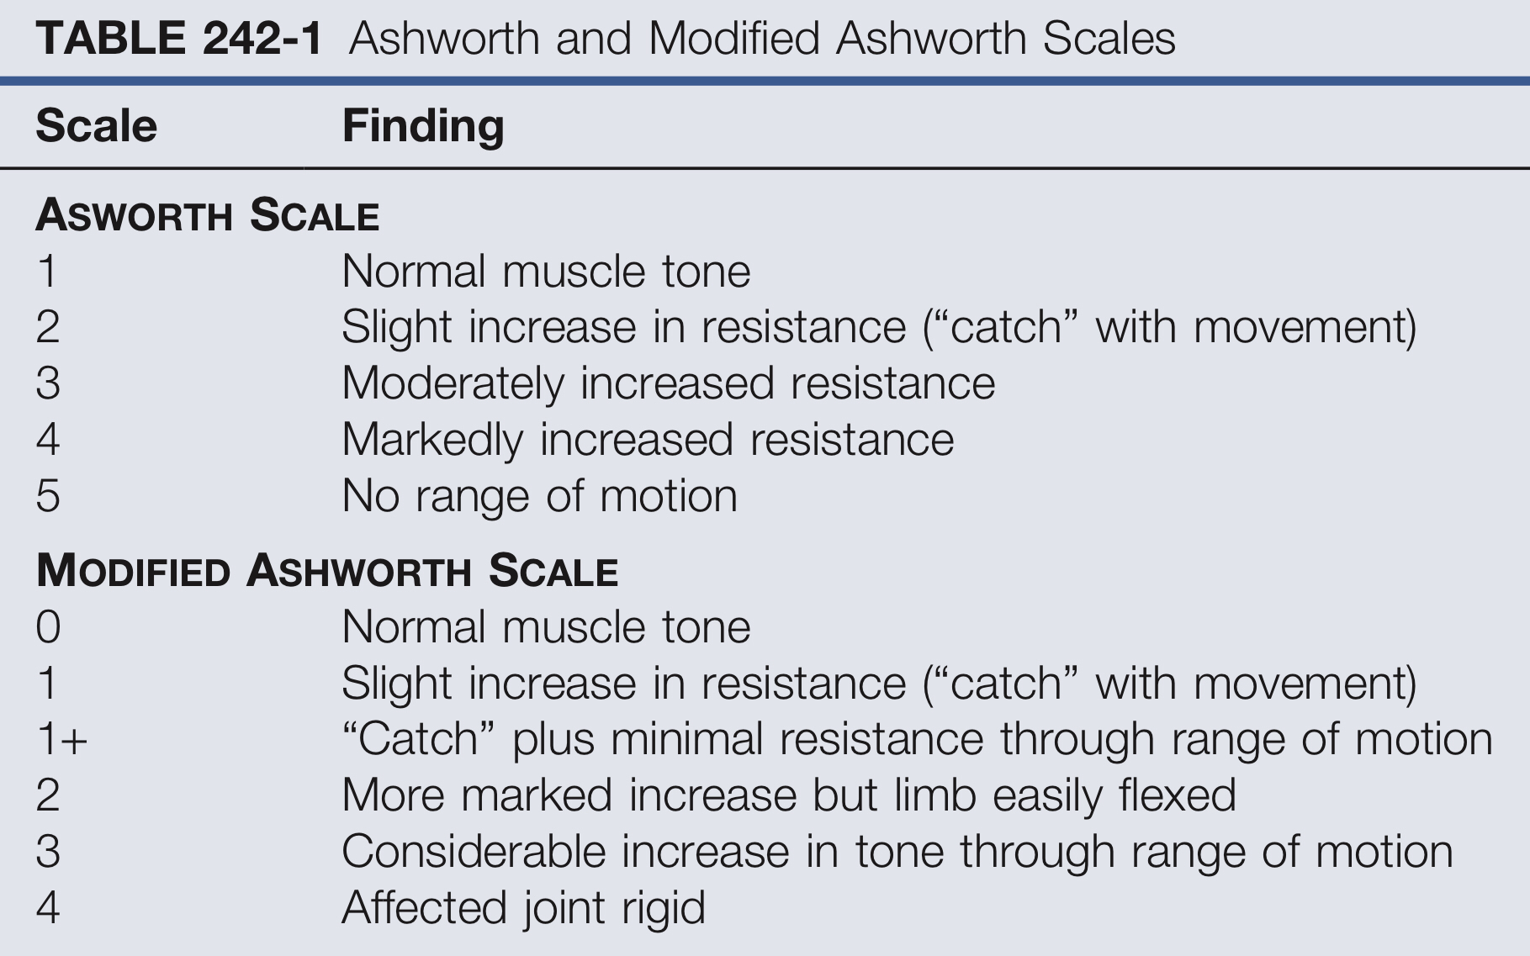
The Ashworth Scale, used for measuring spasticity

Slide 9
Selection criteria for baclofen pump
Age 18–65 yrs.
Able to give informed consent.
Severe, chronic spasticity (≥ 12 mos duration) due to spinal cord lesion or MS.
Spasticity refractory to oral drugs.
Positive response to IT baclofen at test dose ≤ 100 mcg.
Females of childbearing potential: not pregnant & using contraception.
No implanted programmable device such as cardiac pacemaker.
No CSF block (e.g. on myelography).
No hypersensitivity to baclofen.
No history of stroke, impaired renal function, or severe hepatic or GI disease.

Slide 10
SCREENING TESTS
A bolus dose could be as high as 50 µg, delivered over a few seconds.
This dose typically demonstrate whether there will be tone reduction.
but it does not represent a final steady-state dose.
Presumably, as the bolus effect wears off, the patient transiently experiences a level of tone control that would be acceptable in a long-term, steady-state situation.
Test doses: Incremental test doses of 50, 75, and then 100 mcg intrathecal baclofen (ITB) via lumbar puncture or temporary catheter.
The following parameters were evaluated at 0.5,1, 2, 4, 8 & 24 hrs post injection:
pulse and respiratory rate, BP.
hypertonia (Ashworth score).
reflexes, spasm score, voluntary muscle movement.
adverse effects (if any, including seizures).
Pump implantation was offered if there was a
2-point reduction in the Ashworth score for ≥ 4 hrs after bolus injection of active drug without intolerable side effects.
Usual daily dose for ITB is twice the test dose, typically 200 micrograms/d.

Slide 11
PUMP AND CATHETER IMPLANTATION
Under GA, lateral decubitus position.
The right side is most often used as abdominal pocket.
C-arm fluoroscope.
Preoperative antibiotics
A small incision over a lower lumbar interspace L2-L3.
Lumbar puncture slightly off-midline (in order to avoid having the catheter traverse the interspinous ligament).
Subarachnoid placement can be confirmed by backflow of CSF.
The catheter is threaded rostrally ≈ 3 levels, but should be no higher than T10 (risk of rostral progression of hypotonia).
The catheter tunneled to the pocket which is either subcutaneous or subfascial.
Subfascial location is often used in smaller patients a history of infection, but causes increased pain with refills as they age.
Postoperatively, flat bed rest for 72 hours.

Slide 12
For patients with a prior posterior spinal fusion with instrumentation, The following options exist for this situation:
Leave a segment instrumented but without bone graft: If the fusion is done at a time when the future pump surgery is anticipated.
A catheter can also be placed and then tucked into a subcutaneous pocket in the paraspinal region at the time of fusion. It is important that the end of the catheter be securely ligated to prevent both CSF leak and entrance of blood into the subarachnoid space.
Placed above an existing fusion.
Placing the catheter directly through the fusion is an option.
More favorable because
It minimizes the length of subcutaneous tubing
No stresses from spinal motion by entering through the fusion mass Which is important to:
Decreasing the risk of catheter fracture.
When drilling down to the dura, the surgeon must take care to allow for the frequently present rotational deformities.

Slide 13
Pump placement in a child with hydrocephalus:
If the child does not have a shunt → CSF leak after catheter placement.
For children with hydrocephalus and shunts
The basic surgical technique remains the same
Successful catheter placement may be harder to confirm (Specifically, the low CSF pressure in the child with a functioning shunt)
→ difficult to recognize successful dural puncture, because there is little or no backflow through the needle → Mx by Small laminotomy to visualize the dura directly and confirm puncture.

Slide 14
Reservoir volume available in 20-40 ml

Slide 19
DOSING
Pumps are filled and primed intraoperatively with starting dose of 100 μg/day.
Dose titration begins on the first postoperative day.
Rapid increases (of 10% to 20% of starting dose).
After discharge the rate of dose increases should be slowed to avoid overshooting.
The average final dose for a child with CP is in the range of 300 to 500 μg/day. Higher doses may be needed in children with spastic dystonia, but doses higher than 1500 μg/day are extremely rare.
the child who goes through a growth spurt and demonstrates increases in overall stiffness, a small change in dose (typically a 5% to 10% increase in the total daily dose) is sufficient to adjust.
If the process of achieving a final, steady-state dose appears difficult, use of complex programming options. (higher dose rate in the early morning hours to facilitate dressing, transfers, and transportation, but then allow some increase in tone, through a lower dose rate, during the school day to allow the child to sit upright)

Slide 20
With no abdominal site for pump implantation (e.g., because of multiple scars), the infraclavicular region is an alternative site.
T10-11 for patients with spastic diplegia
C7-T4 for those with spastic quadriparesis.
The initial reports of ITB for the treatment of spinal spasticity associated with spinal cord injury or multiple sclerosis positioned the catheter tip in the T10-12 region.

Slide 21
COMPLICATIONS
Most often be attributed to infection, catheter problems, and pump problems.
Infection:
Occur in about 5% to 10% of cases.
The most common organism identified is a staphylococcal.
Manifest within 1 to 2 months postop.
Minimum preoperative weight of 15 kg is desirable with enough room on the abdominal wall to accommodate a pump.
Because pump placement is elective, surgery is sometimes deferred until the child is proven to be gaining weight by high-calorie/high-fat diet or even placing a gastrostomy tube.
Patient is stable: avoid having the patient experience baclofen withdrawal by weaning, decreases of 5% to 10% in the dose once or twice daily (do not remove immediately).
Patient does not stabilize: risks of withdrawal are more likely justifiable (remove immediately).
A new pump can then be implanted, typically within 6 weeks to 3 months after explantation of the first pump.

Slide 22
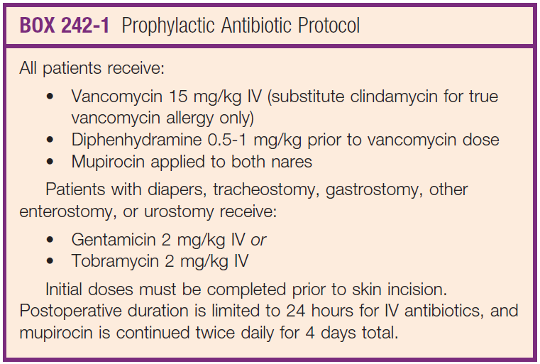

Slide 23
Catheter complications
More delayed fashion than infections.
Catheters can become dislodged, can fracture completely, or can develop microfractures.
Acute dislodgment and fracture:
Presentation with increased tone, severe itching and even seizure activity.
Plain films confirm the diagnosis.
Microfractured catheters:
story evolves over months
A dye study, with dye injected via the sideport, may reveal a point of damage to the catheter.
It is presumed that the period of bed rest results in enhanced delivery of the increased dose to the child, resulting in overdose with sedation. This effect reverses when the child sits up.

Slide 24
Pump problems
Primary malfunctions of the pump itself are rare.
Battery failure or inconsistent drug delivery near the end of the pump’s life is occasionally encountered.
(the elective replacement interval, or ERI), and replacement should be considered for any pump within the last 3-9 months of the ERI.
Transient complications of initial pump placement include sedation, hypotonia, and urinary retention.
They may be signs of mild overdose and respond to dose adjustment.
Headaches and nausea, which are often a sign of CSF leak, can be managed with standard interventions.

Slide 25
APPROACH TO THE PATIENT IN BACLOFEN OVERDOSE
Presentation:
Rostral progression of hypotonia.
Respiratory depression.
Coma, and seizures.
Acute postoperative overdoses: initial pump placement, or after revision.
In the case of the initial pump placement (no risk of experiencing baclofen withdrawal):
Naloxone and flumazenil If patient is unresponsive due to sedated postoperatively.
Pump is turned down to its lowest setting (but not turned off) If the patient remains unresponsive & the vital signs are stable.
Atropine, if exhibiting Bradycardia or respiratory suppression and has small pupils.
Finally, slow increases in the ITB dose may be started after recovery.

Slide 26
After pump revision:
The same issues come into play, with the added element to avoid creating withdrawal by dropping the pump dose too low.
2 option available
Making slower drops in the drug dose while recognizing how slow the return of responsiveness can be.
Turning the pump to its lowest possible setting while being prepared to respond rapidly to withdrawal symptoms.
Pump-related measures: from HB
Empty pump reservoir to stop drug flow (record amount withdrawn).
Administer physostigmine if not contraindicated.
Withdraw 30–40 ml CSF either via LP or through catheter access port.

Slide 27
APPROACH TO THE PATIENT IN BACLOFEN WITHDRAWAL
Causes
Empty pump reservoir.
Pump battery failure.
End of pump life (shut oﬀ automatically after 5 years).
Catheter migration/breakage/kinking/disconnection/occlusion.
Programming error.
Catheter tip granuloma.
Stiff-man syndrome (antibodies to glutamic acid decarboxylase which reduces available endogenous GABA).

Slide 28
APPROACH TO THE PATIENT IN BACLOFEN WITHDRAWAL
The following actions are taken consecutively:
50-μg bolus of baclofen is programmed and delivered, check the refill date and the ERI.
If the pump reservoir is low → refill.
If the refill is not needed but the ERI is low → pump replacement.
No response to the bolus.
Plain films are obtained.
Management of acute withdrawal is initiated, given oral baclofen and oral or intravenous (IV) diazepam.
Plain films demonstrate dislodgment or fracture → urgent surgery to replace the catheter.
No abnormality on imaging → Side port aspiration is performed → Inability to aspirate CSF implies an obstruction in the catheter system, and surgical exploration is advised.
If there is still no resolution to the withdrawal symptoms → occult hydrocephalus should be considered because a disturbance in CSF flow dynamics can manifest as baclofen withdrawal.
In the patient with unexplained baclofen withdrawal → Surgical exploration of the pump.

Slide 29
Syndromes with abrupt discontinuation of ITB:
Mild withdrawal symptoms: return of spasticity and rigidity, tachycardia, piloerection (goosebumps) & pruritus (pruritus without a rash is very suggestive of ITB withdrawal).
More significant withdrawal symptoms: seizures & hallucinations.
Severe withdrawal symptoms: increased rebound spasticity, rigidity, fever, labile BP, and reduced level of consciousness.
If untreated, the severe syndrome can progress over 24–72 hours to
Rhabdomyolysis (with elevated creatine phosphokinase (CPK)and transaminase),
Hepatic and renal failure,
DIC,
Occasionally death.

Slide 30
Thank you

