Slide 1
Arachnoid Cyst youmans Chap 189

Slide 2
Arachnoid cysts are benign, nonneoplastic fluid collections within the arachnoid layer of the meninges.
M : F ( 2 : 1 ) in both adults and children.
Most common site in
  Men: temporal fossa arachnoid cysts.
  Women: CPA arachnoid cysts.
Most arachnoid cysts appear to be congenital anomalies.
They are usually discovered on work-up of headache, increasing head circumference, or developmental delay, or after trauma .
Rarely, they have been observed to cause weakness and cranial neuropathies or have been associated with seizures and psychiatric disorders.
Arachnoid cysts secondary to trauma, hemorrhage, or meningitis have also been described.
Most common is asymptomatic 👍🏻

Slide 3
Intracranial Distribution :
  Middle Fossa Or Sylvian Fissure 49%
  Cerebellopontine Angle 11%
  Quadrigeminal Plate Area 10%
  Vermis 9%
  Suprasellar ( Paraseller ) Area 9%
  Interhemispheric Fissure 5%
  Cerebral Convexity 4%
  Interpeduncular Area (clival) 3%
Rate of symptom
  Increase in CPA, quadrigeminal cistern, sella, and ambient cisterns.
  Lower in Middle fossa cysts
  MCQ VS ICI

Slide 4
Pathology
AC : a loculated cavity within the arachnoid mater without discrimination of the wall or cyst content
Although most cysts had
  Walls of normal arachnoid cells.
  Some demonstrated fibrosis.
  Some demonstrated microvilli and cilia.
Arachnoid cyst contents are very similar, but not identical to (CSF).
Different by concentration of protein, LDH, and phosphate.
The underlying cortex is usually normal, but some gliosis may be present
The Distinguishing features of the arachnoid cyst wall versus a normal arachnoid membrane include
  Split of the arachnoid layer at the margin of the cyst.
  Increased thickness of the collagen layer
  Absence of the cobweb-like trabeculations of normal arachnoid.
The cyst fluid is clear and devoid of cellular or proteinaceous material. Inflammatory cells and hemosiderin are absent from the fluid or cyst walls

Slide 5
Pathogenesis
Arachnoid cyst have higher incidence with some syndromes like
  Marfan's syndrome
  Neurofibromatosis
  Autosomal Dominant Polycystic Kidney Disease
  Tuberous Sclerosis
Arachnoid cysts are postulated to arise from splitting of the arachnoid membrane in early development.
Its enlarge because of an
  Osmotic pressure gradient.
  Active secretion by the cyst wall lining or ectopic choroid-like structures.
  CSF movement through a communication between the subarachnoid space and the cyst during venous or arterial pulsations.
A slit valve is often noted between the cyst and basal cisterns.

Slide 6
Clinical features
Progressive macrocephaly, intracranial hypertension, headache, hydrocephalus, and developmental delay.
In adults, headache was the most common complaint found in patients considered to have symptomatic arachnoid cysts, but hydrocephalus, ataxia, vertigo, hearing loss, and seizures were also common complaints in this population
Factors predispose Arachnoid cysts to Intracranial Hemorrhage
  After mild head trauma.
  Large size cyst

Slide 7
Middle cranial fossa Arachnoid cyst
Male more than female
Left side 66%
Symptom
  Most commonly unilateral Supra orbital or temporal Headache ,
  Seizure is 2nd common symptoms as focal, complex type, generalized in 1/3 of patient.
Galassi Grading
Type I: small, biconvex, located in anterior temporal tip. No mass effect. Communicates with subarachnoid space.
Type II: involves proximal and intermediate segments of Sylvian fissure. Completely open insula gives rectangular shape, Partial communication.
Type III: involves entire Sylvian fissure, Marked midline shift, Bony expansion of middle fossa (elevation of lesser wing of sphenoid, outward expansion of squamous temporal bone), Minimal communication.

Slide 8
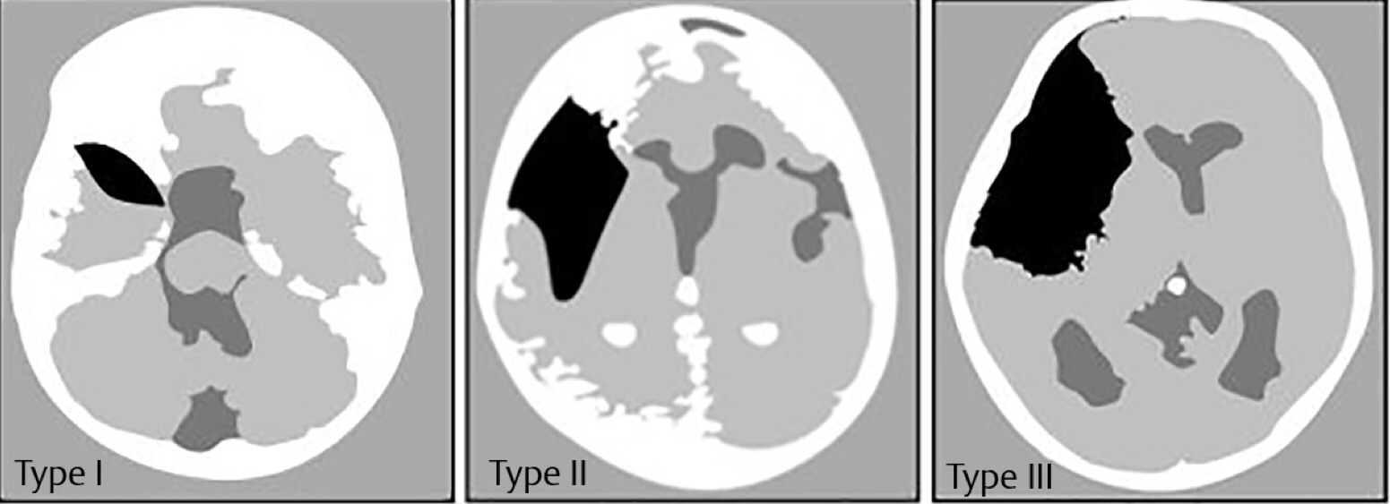

Slide 9
Suprasellar Arachnoid Cyst.
50% of suprasellar occur in child < 5 years old.
Commonly present with hydrocephalus
Visual symptoms, gait ataxia , bobble head doll syndrome.
Endocrinopathies 10 – 60% as precocious puberty or GH deficiency
Intrasellar arachnoid
Sellar arachnoid cysts arise as a diverticulum of the suprasellar arachnoid through an opening in the diaphragma sellae.
Cysts are uncommon and, typically present with symptoms in 4th & 5th decade of life.
The most common presenting symptom is headache, but vision changes and endocrinopathy are also common.
Treated through ventral endonasal transsphenoidal approaches

Slide 10
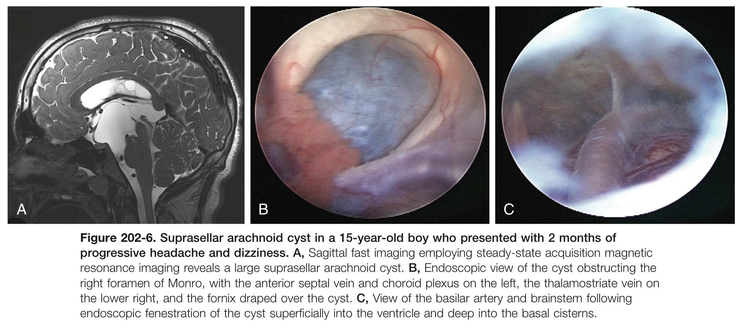

Slide 11
A, Computed tomography showing suprasellar arachnoid cyst with associated hydrocephalus.
B, T2-weighted magnetic resonance imaging showing suprasellar arachnoid cyst with associated hydrocephalus.

Slide 12
Arachnoid cysts of the cerebral convexities
Usually present with headaches, seizures, or both
Small cysts may focally compress the underlying brain and thin the overlying bone, whereas large cysts may lead to asymmetrical calvarial expansion, suture diastasis, and hemispheric distortion.
Arachnoid cysts in the quadrigeminal cistern
Abutting the collicular plate may cause hydrocephalus by obstructing the sylvian aqueduct. They are significantly more likely to cause symptoms. Progressive macrocephaly in an infant is the most common presentation.
Other symptoms and signs associated with quadrigeminal plate cistern arachnoid cysts include Parinaud’s syndrome nystagmus, hearing deficits, trochlear nerve palsy, and apneic spells.

Slide 13
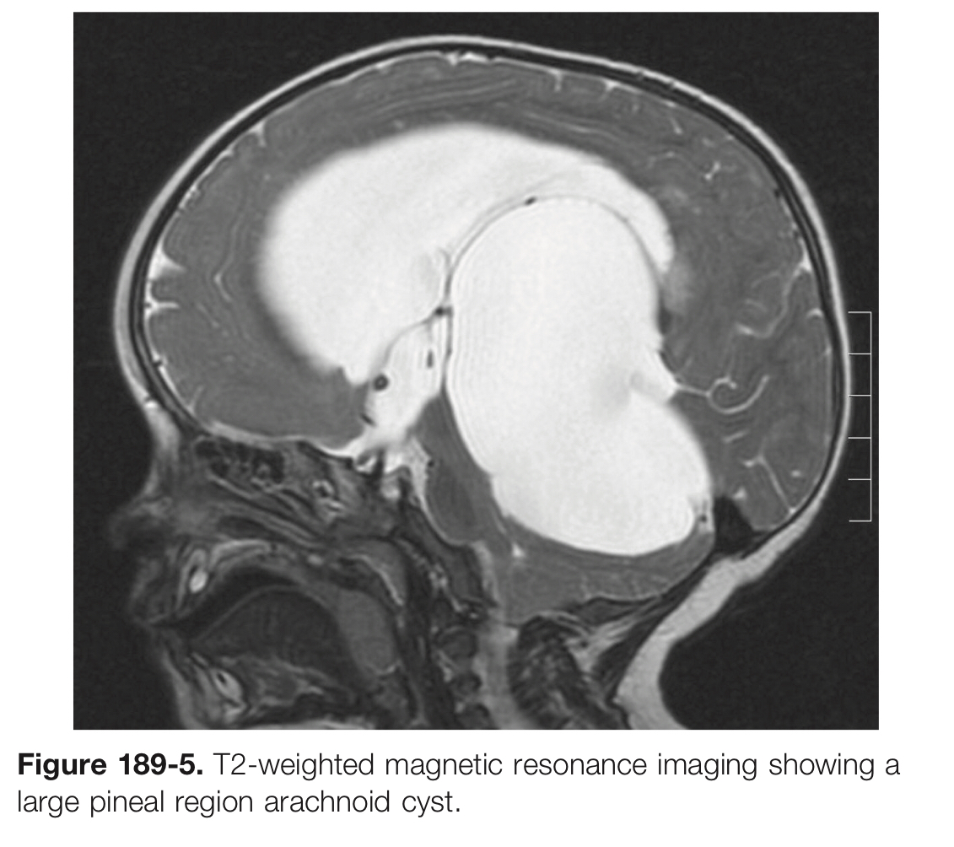

Slide 14
Interhemispheric
Cysts are often associated with agenesis of the corpus callosum.
They present with macrocephaly and asymmetrical growth of the calvaria.
They tend to be associated with increased ICP , developmental delay, hypertonia or hypotonia, hemiparesis, ocular changes, and epilepsy.
T2-weighted magnetic resonance imaging showing a large hemispheric arachnoid cyst.
T1-weighted magnetic resonance imaging showing an interhemispheric arachnoid cyst.

Slide 15
CPA Arachnoid Cyst
cerebellopontine angle can present with tinnitus, vertigo, facial weakness, facial sensory loss, hearing loss, or ataxia.
The presentation may be indistinguishable from Meniere's disease.
Other presentations have included trigeminal neuralgia and hemifacial spasm.
Large midline posterior fossa cysts often present with obstructive hydrocephalus .
Differential Diagnosis
  Mega Cisterna Magna .
  Dandy-walker Malformation .
  Epidermoid Cyst .
  Large Cystic Tumors .

Slide 16
Diagnosis
Noncontrast CT scan is sufficient to differentiate AC from other cystic lesion.
CT cisternography or cystography may show communication of the cyst with the basal cisterns and subarachnoid space
Electrocardiogram-gated cine-mode MRI sequences in 95% can show communication.
CISS MRI to delineated adjacent anatomical structures.
DWI Not restricted.
Many cystic lesions appear
  Hyperintense on T2
  Hypointense on T1
  Although the appearance of the cystic margin, surrounding edema, and contrast enhancement can provide clues to the diagnosis

Slide 17
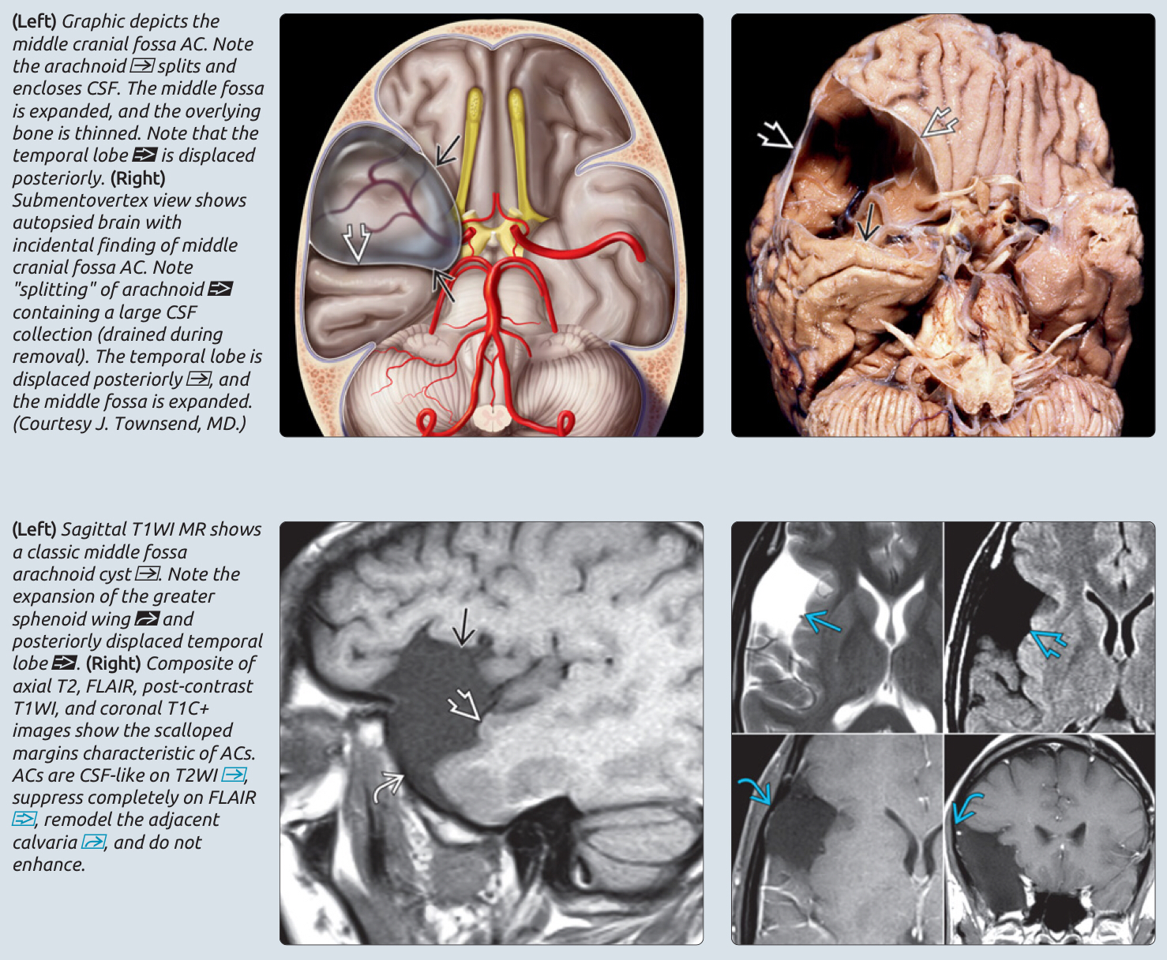

Slide 18
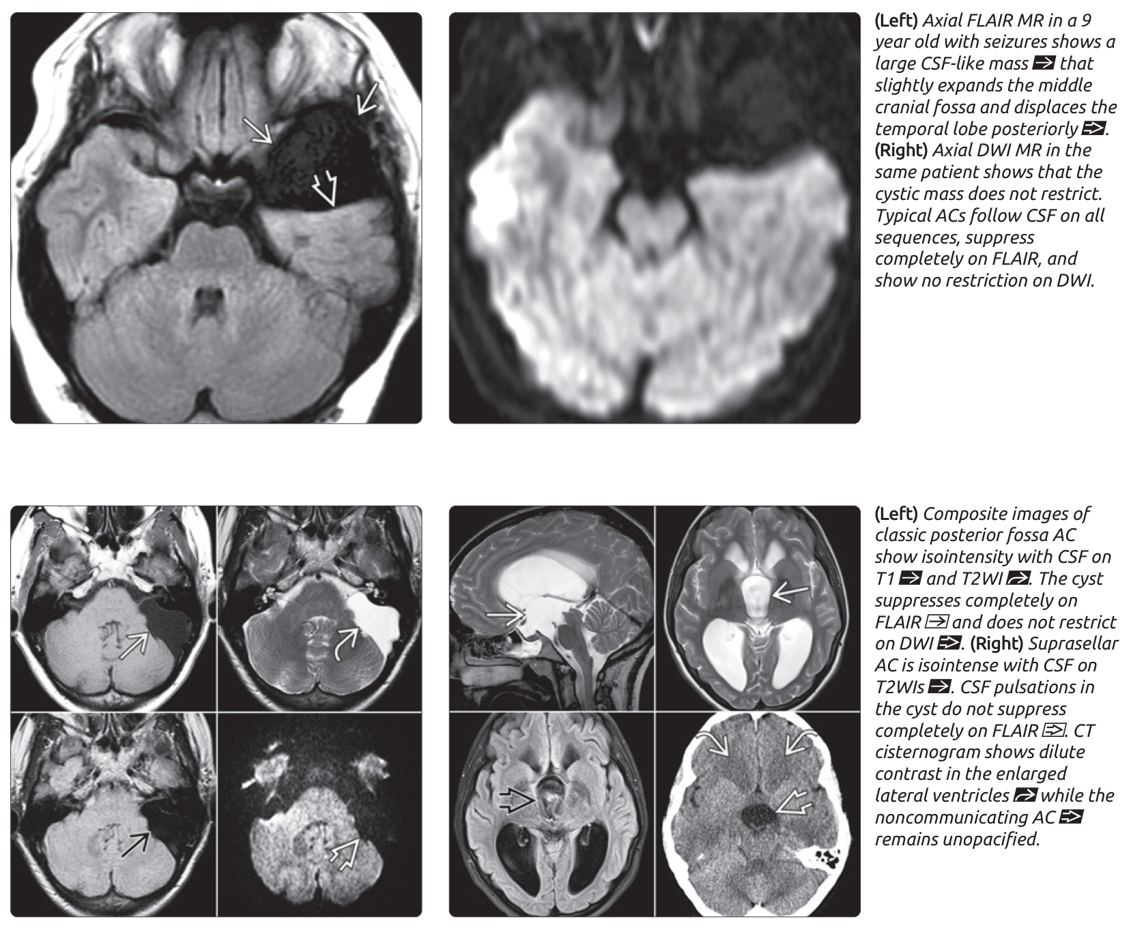

Slide 19
DIFFERENTIAL DIAGNOSES
Epidermoid cyst
Chronic subdural hematoma
Subdural Hygroma
Other nonneoplastic cysts
  Porencephalic cyst
  Neurenteric cyst
  Neuroglial (glioependymal) cyst

Slide 20
Treatment
Conservative :
Symptomatic treatment of Headache and serial follow up.
Surgery:
Open microsurgical craniotomy :
  The preferred method of treatment.
  Fenestration or excision of cyst wall then fenestration of the adjacent arachnoid membrane into the nearest cistern or ventricle.
  This method is significantly less effective if the patient has preoperative hydrocephalus.
Cystoperitoneal shunt :
  With adjustable pressure valve this provide more reduction in cyst volume when compare with microsurgery fenestration, and avoidance of low-pressure or valveless shunts.
  For patients presenting with quadrigeminal cistern or pineal region arachnoid cysts, Torkildsen shunt offers the ability for cyst drainage without the risk for overdrainage.

Slide 21
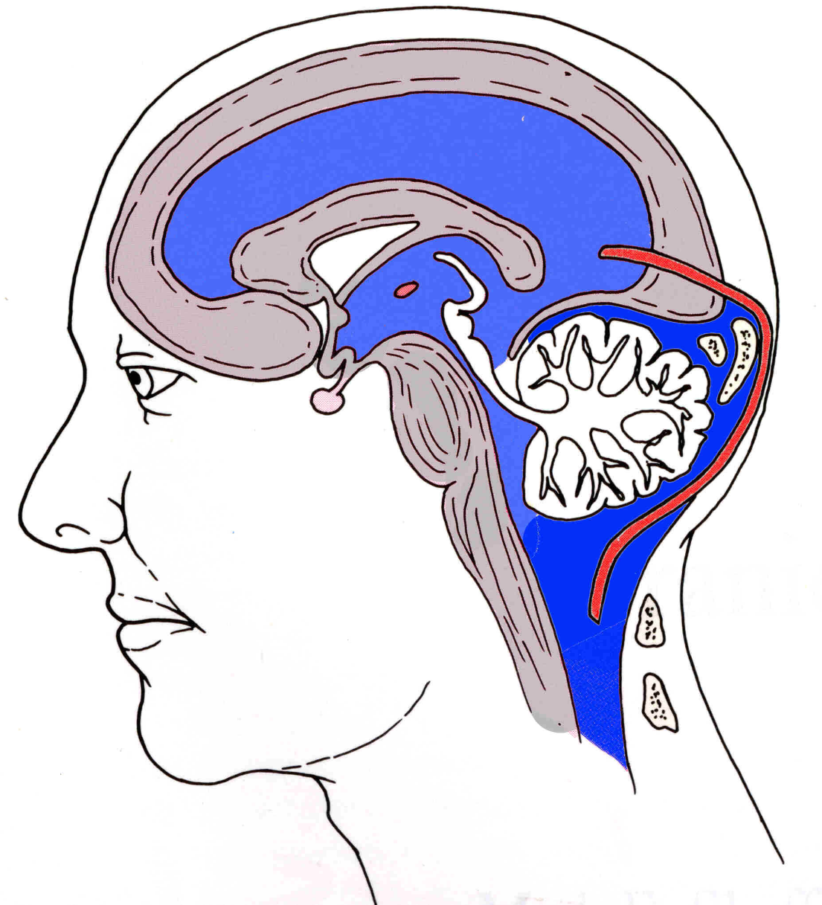
Torkildsen operation is a ventriculo-cisternal shunt that diverts the cerebrospinal fluid flow from one of the lateral ventricles or cyst, via a ventricular catheter, to the cisterna magna of the posterior fossa.

Slide 22
Rupture of arachnoid cysts, with or without traumatic history, can result in development of a subdural hygroma and presentation of headache, nausea, and emesis.
These hygromas, and the accompanying symptomatology, frequent resolve over time and do not necessarily require operative treatment.

Slide 23
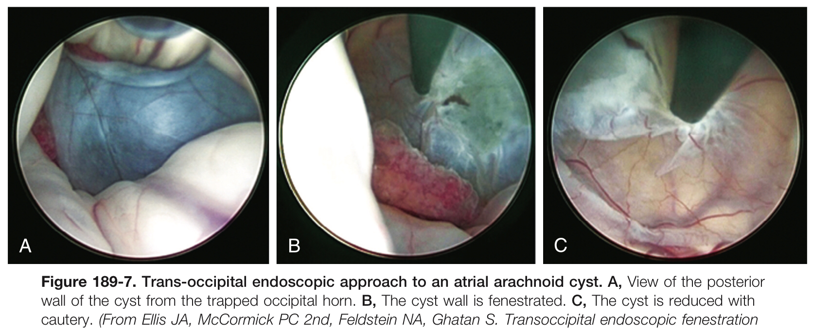
Endoscope fenestration :
  Suprasellar, quadrigeminal, and posterior fossa cysts have higher rates of success compared with sylvian fissure and interhemispheric cysts.
  The most common postoperative complications include
    SDH
    Subdural effusion
    Cyst recurrence
  Ventriculocystocisternostomy may produce more durable results compared with ventriculocystostomy.

Slide 24
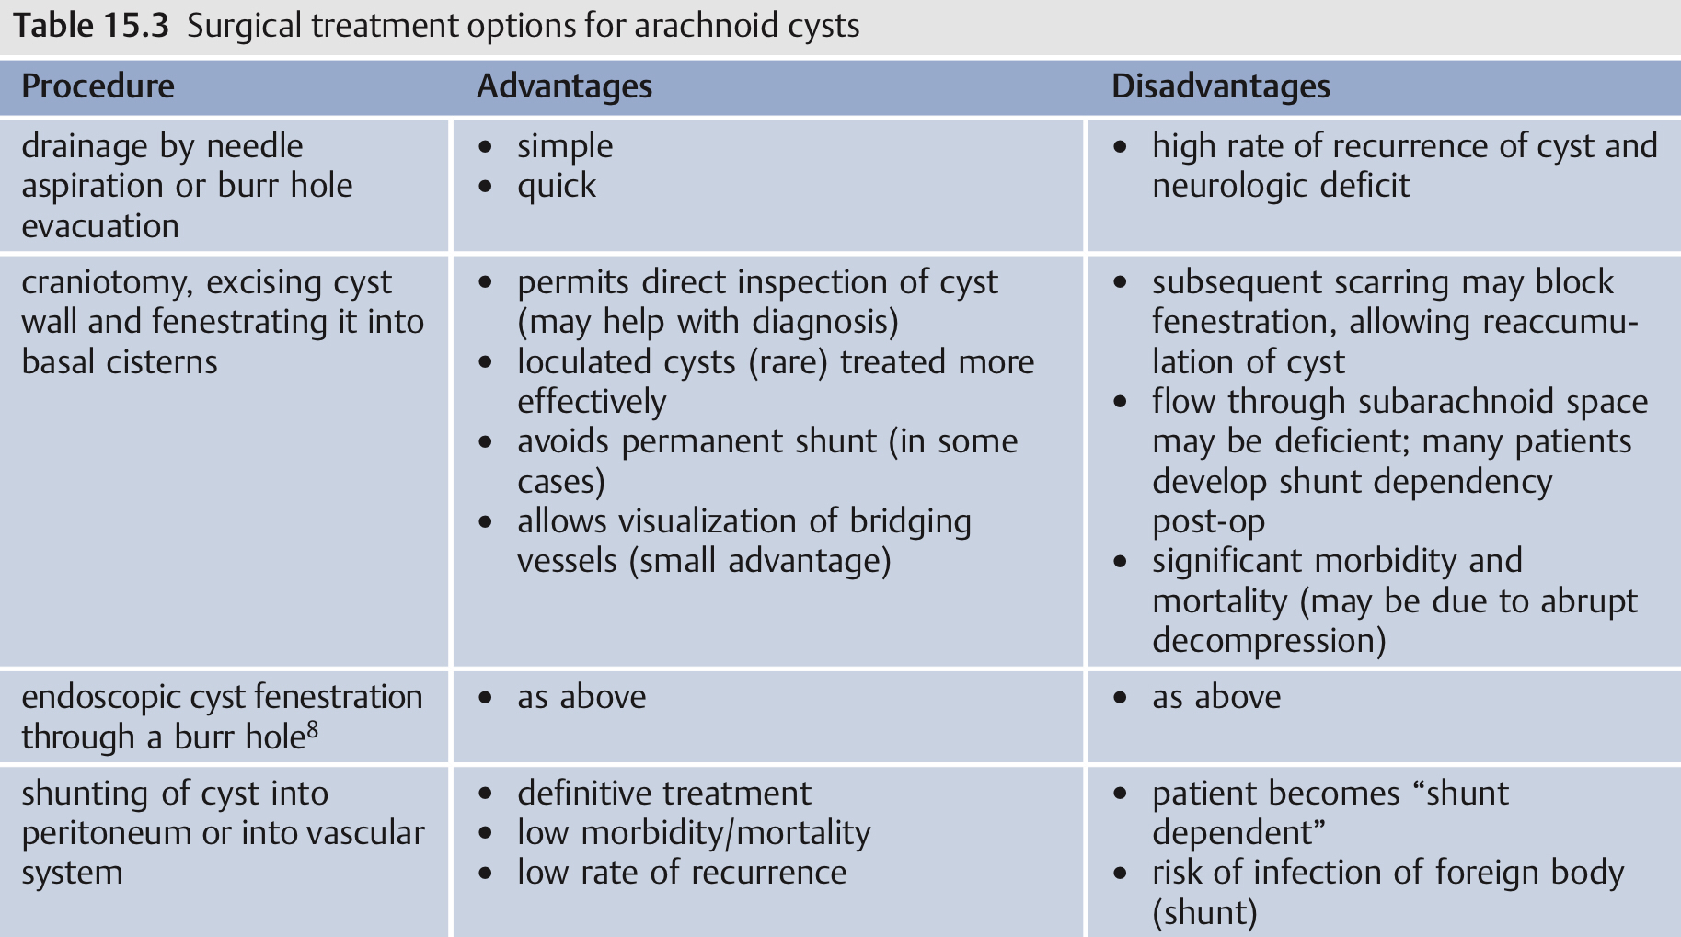

Slide 25
Spinal arachnoid cyst
Within the spine, arachnoid cysts can be either Intradural or Extradural.
They tend to be located in the Thoracic Spine, present with subtle symptoms, and may mimic cord compression
Affected patients often Complain of
  Intermittent back pain or radicular pain that may be exacerbated by Valsalva maneuvers.
  Chronic myelopathy.
  Intradural AC found Ventral to Spinal Cord and cause myelopathy
  whereas those found Dorsal to Spinal Cord cause numbness
MRI is the most sensitive and specific study of arachnoid cysts
The Goals of surgical intervention are similar to those of intracranial cysts,
  Wide fenestration of the cyst alone may be sufficient to avoid recurrence.
  A posterior approach usually provides sufficient exposure of both ventral and dorsal cysts.
  Weakness and myelopathy generally respond better to surgery than pain and numbness.

Slide 26
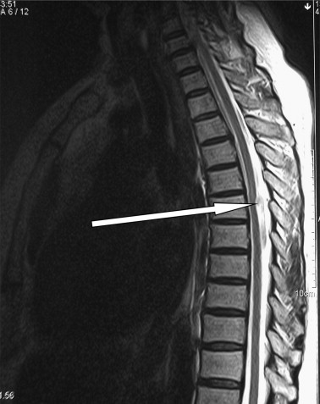
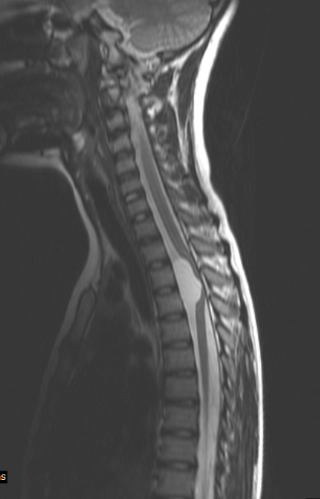
untreated spinal arachnoid cysts may cause syringomyelia.

Slide 27
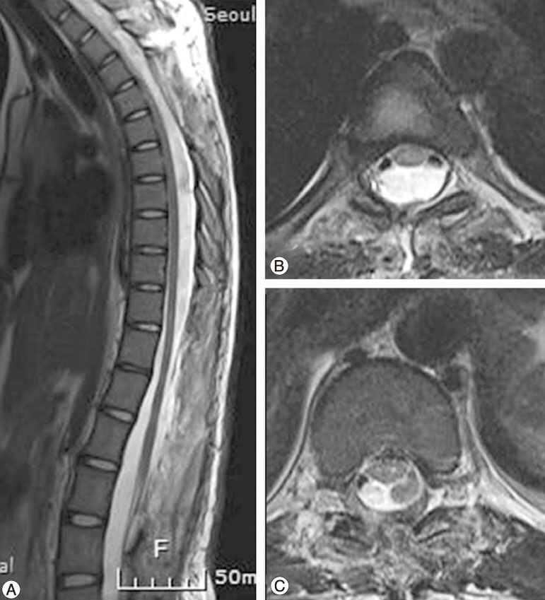

Slide 28
Thank You

