Slide 1
Pathophysiology of Chronic Subdural Hematomas Youmans Chap. 33

Slide 2
Also called Pachymeningitis hemorrhagica interna
Chronic subdural hematoma (CSDH) defined as liquefied hematoma in the subdural space with a characteristic outer membrane and occurring, at least 3 weeks after head injury.
Subdural hygroma contains cerebrospinal fluid (CSF) and, is xanthochromic, which means that bleeding occurred at some point.
Factors associated with increased risk of CSDH are as follows:
Increasing age
Alcohol consumption
Male sex ( M:F — 3:1 ).
Use of anticoagulant or antiplatelet drugs (the most common)
Alzheimer’s disease
Dialysis
The period after VP shunting for hydrocephalus
Spontaneous intracranial hypotension
Lumbar puncture
Spinal anesthesia
Spinal surgery complicated by dural tears

Slide 3
Etiology
The most common theory of the cause of CSDH is that minor inertial brain injury causes movement of the brain within the skull and tears bridging veins as they traverse the cell layer of the dural border.
History of trauma in the months before diagnosis.
The second etiology is from a subdural hygroma, a collection of cerebrospinal fluid in the subdural space caused by the splitting of the dural border cell layer at points of tension between the dura mater and arachnoid mater. This has been shown to occur spontaneously, especially in asymmetrical skulls where the tension may not be spread evenly.

Slide 4
Mechanism
Blood within the subdural space evokes an inflammatory response.
Within days, fibroblasts invade the clot and form neomembranes on the inner (cortical) and outer (dural) surface.
Followed by ingrowth of neocapillaries, enzymatic fibrinolysis, and liquefaction of blood clot.
Fibrin degradation products are reincorporated into new clots and inhibit hemostasis.
CSDHs are encapsulated, flattened structures usually located over one cerebral convexity, although they are bilateral in 20%.
The outer membrane is thick up to 10 mm.
The inner membrane is a thin (30-300 µm), relatively avascular layer of cells adherent to the residual dural border cells and arachnoid cells.
CSDHs contain fluid ranging from yellow to dark brown, described as like coffee, red wine, or engine oil.
The cause of enlargement of CSDH is recurrent hemorrhage into the subdural fluid from the outer membrane. Fibrinolysis and inflammation are probably pathophysiologically important and are known to interact.

Slide 5
CLINICAL PRESENTATION
Common presenting symptoms and signs include
Headache.
Limb and gait disturbance.
Hemiparesis/hemiplegia.
Cognitive decline.
Confusion.
20% to 30% of CSDHs may be completely asymptomatic and discovered incidentally.
Consciousness level at presentation is usually normal or only slightly altered, although a minority (20%) may present with GCS < 13.

Slide 6
Radiology
CSDHs are
Hypodense in the early stage.
Isodense or of high density in the mature stage.
Mixed density in the progressive stage.
Low density in the resolving phase.
The mainstay for diagnosis is CT.
Hypodense (chronic, <30 Hounsfield units)
Isodense (subacute, 30-60 Hounsfield units)
Hyperdense (acute, >60 Hounsfield units)

Slide 7
Recurrence is defined, as return of symptoms within some time after surgery (variably defined as up to 6 months) with or without expansion of the CSDH or with expansion of residual postoperative CSDH.
It is reported in 9% to 27% of patients.
Risk factors for recurrence include
Bleeding disorders.
Intracranial hypotension.
Older age, brain atrophy, diabetes mellitus, alcohol abuse.
Bilateral CSDH.
CT appearance ( Separation and gradation ).
Absence of a drain.
Postoperative accumulation of subdural air, inflammatory cytokine concentrations in the CSDH fluid.
Recurrence rate
Higher recurrence rates in the separated subtype (36%)
Lower recurrence rates in the trabecular subtype (0%)

Slide 8
10%-15%

Slide 12
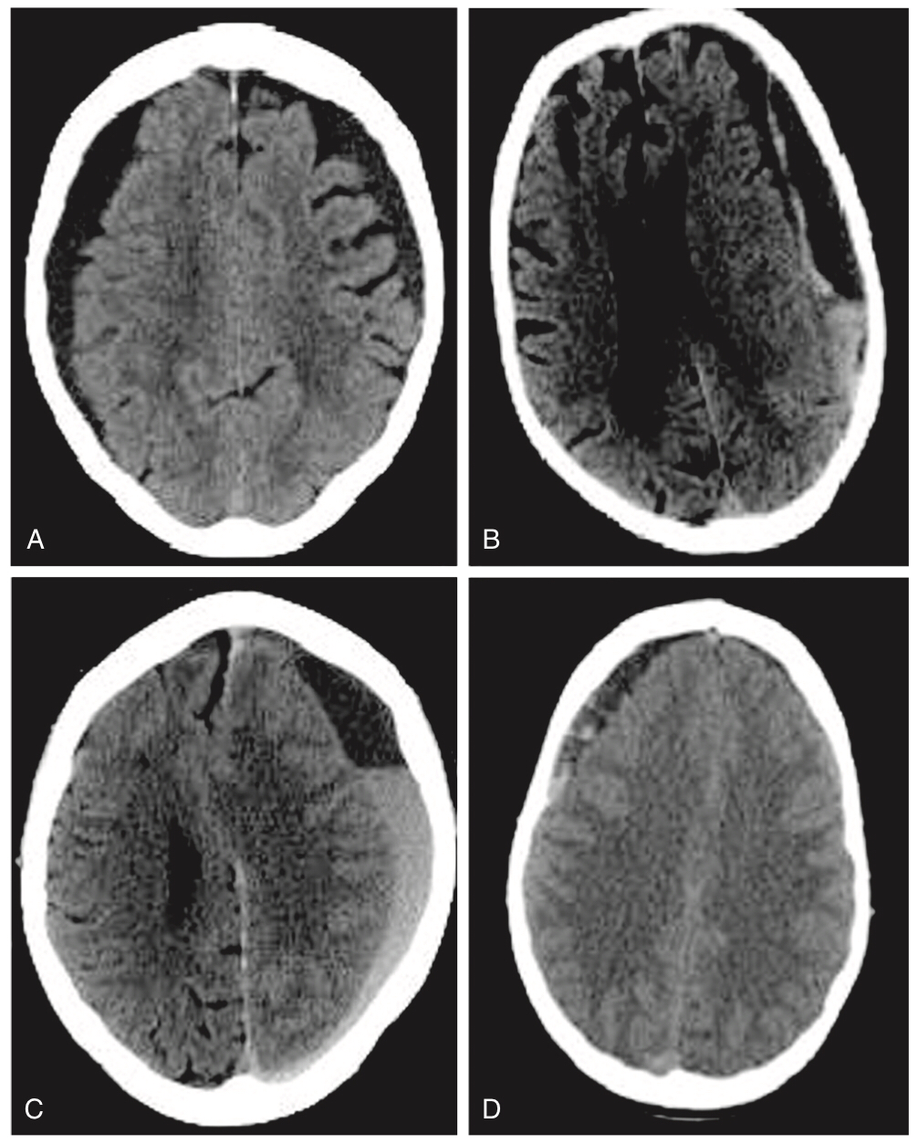
Figure 34-3.
Computed tomography scans demonstrating classification of chronic subdural hematomas according to their internal architecture
Homogeneous.
Laminar.
Separated.
Trabecular.

Slide 14
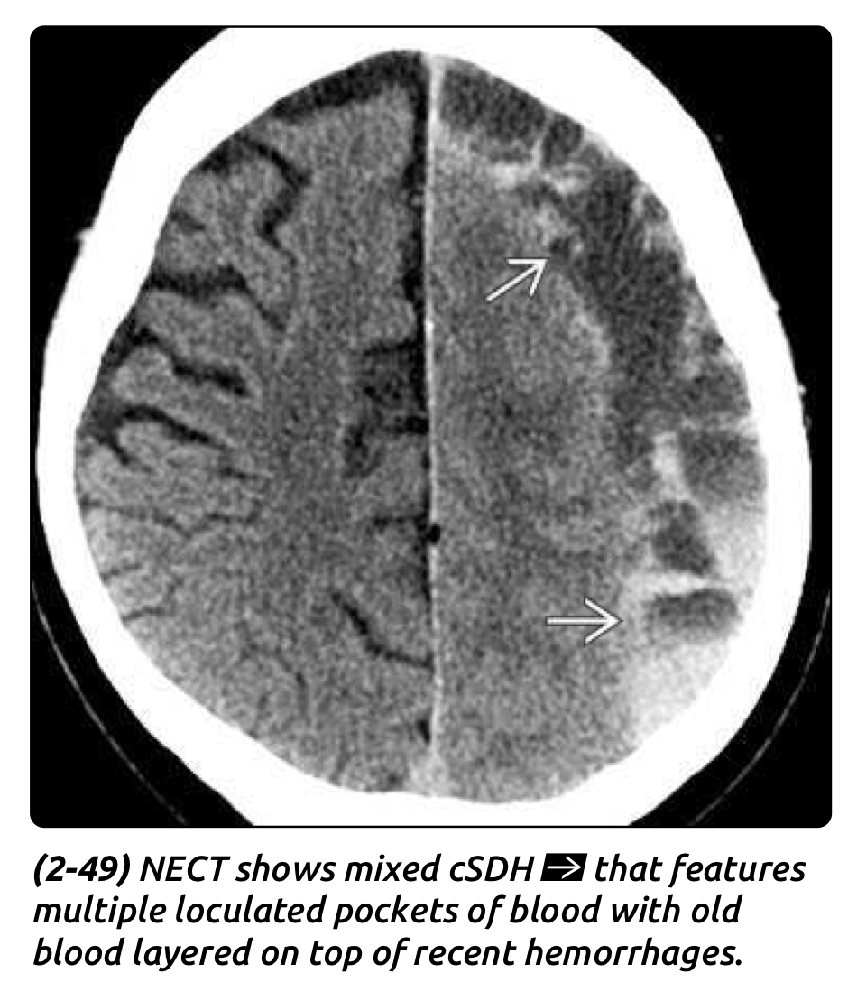

Slide 15
MANAGEMENT
Correction of Coagulopathy and Thrombopathy
Reversal of coagulopathy should occur in nonoperatively managed patients to prevent further expansion.
Warfarin
Can be reversed using a combination of prothrombin complex concentrate (PCC), fresh frozen plasma, and parenteral vitamin K.
For the patient with CSDH in need of urgent surgical intervention:
Combination of PCC and parenteral vitamin K should be given.
The INR should be less than 1.4 prior to surgery.
New oral anticoagulants (dabigatran, rivaroxaban, and fondaparinux)
Time is the best antidote; surgery should be delayed until 24 hours after the last dose and this should be extended to 48 hours if the patient has renal impairment and is on a direct thrombin inhibitor (dabigatran), PCC to reverse the effect also.
Antiplatelet therapy (Asprin)
Delaying treatment by 7 to 10 days to allow the production of fully functional platelets.
If treatment cannot be delayed, recommend platelet transfusion,

Slide 16
Adjuvant Treatments
Two main adjuvant medical therapies used for the treatment of CSDH:
Steroids: associated with lower recurrence risk when used preoperative and 2 weeks postop.
Antiepileptic medications.
Conservative Management
Indications
Asymptomatic patients with small collections.
Patient with high risk for surgery.
For the asymptomatic patients
Reverse coagulopathy and/or thrombopathy.
Course of steroids.
Following discharge, repeat CT scanning (every 2 weeks) until hematoma resolution.

Slide 17
Surgical Intervention
Indications
Symptomatic CSDH
Low surgical risk.
Results in a rapid improvement of patient symptoms and a favorable outcome in over 80% of patients.
Three primary surgical techniques are used:
twist-drill craniostomy (TDC), involving small openings (<10 mm) made using a twist drill.
bur-hole craniostomy (BHC), involving openings of 10 to 30 mm.
Craniotomy, involving larger opening.

Slide 18
Twist-Drill Craniostomy
Indications
Patients with a predominantly hypodense collection with no membranes.
Anesthesia: Local anesthesia is used for TDC.
Technique:
One or more twist drill holes are placed over the maximal width of the hematoma.
The dura and outer membrane are then pierced with a spinal needle and a drainage system is placed.
Draining by different systems are available, including (subdural irrigating and non-irrigating drains and hollow screw systems).
Drains may be removed after approximately 48 hours.
Hollow screw technique
Involves the insertion of a Hollow screw to set up a closed drainage system.
This technique does not require the blind insertion of a catheter in the subdural space, subverting the risks of brain laceration and bleeding from cortical vessels.

Slide 20
Bur-Hole Craniostomy
The most common technique unless there are multiple membranes or a significant acute component to the hematoma.
Anesthesia: GA but may be performed under local anesthesia.
Technique:
Two bur holes are placed over the maximum width of the hematoma, 7 cm apart.
Usually, there is one frontal and one parietal bur hole, both of which are just superior to the superior temporal line.
Ideally the frontal bur hole being placed at the highest point of the head.
Common mistake is to place the bur holes too medially.
The dura and outer membrane of the CSDH are incised, releasing hematoma fluid, which is classically described as “engine-oil” colored but may resemble blood, serum, or cerebrospinal fluid.
The subdural collection cavity is then irrigated with saline until the effluent runs clear.
A soft, flexible catheter may be used to augment thorough irrigation in areas remote from the bur holes, although it does carry risks associated with blind insertion of the tubing into subdural space.

Slide 21
First the parietal wound is closed: the bur hole is plugged with a thick wafer of absorbable sponge (e.g., gelatin sponge) to aid hemostasis and improve the seal.
Next the scalp is closed in two layers, galeal and cutaneous.
Soft silicone drain is then inserted into the subdural space via the frontal bur hole.
The cavity and drainage tubing are filled with saline prior to closure to aid brain reexpansion through the combination of brain pulsation and the siphoning effect of the drain.
The drain tubing is at least 50 cm long and the drainage bag is positioned below the level of the patient’s head.
Air trapped in the subdural space and tube may dampen the efficacy of the drain, and hence brain reexpansion, and so may increase recurrence.
The drain is removed after approximately 48 hours.

Slide 22
Regarding burrholes
One bur hole may be considered if the CSDH is more localized or the procedure is performed under local anesthesia.
Regarding irrigations
Irrigating the hematoma cavity leads to better outcomes despite the potential risks associated with introducing air and infection.
Although saline is currently used, using thrombin and tissue plasminogen activator as irrigation fluid can reduce recurrence.
Regarding drain
The use of subdural drains reduces recurrence.
Subgaleal and subperiosteal drains may be equally effective.

Slide 24
Craniotomy and Mini-craniotomy
Indications.
Patients with a significant acute component to the collection.
Multiple membranes.
Recurrent CSDH.
Outcome
Good functional outcomes are achieved in more than 80% of patients.
At 6 months, about 10% of patients experience a recurrence and mortality is 5%.
Craniotomy associated with less recurrence but a higher rate of mortality.
TDC has the lowest morbidity and mortality rates, recurrence is higher.
BHC is generally recommended because it provides the balance between efficacy and risks.
CTs showed persistent fluid in 78% of cases on post-op day 10, and in 15% after 40 days

Slide 25
Postoperative Care
Bed rest
Bed-rest restriction with the head of the bed flat (1 pillow is permitted) with mild overhydration for 24–48 hours post-op (or if a drain is used, until 24–48 hours after it is removed). May promote expansion of the brain and expulsion of residual subdural fluid.
Allowing patients to sit up to 30–40°immediately post-op was associated with higher radiographic recurrence rate but usually not need for reoperation.
Early mobilization is thought to decrease medical complications associated with immobility, specifically venous thromboembolism and hospital acquired infections.
Prophylactic low-molecular-weight heparin should also be prescribed if the patient is immobile postoperatively; if a drain is left in situ postoperatively, then it can be commenced once the drain is removed.
Anticoagulant medications, it suggest they can be safely restarted 10 to 14 days after an intracranial hemorrhage.

Slide 26
Complications
The most important complication of CSDH is recurrence.
Procedure-specific complications include
Focal brain injury,
Postoperative acute subdural or intracranial hemorrhage,
Seizures,
Surgical site infection,
Subdural empyema,
Tension pneumocephalus.

Slide 27
Traumatic subdural hygroma AKA (traumatic subdural eﬀusion & hydroma).
Charecteristics
Excess fluid in the subdural space (may be clear, blood tinged, or xanthochromic and under variable pressure).
Almost always associated with head trauma, especially alcohol-related falls or assaults.
Sometimes associated with Skull fractures.
Lack membranes.
Distinct from chronic subdural hematoma (usually associated with underlying cerebral contusion, and usually contains darker clots or brownish fluid “motor oil” fluid, and may show membrane formation adjacent to inner surface of dura).
Simple hygroma: without significant accompanying conditions.
Complex hygroma: with associated significant subdural hematoma, epidural hematoma, or intracerebral hemorrhage.

Slide 28
Pathogenesis
Tear in the arachnoid membrane with resultant CSF leakage into the subdural compartment.
Hygroma fluid contains pre-albumin, which is also found in CSF but not in subdural hematomas.
The most likely locations of arachnoid tears are in the Sylvian fissure or the chiasmatic cistern.
May increase in size (possibly due to a flap-valve mechanism) and exert mass effect.
Another possible mechanism is post-meningitis effusion (especially influenza meningitis).

Slide 29
Imaging
CT the density of the fluid is similar to that of CSF.
MRI Signal characteristics follow those of CSF.
Appears as a crescentic near-CSF density/signal accumulation in the subdural space that does not extend into the sulci and rarely exerts significant mass-effect.
The cortical vein sign refers to the presence of superficial cortical veins seen on MRI and CT (particularly with contrast injection) traversing an enlarged subarachnoid space.
This sign is also valid for differentiating benign enlargement of the subarachnoid spaces in infancy from subdural hygroma.
Treatment
Asymptomatic hygromas do not require treatment.
Recurrence following simple burr hole drainage is common.
Maintain a subdural drain for 24–48 hrs post-op.
Recurrent cases may require either a craniotomy to locate the site of CSF leak (may be very difficult), or a subdural-peritoneal shunt may be placed.

Slide 31
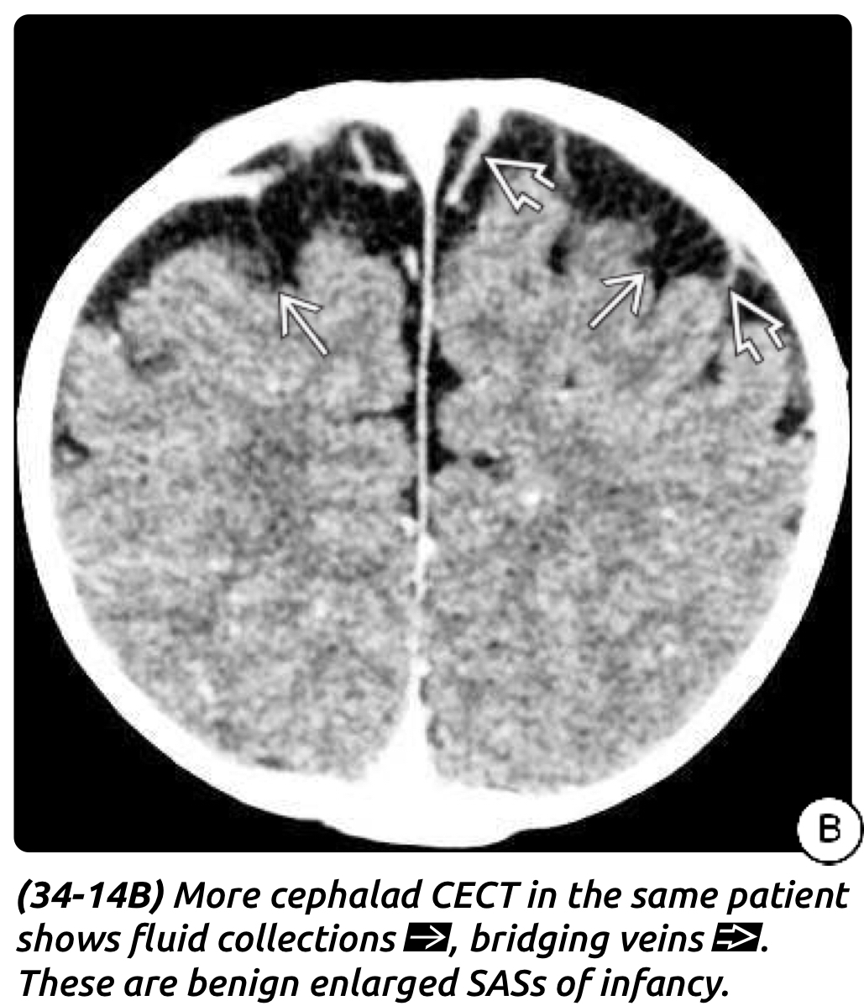

Slide 34
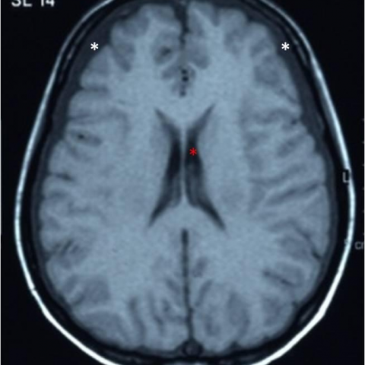
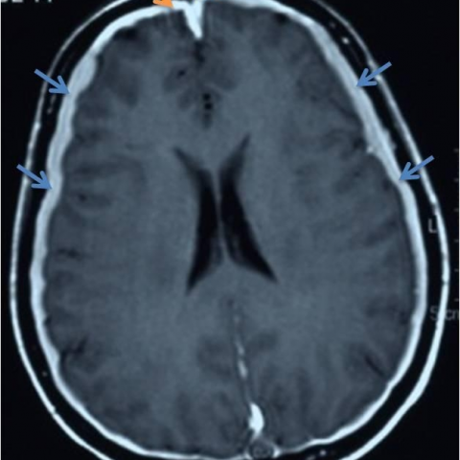
Subdural effusion
Accumulation of clear fluid over the cerebral convexities or in the interhemispheric fissure. Subdural effusions are generally complications of meningitis; a history of prior infection, not trauma, is typical.
Typically bilateral, and does not restrict on DWI.
Because of its increased proteinaceous contents, effusions are typically hyperintense to CSF on FLAIR.

Slide 35
Thank you

